Slide 1
Member Enrollment Preparation and Implementation
AmeriCorps State and National
April, 2021

Slide 2
Purpose
This presentation is designed to guide AmeriCorps program users to enroll individuals as AmeriCorps members in the My AmeriCorps Portal, the system by which AmeriCorps members are entered into the National Service Trust.
The presentation represents AmeriCorps State and National requirements for enrolling members in the Portal as of April 29, 2021.
Please begin the member enrollment process as soon as possible after grant notification. This includes taking proactive steps to plan for member recruitment, citizenship verification, and National Service Criminal History Check processes well in advance of your expected member start dates.
If you are a subgrantee, please ensure you are following any additional policies or procedures required by your State Commission or prime grantee.
Notes:
This presentation is designed to guide AmeriCorps program users to enroll individuals as AmeriCorps members in the My AmeriCorps Portal, the system by which AmeriCorps members are entered into the National Service Trust. Often, we will just refer to this as 'The Portal.”
The presentation represents AmeriCorps State and National requirements for enrolling members in the Portal as of April 29, 2021.
Please begin the member enrollment process as soon as possible after grant notification. This includes taking proactive steps to plan for member recruitment, citizenship verification, and National Service Criminal History Check processes well in advance of your expected member start dates.
If you are a subgrantee, please ensure you are following any additional policies or procedures required by your State Commission or prime grantee.

Slide 3
Quick Links and Resources:
References:
Enrollment Preparation and Implementation Resources:
AmeriCorps State and National Knowledge Network
Member Enrollment Resources (to be updated May 1st, 2021)
NSCHC and New Rule Information:
General AmeriCorps NSCHC Resource Page
AmeriCorps Resources regarding the May 1st NSCHC Rule
Federal Register New Rule (effective May 1st) for 45 CFR § 2522 and 45 CFR §2540
eGrants Login
My AmeriCorps Portal
eGrants Tutorials (these are dated, but there is still some useful content)
Notes:
Here are some quick links for you to reference as you proceed through this training. Our colleagues have put together some great resources on our website to support you in understanding the May 1st, 2021 National Service Criminal History Check (NSCHC) Rule in addition to more general NSCHC resources.

Slide 4
Let’s compare:
Enrollment Parameter | Members enrolled prior to April 29, 2021 | Members enrolled after April 29, 2021
Enrollment certification timeline | Certification of member enrollments required within 8 days Enforced by My AmeriCorps system validations | Certification of member enrollments required within 8 days Monitored through annual progress reports rather than My AmeriCorps system validations
National Service Criminal History Checks (NSCHCs) | NSOPW completion and State/FBI check initiation certified by checking two boxes My AmeriCorps records the date on which the boxes were checked Recorded date must be on or before member start date Certification required for all members | Completion and adjudication of all required checks certified by entering a date in the NSCHC Certification field My AmeriCorps records the date entered in the field Recorded date must be before member start date Certification required for applicants ages 18+ as of the entered start date
Citizenship and SSN verification | SSN and citizenship status must be verified on or before member start date | SSN and citizenship status must be verified on or before member start date
Start date changes | Can be made by grantee staff within the parameters outlined above Changes outside these parameters require Administrative Review Will only be considered if a failure in AmeriCorps’ technology platform or other circumstances prevent timely enrollment | Can be made by grantee staff within the parameters outlined above Changes outside these parameters require Administrative Review Will only be considered if a failure in AmeriCorps’ technology platform or other circumstances prevent timely SSN or citizenship verification
Notes:
Notable changes:
Applicants enrolled after April 29th will have:
Enrollment certification within 8 days enforced through annual progress reports rather than the My AmeriCorps system validations
Programs must complete and adjudicate all required checks and certify by entering the date in the NSCHC certification field
My AmeriCorps will record the date entered in the field rather than the date on which certification boxes were checked
The recorded date of NSCHC certification must be before the member start date
Certification of the NSCHC is only required for applicants 18+ as of the entered start date

Slide 5
Requirements for All Member Enrollments
This includes both Individual and Group Enrollments
Notice of Grant Award has been received
The program’s Member Enrollment Period has begun
Service locations are set up in the My AmeriCorps Portal
Slots of the right type are available for all applicants being enrolled
Citizenship and SSN have been verified
National Service Criminal History Checks (NSCHCs) have been completed for applicants ages 18+
Applicants have been determined to be eligible to serve
Applicants have completed their portion of the enrollment form (including acknowledging a partial Education Award if applicable)
Notes:
Before you can enroll an individual, the following things need to happen:
Notice of Grant Award has been received
The program’s Member Enrollment Period has begun
Service locations are set up in the My AmeriCorps Portal
Slots are available for all applicants being enrolled
Citizenship and SSN have been verified
National Service Criminal History Checks (NSCHC) has been completed for individuals ages 18 and up
Applicants have been determined to be eligible to serve
Applicants have completed their portion of the enrollment form (including acknowledging a partial Education Award if applicable)
In this presentation we will look at each of these steps in detail.

Slide 6
Notice of Grant Award
Following the grant application review process, successful programs receive a Notice of Grant Award (NGA) prior to the requested start date in their grant
Programs cannot take the necessary steps in the My AmeriCorps Portal until the NGA is received
Grantees access NGA via eGrants; subgrantees are notified by their State Commission
Notes:
Following the grant application review process, successful programs receive a Notice of Grant Award. Email notifications of grant awards go out each Spring. National Direct and Tribal Grantees, along with our State Commissions will receive their Notices of Grant Award prior to the requested start date in their grant. Notices of Grant Award can be accessed via eGrants.
Subgrantees will experience a different process of notification depending on your prime grantee or state commission’s procedures for award notification.

Slide 7
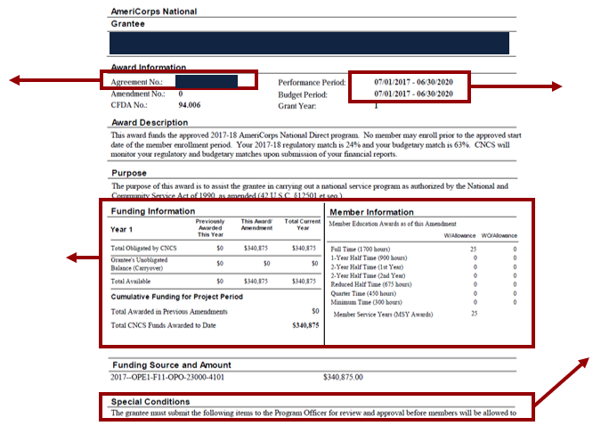
Notice of Grant Award (Direct Grantees and State Commissions)
Project and Budget Periods (NOT the same as member enrollment period, which may start later and/or end earlier)
Grant ID
Awarded funds and member positions
Special conditions on the award (including subgrantee-specific special conditions)
Notes:
We wanted to provide Direct grantees and State commissions with a reference of what the Notice of Grant Award looks like.
It is important to note that the Grant ID, project and budget periods, awarded funds, member positions, and any special conditions on the grant can be found in this document.
The Notice of Grant Award, along with your approved grant application, define the parameters of your grant. Please review this information carefully and ensure you understand all components including special conditions, which may specify actions you may take before enrolling members. If you believe anything on the Notice of Grant Award to be incorrect, please contact your Portfolio Manager.

Slide 8
Please remember, an individual is officially an AmeriCorps member on the start date recorded in eGrants. Prior to this start date, individuals should not accrue any service hours
Notes:
Please remember, an individual is officially an AmeriCorps member on the start date recorded in eGrants. Prior to this start date, applicants should not accrue any service hours.

Slide 9
Enrollment Process
*Process may vary for sub-grantees. Please check with your Commission or Prime grantee for further guidance.*
Preparation for Enrollment
Staff have completed required NSCHC training
Identify your member
Individual applies
Select your member
Select applicant in eGrants
Enrollment
Set up operating sites (Direct)
Set up service locations
Create service opportunity listings
Program screens applicant
Gather applicant information
Complete NSCHC
Determine applicant eligibility
Applicant completes enrollment form in My AmeriCorps
Social Security Administration Check
Verification of Eligibility
eGrants Enrollment process
Individual Enrollment
Group Enrollment
Partial Award Acknowledgment (if applicable)
Notes:
Here we have outlined the enrollment process for grantees. We recognize that as individual grantees, you may have additional steps within this process. This is just an attempt to outline the basic steps, and requirements that are involved in how to get an applicant to be an AmeriCorps member.
The first box provides steps a program needs to complete prior to selecting an applicant for service. The first step is to ensure program staff have completed the National Service Criminal History Check required Training. The next three steps occur in the eGrants portal and include setting up operating sites which applies only to National Direct programs; set up service locations; and create service opportunity listings.
The second box outlines steps programs need to take to identify potential applicants. First, applicants need to apply to the service position you are looking to fill. Second, the program needs to go through its process to gather applicant information in order to complete the National Service Criminal History Check and determine eligibility.
The third box encompasses steps around selecting your member. First, we will walk through the steps on how to select an applicant in eGrants, and then outline the process the applicant takes to be enrolled in AmeriCorps which will trigger the last step- Social Security Administration Check.
Finally, this presentation will walk you through the steps on how to enroll a member. Once eligibility is verified, you will be able to go into the eGrants enrollment screens to officially move your applicant, to member status. For those applicants who have served before, there may be an additional step of acknowledging a partial education award which we have also covered.
At the end of this PowerPoint, we will also provide you with some additional information regarding member enrollment to for your reference so you can continue to reference this document for all things- Enrollment!

Slide 10
Staff have completed required NSCHC training
Set up operating sites (Direct)
Set up service locations
Create service opportunity listings
Preparation for Enrollment
Link to NSCHC required annual training: https://nationalservice.gov/reqCHCtraining
Notes:
Before you begin the enrollment process, there are a couple of preparation steps that need to occur.
Staff have completed required NSCHC training
Set up operating sites (Direct)
Set up service locations
Create service opportunity listings
The National Service Criminal History Check training course is required for AmeriCorps grantees and subgrantees annually. You must complete the course each year before the day your certificate from the previous year expires. Grantees and subgrantees must maintain copies of dated completion certificates for each grant year.
The next three bullet points will be addressed in the following slides.

Slide 11
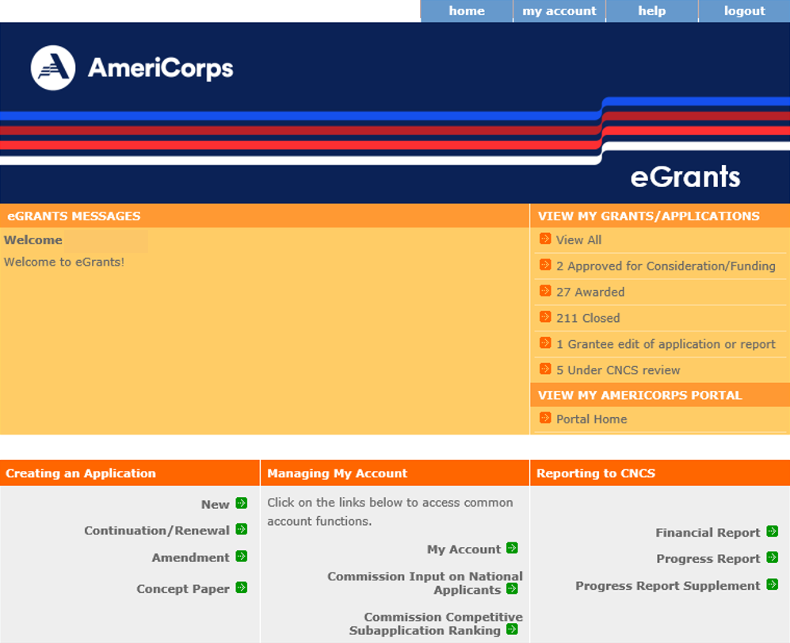
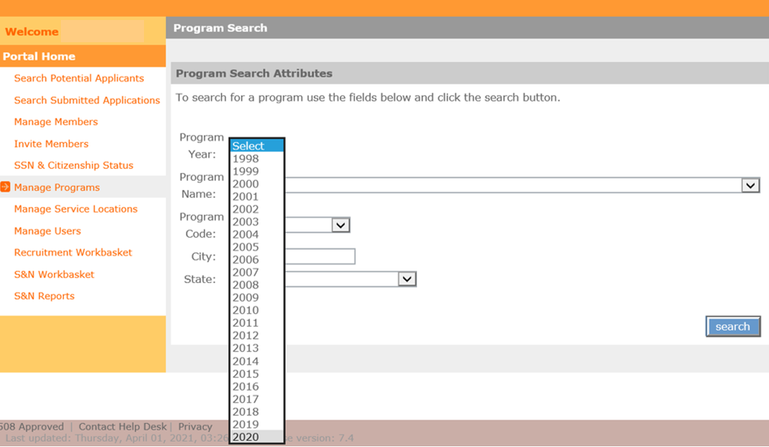
Log into eGrants and My AmeriCorps Portal
For Direct Grantees and Subgrantees
Notes:
Here are some screenshots on what you will see once you log into eGrants. Click on Portal Home to access the links we will be using throughout the enrollment preparation and implementation process.
You can search and view your program specific information by selecting ‘manage programs.’

Slide 12
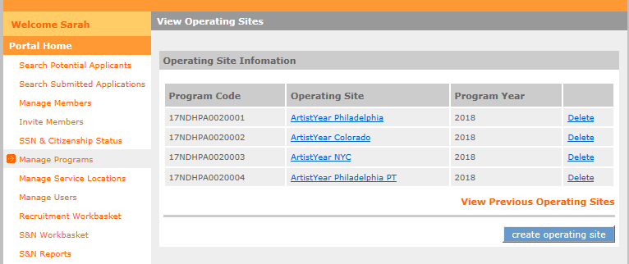
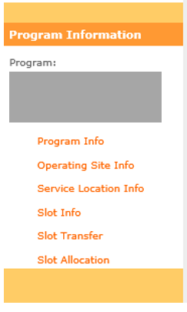
Set up Operating Sites
For Direct Grantees Only
Required in order to issue member invitations
See Program Management tutorial on the Knowledge Network
Click to set up operating sites
Notes:
Setting up operating sites in the portal is an additional step for Direct grantees that state and subgrantees do not need to complete.
This step is required before direct grantees can issue invitations. We have included a link to our knowledge network here that provides additional guidance on how to complete this step in addition to this screenshot. As you can see, when in the portal the program must go into “manage programs”, search for and open the program for which you need an operating site, click on operating site info on the left-hand side and click the link on the bottom right of your screen to set up an operating site.
If applicant invitations and Service Opportunity Listings are not associated with the correct operating site, it may complicate the enrollment steps later in the process.

Slide 13
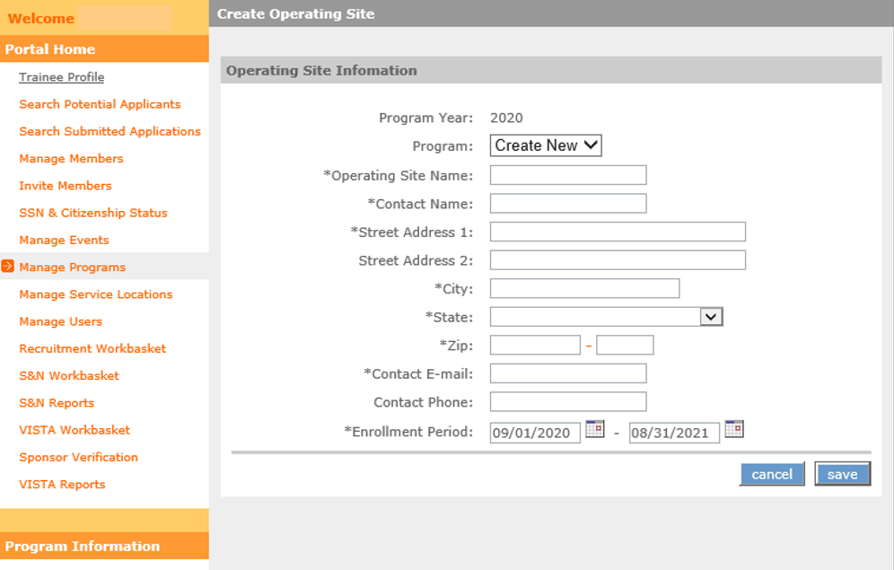
Set up Operating Sites
Direct Grantees Only
Complete all fields and click “save”
Notes:
When you click ‘Create Operating Site,’ this is the screen you will see. Complete all fields and click save to set up a new operating site.

Slide 14
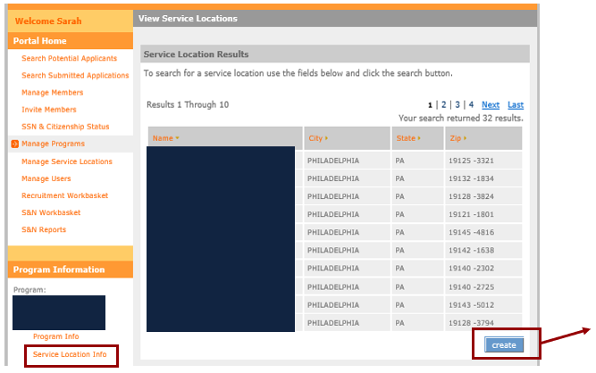
Set up Service Locations in eGrants
All AmeriCorps applicants must be assigned to service locations
See Program Management tutorial on the Knowledge Network
Click to create new service locations
Notes:
All programs must set up service locations in the portal, as this is what applicants will be assigned to. Again, please utilize our program management tutorials on the knowledge network for detailed steps on this process as we will not be going through this in detail today.
Here, we have provided a quick snapshot for you to know where to access service locations in the portal.

Slide 15
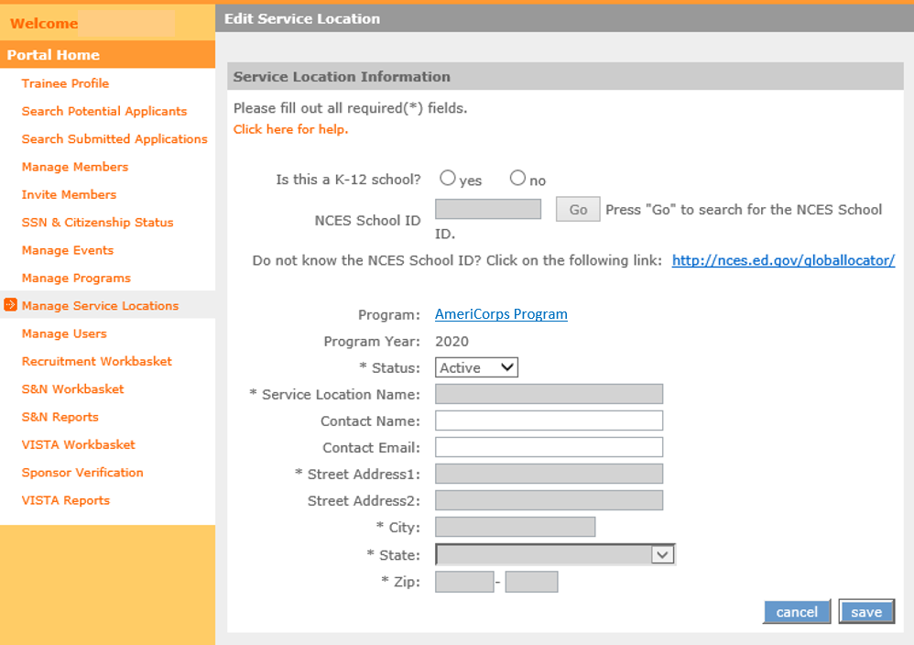
Set up Service Locations
Complete all fields and click ‘save’
Notes:
From the previous slide, when you click ‘create’ this is the next screen you will see. To create a new service location, complete all required fields and click ‘save.’

Slide 16
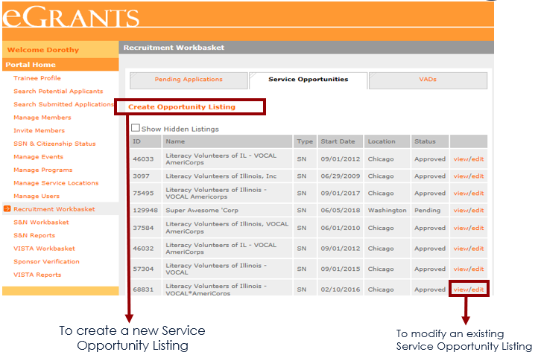
Service Opportunity Listings
Grantees are required to post all available member service opportunities in the My AmeriCorps Portal
Service Opportunity Listing Resources include a PowerPoint step-by-step, outline requirements, and provide a template for programs
Grantees may also use other recruitment strategies in addition to the My AmeriCorps platform
Notes:
Prior to enrollment, programs need to submit a service opportunity listing in My AmeriCorps.
Per Agency policy, all grantees are required to post available member service opportunities in the My AmeriCorps Portal. We included a link to the Service Opportunity Listing Resources on our website that includes PowerPoint step-by-step instructions, an outline of our requirements, and a template for you to use.
Here is what this step looks like in the eGrants portal. Grantees may create new service listings by clicking the box indicated. Or, if you are a previous grantee, you may modify an existing listing. Grantees may use a variety or combination of strategies for recruitment based on your program model and needs.

Slide 17
Individual applies
Program screens applicant
Gather applicant information
Complete NSCHC
Determine applicant eligibility
Identify your member
Notes:
Our second box in the enrollment process focuses on identifying an applicant to serve with your program. In order to find members, they must first apply to the positions you are seeking to fill. We will walk through two processes for applicants to take.
The second portion of this section focuses on applicant screening. Each program has its own process and policies around how to screen applicants to make sure you have the best individual to serve with your program. We will cover just the basics you need to ensure you have the appropriate information needed to complete the National Service Criminal History check and to determine member eligibility.

Slide 18
Receiving Applications
Programs can set up their Service Opportunity Listings to allow applicant to apply inside and/or outside of My AmeriCorps:
Indicates whether individuals can apply via My AmeriCorps
Programs that do not accept applications via My AmeriCorps must develop their own process to receive applications and select applicants
Notes:
As mentioned, applicants may apply to an AmeriCorps programs either through the My AmeriCorps portal, or outside My AmeriCorps.
When you are creating your Service Opportunity Listings as noted in the steps prior to enrollment, you will have the opportunity to indicate whether an applicant can apply via My AmeriCorps to your program. For programs who select yes, applicants may apply via the My AmeriCorps Portal.
If you choose no, this is because your program has its own recruitment process external to My AmeriCorps. If this is the case, you will be asked to provide details about where applicants can receive information to apply to your program in your service opportunity listing as shown here.

Slide 19
Applicant Screening
All applicants are required to be screened for eligibility and criminal history. Programs may vary in their process and policy regarding how they conduct applicant screening
Programs should build in as much time as possible to complete the National Service Criminal History Check (NSCHC) and determine eligibility
Applicants must have their eligibility verified before they can start service
Notes:
All applicants are required to be screened for eligibility and criminal history. Programs may vary in their process and policy regarding how they conduct applicant screening.
Programs should build in as much time as possible to complete the National Service Criminal History Check (NSCHC) and determine eligibility
Applicants must have their eligibility verified before they can start service

Slide 20
Gather Applicant Information
In order to be enrolled in eGrants and the National Service Trust, programs need to gather information that is consistent with the Social Security Administration Records. This includes:
Applicant Name
Social Security Number
Date of Birth
Additional Recommendations for information gathering
Citizen Verification Documents (e.g. birth certificate, passport, certificate of citizenship, green card, etc.)
Contact information (phone, email, address, etc.)
Notes:
In order to be enrolled in eGrants and the National Service Trust, programs need to gather applicant information that is consistent with the Social Security Administration Records. This includes:
Applicant Name
Social Security Number
Date of Birth
Additional Recommendations for information gathering
Citizen Verification Documents (e.g. birth certificate, passport, certificate of citizenship, green card, etc.)
Contact information (phone, email, address, etc.)

Slide 21
National Service Criminal History Check (NSCHC)
AmeriCorps State and National grantees must conduct National Service Criminal History Checks for AmeriCorps applicants ages 18+
Three checks are required for individuals to comply with NSCHC requirements:
A nationwide check of the National Sex Offender Public Website through NSOPW.gov
A check of the State criminal history record repository or agency-designed alternative for the individual’s state of residence and state of service
A fingerprint-based check of the FBI criminal history record database through the state criminal history record repository or agency-approved vendor
45 CFR § 2540.205(a) The National Service Criminal History Check must be conducted, reviewed, and an eligibility determination made by the grant recipient or subrecipient based on the results of the National Service Criminal History Check before a person begins to work or serve in a position specified in 45 CFR § 2540.201(a).
Notes:
AmeriCorps State and National grantees who receive an operational grant must conduct National Service Criminal History Checks for AmeriCorps applicants ages 18+.
Subgrantees should reach out to your prime grantee, or state commission to understand your programs specific requirements regarding NSCHC as what we are discussing here are the basic AmeriCorps requirements.
AmeriCorps recommends using our approved vendors to conduct the National Service Criminal History Checks. These vendors are Truescreen and Fieldprint. Detail on how to utilize these vendors can be found on the NSCHC resource page. AmeriCorps selected these specific vendors to help ensure NSCHC compliance.
Please become familiar with our NSCHC requirements by reviewing our resources that were provided on the previous slide. Failure to conduct timely and compliant National Service Criminal History Checks may delay enrollment and can also result in sometimes significant cost disallowances to your program.
Reference:
§ 2540.204
What are the components of a National Service Criminal History Check?
(a) Unless CNCS approves a waiver under § 2540.207, for each individual in a position specified in § 2540.201, grantees or subgrantees must, obtain:
(1) A nationwide check of the National Sex Offender Public website through NSOPW.gov;
(2) A check of the State criminal history record repository or agency-designated alternative for the individual's State of residence and State of service; and
(3) A fingerprint-based check of the FBI criminal history record database through the State criminal history record repository or agency-approved vendor.
(b) One way for grant recipients or subrecipients to obtain and document the required components of the National Service History Check is through the use of agency-approved vendors.
§ 2540.205
By when must the National Service Criminal History Check be completed?
(a) The National Service Criminal History Check must be conducted, reviewed, and an eligibility determination made by the grant recipient or subrecipient based on the results of the National Service Criminal History Check before a person begins to work or serve in a position specified in § 2540.201(a).
(b) If a person serves consecutive terms of service or employment with the same organization in a position specified in § 2540.201(a) and does not have a break in service or employment longer than 180 days, then no additional National Service Criminal History Check is required, as long as the original check complied with the requirements of § 2540.204.
If a National Service Criminal History Check was not conducted on a person because they were under the age of 18 at the time they began their prior term(s) of service or employment in a covered position, pursuant to § 2540.201
(b), a National Service Criminal History check must be conducted prior to the individual beginning a subsequent term of work or service for which the person is 18 years of age or older at the start of work or service.
(c) Persons working or serving in positions specified in § 2540.201(a) prior to May 1, 2021, who continue working or serving in a position specified in § 2540.201(a) on or after November 1, 2021, must have a National Service Criminal History Check conducted, reviewed, and an eligibility determination made by the grant recipient or subrecipient based on the results of the National Service Criminal History Check completed in accordance with this part. For these people, the National Service Criminal History Check must be completed no later than November 1, 2021.

Slide 22
Determine Member Eligibility
Programs must conduct a screening of individuals as part of the recruitment and selection process
Eligibility Requirements: 45 CFR § 2522.200
Age
An AmeriCorps participant must be at least 17 years of age
Have a high school diploma or equivalent (see regulation for additional details)
Be a citizen, national, or lawful permanent resident alien of the United States (see regulation for a list of acceptable forms certifying status as a citizen)
Satisfy the National Service Criminal History Check eligibility criteria
Failure to conduct timely and compliant NSCHCs and ensure eligibility of an individual may:
- Delay the enrollment process
- Result in cost disallowances
Notes:
Programs must conduct a screening of applicants as part of the recruitment and selection process. Failure to conduct timely and compliant NSCHC and eligibility check of an applicant may delay the enrollment process and result in cost disallowances.
You can find the comprehensive list of Eligibility Requirements by clicking the link to review 45 CFR 2522.00 (or reference the notes below). In summary, an AmeriCorps participant must be at least 17 years of age, have a high school diploma or equivalent, be a citizen/national/lawful permanent resident of the United States, and satisfy the NSCHC eligibility criteria.
Reference:
§2522.200 What are the eligibility requirements for an AmeriCorps participant?
(a) Eligibility. An AmeriCorps participant must—
(1)(i) Be at least 17 years of age at the commencement of service; or
(ii) Be an out-of-school youth 16 years of age at the commencement of service participating in a program described in §2522.110(b)(3) or (g);
(2)(i) Have a high school diploma or its equivalent; or
(ii) Not have dropped out of elementary or secondary school to enroll as an AmeriCorps participant and must agree to obtain a high school diploma or its equivalent prior to using the education award; or
(iii) Obtain a waiver from the Corporation of the requirements in paragraphs (a)(2)(i) and (a)(2)(ii) of this section based on an independent evaluation secured by the program demonstrating that the individual is not capable of obtaining a high school diploma or its equivalent; or
(iv) Be enrolled in an institution of higher education on an ability to benefit basis and be considered eligible for funds under section 484 of the Higher Education Act of 1965 (20 U.S.C. 1091);
(3) Be a citizen, national, or lawful permanent resident alien of the United States;
(4) Satisfy the National Service Criminal History Check eligibility criteria pursuant to 45 CFR 2540.202.
(b) Written declaration regarding high school diploma sufficient for enrollment. For purposes of enrollment, if an individual provides a written declaration under penalty of law that he or she meets the requirements in paragraph (a) of this section relating to high school education, a program need not obtain additional documentation of that fact.
(c) Primary documentation of status as a U.S. citizen or national. The following are acceptable forms of certifying status as a U.S. citizen or national:
(1) A birth certificate showing that the individual was born in one of the 50 states, the District of Columbia, Puerto Rico, Guam, the U.S. Virgin Islands, American Samoa, or the Northern Mariana Islands;
(2) A United States passport;
(3) A report of birth abroad of a U.S. Citizen (FS-240) issued by the State Department;
(4) A certificate of birth-foreign service (FS 545) issued by the State Department;
(5) A certification of report of birth (DS-1350) issued by the State Department;
(6) A certificate of naturalization (Form N-550 or N-570) issued by the Immigration and Naturalization Service; or
(7) A certificate of citizenship (Form N-560 or N-561) issued by the Immigration and Naturalization Service.
(d) Primary documentation of status as a lawful permanent resident alien of the United States. The following are acceptable forms of certifying status as a lawful permanent resident alien of the United States:
(1) Permanent Resident Card, INS Form I-551;
(2) Alien Registration Receipt Card, INS Form I-551;
(3) A passport indicating that the INS has approved it as temporary evidence of lawful admission for permanent residence; or
(4) A Departure Record (INS Form I-94) indicating that the INS has approved it as temporary evidence of lawful admission for permanent residence.
(e) Secondary documentation of citizenship or immigration status. If primary documentation is not available, the program must obtain written approval from the Corporation that other documentation is sufficient to demonstrate the individual's status as a U.S. citizen, U.S. national, or lawful permanent resident alien.

Slide 23
Select applicant in eGrants
Applicant completes enrollment form in My AmeriCorps
Social Security Administration Check
Select your member
Notes:
In this next section we will focus on the steps to select an applicant to serve with your program. We will walk through how to do this in eGrants, what steps the applicant needs to complete before they can be enrolled and walk through the Social Security Administration check process.

Slide 24
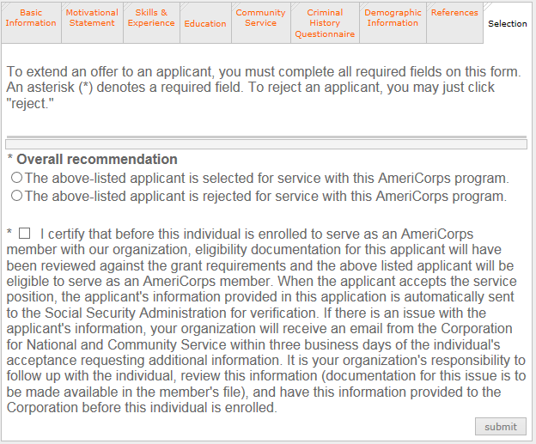
Selecting your applicant in eGrants
Selecting an applicant who applied via My AmeriCorps:
There are two ways to select an applicant in eGrants:
Via My AmeriCorps application process
Inviting an individual in eGrants following program specific recruitment
Click the relevant radio button to select the applicant
Click to submit the selection. The applicant will be notified via email
Complete the certification
Notes:
Following your screening process where you have determined an applicant is eligible to become an AmeriCorps member, you can accept an applicant to serve with your program.
This slide is focused on the first track of accepting an applicant via My AmeriCorps. When you are logged into eGrants portal you may review applications based on these tabs you see in our slide. The very last tab is “selection” where you will click if you would like to select or reject the applicant for your program. Below you will check the box indicating that you certify prior to enrollment, the applicant will be determined as eligible to serve.
Once you click submit, the applicant will be notified via email. We will show an example of this email in just a moment.

Slide 25
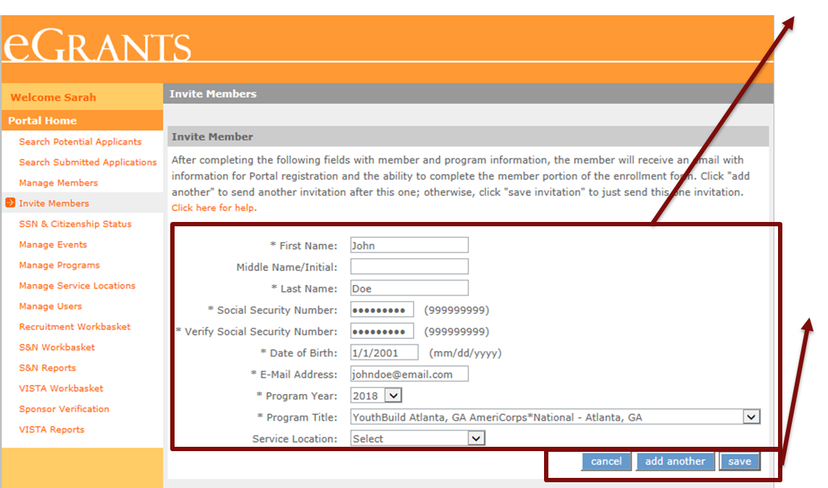
Selecting your applicant in eGrants
There are two ways to select an applicant in eGrants:
Via My AmeriCorps application process
Inviting an individual in eGrants following program specific recruitment
Enter applicant’s data. Important: make sure this information is entered correctly and matches what is listed on the member’s ID and Social Security Card
Click add another to send the current invitation and enter another
Click save and then send to complete the invitation. The applicant will be notified via email
Notes:
If an individual is serving with another program immediately before your program, the applicant must first be exited.
Date of birth and SSN must be entered correctly to avoid delays in enrollment
Notes:
The other process to select an applicant, is to invite them via eGrants. This process is for applicants who have applied to your position through a process outside of the My AmeriCorps portal.
Your program has gone through its own screening process and has decided to send an invitation to the applicant. In the portal your screen will look similar to this. On the left-hand side, you will select the “invite Members” tab which will allow you to enter the applicants' data. You will also need to select the program year, title, and service location from the drop-down lists.
It is critical to make sure this information is correct. Entering in incorrect date of birth, or SSN could lead to the creation of duplicate accounts that will cause a delay in citizenship and SSN verification and thus delay the member start date.
If you would like to send more than one invitation at a time, click “add another” to send the current invitation and enter another. You may also click just click save and send to complete the individual invitation.
The applicant will be notified via email as shown in the next slide.

Slide 26
Applicant Invitation
The link in the email connects to the My AmeriCorps Portal where the applicant’s identity will be verified.
Ensure applicants understand this is a secure site and the information entered must be accurate and reflect what is on the government issued ID (this includes hyphens, spaces, multiple middle or last names, etc.).
The link will be broken if the program resends or deletes the invitation.
Notes:
When you select an applicant in the My AmeriCorps portal or send an invitation to an applicant who applied outside of the My AmeriCorps portal, they will receive an email notification. The individual will then need to accept the invitation and complete the applicant portion of the enrollment form.
Here is your applicant’s view of the invitation that they received either through applying in My AmeriCorps or with your specific program.
In the example on this slide, Jim was lucky enough to be selected to serve with City Year! He is now instructed to complete the registration and enrollment forms by clicking on the link indicated. This will open his My AmeriCorps page where he will be instructed to verify his information to access his enrollment form.

Slide 27
Member Enrollment Form
Per the Grant Terms and Conditions, the Enrollment Form must be completed by the applicant
Programs must request a waiver if this is not possible
To facilitate successful enrollment, individuals who have previously served in AmeriCorps must:
Ensure that they have been exited from their previous program by verifying with their previous supervisor or checking their Ed Award status
Notes:
Please be aware that the AmeriCorps Terms and Conditions state that the enrollment form must be completed by the applicant. eGrants will not allow programs to complete this step unless you have a waiver.
Throughout your screening process, you may have learned that the applicant has previously served in an AmeriCorps Program. It is a good idea to make sure that the individual has been exited with satisfactory service from their previous position. There are various ways for the individual to do this, including reaching out to their previous supervisor, or checking to see if they have access to their education award as this is only available if the individual has been fully exited.

Slide 28
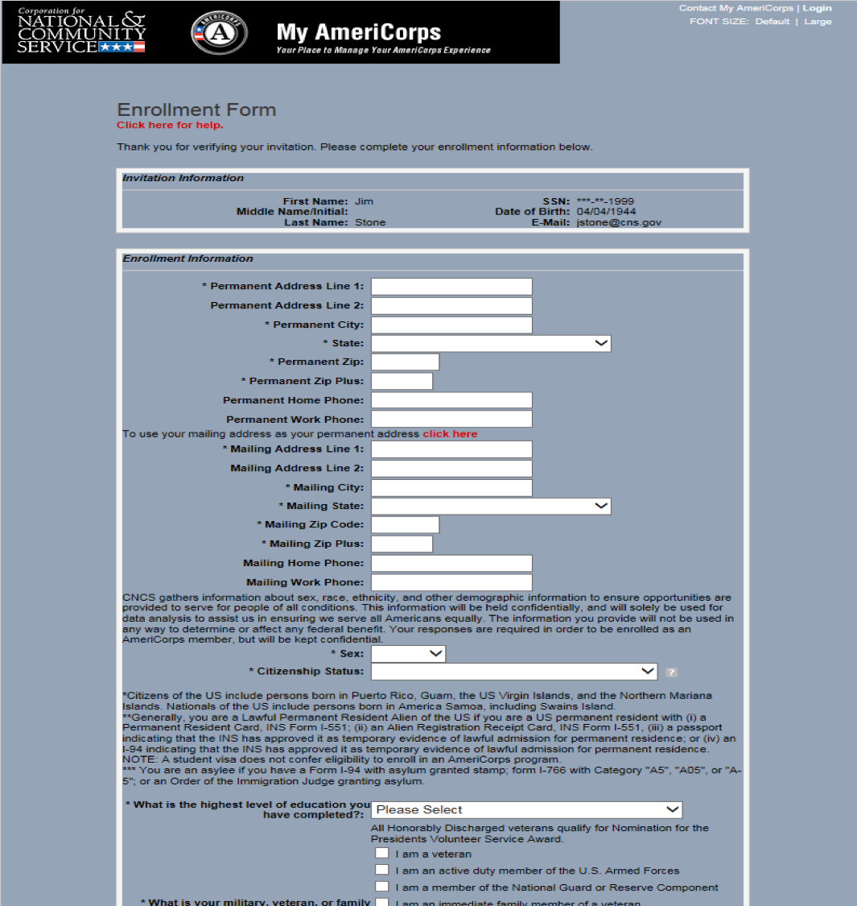
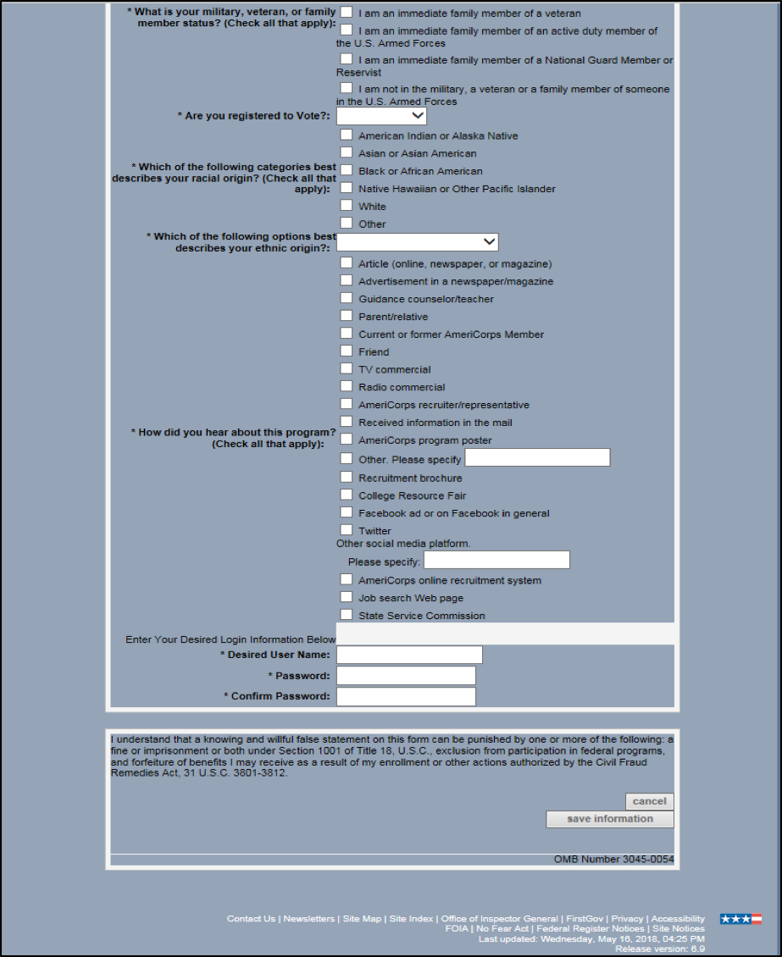
Applicant Enrollment Form
Form continued…
Once the individual clicks ‘save information’ to submit the form, the eligibility verification process is initiated.
Notes:
Here is the enrollment form as the applicant will see it.
Once the individual clicks ‘save information’ to submit the form, the eligibility verification process is initiated.
Note:
If an applicant incorrectly lists the 4-digit postal code after the first 5-digit code, their enrollment may be held up

Slide 29
SSN & Citizenship Verification
The My AmeriCorps portal submits the record to the Social Security Administration (SSA) as soon as the applicant completes and saves their section of the enrollment form.
The Social Security Administration will then follow their process to verify the applicant's citizenship status and social security number (SSN).
Within three business days, My AmeriCorps will be updated with either "Verified" or "Returned" for both the SSN and citizenship status.
Example of an applicant who will have to be manually verified
Example of a verified applicant
Both the SSN and citizenship status must be noted as “Verified” or “Manually Verified”
in My AmeriCorps before the individual can be enrolled.
Notes:
As previously mentioned, the portal submits the record to the Social Security Administration, or SSA, as soon as the applicant completes and saves their section of the enrollment form.
SSA will then follow their process to verify the applicant’s citizenship status and social security number. Within three business days, the portal will be updated with either “verified” or “returned” status. An example is shown here.
Programs will not receive an email if the applicant is automatically verified but will receive a notice if the citizenship and/or SSN status is “returned”.

Slide 30
Manual Verification Steps
Only required if applicant is not automatically verified
The grantee administrator receives an email notification to submit additional documentation via Secure File Transfer for manual verification of the applicant’s citizenship or Social Security Number
To submit documentation, the program must request a secure file link from the AmeriCorps Hotline (detail on next slide)
Program submits additional documentation (refer to 45 CFR 2522.200 for documentation guidance)
AmeriCorps Hotline forwards submitted documentation to the National Service Trust
If the submitted documentation is sufficient to verify eligibility, the record in eGrants will be updated within 3 business days. This ends the manual verification process
If the submitted documentation is not sufficient to verify eligibility, the grantee administrator will receive another email notification to submit sufficient eligibility documentation to continue the manual verification process until the documentation is sufficient
For some individuals, the Social Security Number and citizenship manual verification process may take several days to a couple of weeks to complete. Programs must factor that into their planning.
Notes:
Again, if not automatically verified, programs will receive a notification via email to submit additional documentation.
We have provided a link to our Code of Federal Regulations that outlines what documentation can be gathered to verify citizenship. Additionally, the program may be asked to provide documentation to verify the Social Security Number, which can simply be a copy of the social security card, or documentation that indicates a name change.
To submit this documentation, the program must request a secure file link from the hotline. Additional details will be provided on the next slide.
If the documentation is sufficient to verify eligibility, the status will be updated to “Manually Verified.” If not, the program will again be notified that documentation was not sufficient and will request this again via email.
Manual verification can take a significant amount of time. Programs must factor this required time into their planning and ensure that they begin the enrollment process sufficiently in advance of the desired start date.

Slide 31
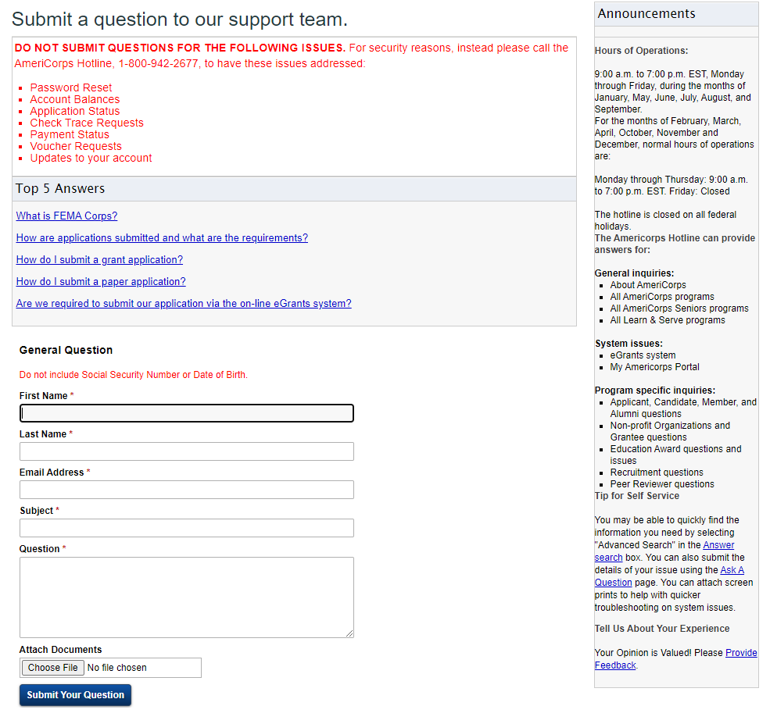
Requesting a Secure File Link
Go to webform: https://questions.americorps.gov/app/ask to request helpdesk ticket(s).
Request a secure file link by completing the form (below)
Best practices:
Indicate that you are a State and National program enrolling applicants and need a Secure File Link to submit SSN/citizenship verification documentation
If your program has multiple individual cases requiring SSN/citizenship verification at the same time, send these cases under a single ticket
Document all communication and take screenshots if necessary
Reach out to your Portfolio Manager if you encounter any challenges
Notes:
Here is the form to request a secure file link from the hotline.
We have included a couple of best practices for you to consider when providing additional documentation including what information to include, and if you have multiple documentation requests to include this all-in-one email giving you one single ticket to track.
For subgrantees, your prime grantee or state commission can assist you through this process.

Slide 32
Verification of eligibility
eGrants enrollment process
Individual Enrollment
Group Enrollment
Partial award acknowledgment (if applicable)
Enrollment
Notes:
The step we have all be working toward- Enrollment. Covered in this next section we will demonstrate how to verify eligibility of your applicant, the process in eGrants you need to take to enroll your applicant, and what to do if you have an applicant who has already served and needs to acknowledge a partial award prior to enrollment.

Slide 33
Confirming SSN & Citizenship Verification
Check the applicant SSN and Citizenship status in eGrants- the applicant must be ‘Verified’ or ‘Manually Verified’ to continue
Note: My AmeriCorps will not allow you to enter an applicant’s start date that is earlier than the verification dates
Verification Status Types
Open: individual has been invited to participate in a program but has not yet created/updated and saved their My AmeriCorps Portal Profile
Pending: individual’s name, SSN, and DOB have been sent to SSA for verification and are awaiting results
Verified: individual’s SSN/citizenship eligibility has been automatically verified by SSA
Returned: individual was not verified automatically by SSA; document submission is required to prove eligibility
Manually Verified: individual’s SSN/citizenship eligibility has been verified by AmeriCorps based on submitted documentation
Cannot be Verified: individual has been proven not to be eligible with respect to SSN or citizenship. (If a program believes this status is incorrect, they can submit an appeal to their Portfolio Manager within 30 days of the eligibility decision)
Notes:
The first step is for program staff is to verify that the applicant’s SSN and Citizenship status.
We have provided you in this slide all possible statuses that the applicant may be in and why. The only way to move forward is if they are in “verified” or “manually verified” status.

Slide 34
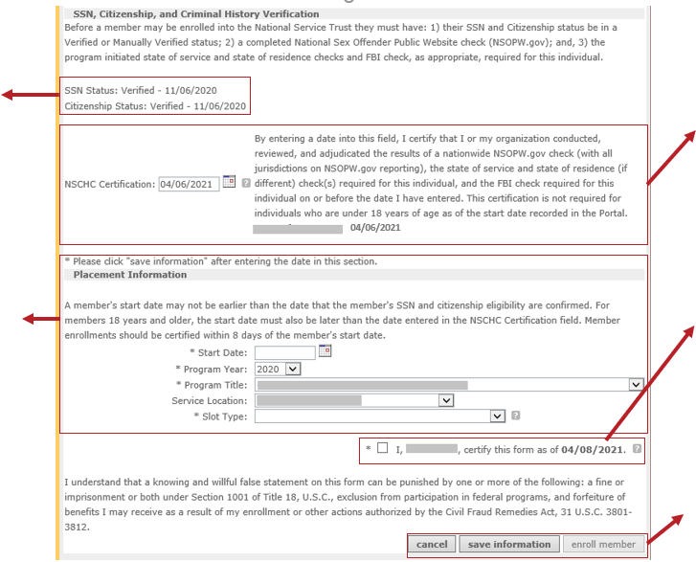
Completing Individual Member Enrollment Form
Confirm SSN/Citizenship are in “Verified” or “Manually Verified” status
If applicant is 18 or older, enter the date the NSCHC was completed and adjudicated.
Complete the placement information
Start date must be on or after SSN/citizenship verification dates and after NSCHC certification date
Check the certification box
Once all information has been entered correctly, the “enroll member” button will become active
Notes:
Steps to complete the enrollment form:
1- Confirm SSN/Citizenship are in “Verified” Or “Manually Verified” status
2- If the applicant will be 18 or older as of the start date entered on the enrollment form, enter the date on or before which the NSCHC was completed and adjudicated. You can enter a date that is in the past. This date can be corrected if needed prior to enrollment; however, once the individual is enrolled, the NSCHC certification date cannot be changed.
When you click “Save,” the date entered in the box and the name of the certifying individual will appear below the certification statement.
3- Complete the placement information
This includes the start date, program year, program title, service location and slot type. The entered start date needs to be on or after the date of SSN and citizenship verification and after the date of NSCHC certification in order to enroll. You can enter a start date that is in the past as long as it is within the program’s enrollment period. However, per AmeriCorps policy, enrollments should be certified within 8 days of the member’s start date.
4- Check the certification box to certify the form.
Once you have entered in all information correctly, the “Enroll member” button will become active. All information can be entered ahead of time except the start date and slot type, so if you save information and leave this page, the next time you log on you will have to re-enter this information.

Slide 35
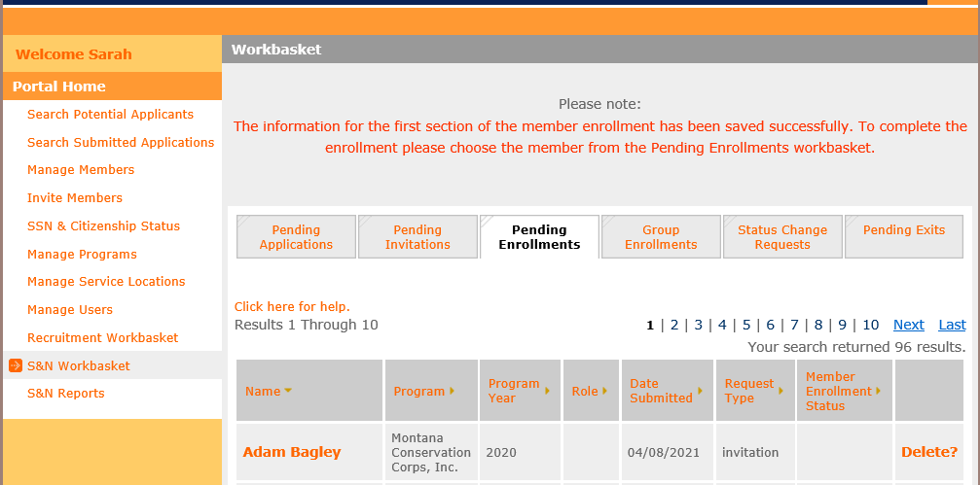
Saving Information in the Enrollment Field
As mentioned, you can enter information ahead of time (except for start date and slot type).
Notes:
All information can be entered ahead of time except the start date and slot type, if you save information and leave the enrollment page. When you return to complete the applicant enrollment, you will need to re-enter the start date and slot type. Filling in the other information ahead of time may save you some time throughout the process.

Slide 36
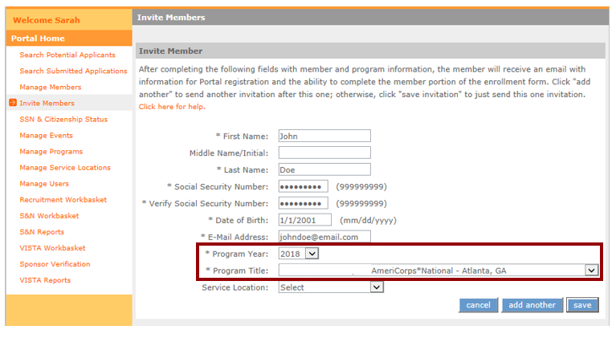
Group Enrollment
Group Enrollment is an option during the final phase of enrollment in eGrants.
Extra step for group enrollment during the invitation process:
Applicants must be associated with the correct Program Year and Program Title
Notes:
Programs wishing to enroll a large number of applicants at one time can use the Group Enrollment option in eGrants. For a program to use the Group Enrollment feature, there are a couple of extra requirements that need to be fulfilled. Specifically, AmeriCorps applicants need to be associated with the correct Program Year and Program Title during the invitation process. (Program Title is another term for the operating site name or subgrantee program name.) This slide shows where these two key fields are located on the applicant invitation screen in the My AmeriCorps Portal.

Slide 37
Special Requirement for Group Enrollment
Continued…
Program Year must be selected correctly by the program on the applicant invitation
Applicants who applied via My AmeriCorps will need have the program year entered manually on their individual Enrollment Form, and so cannot participate in group enrollment (i.e., they will not appear on the Group Enrollment tab)
Program Title (operating site/subgrantee program name) must be selected correctly by the program
Applicants who applied to/were invited under a different operating site must have the Program Title changed manually on their individual Enrollment Form, and so cannot participate in group enrollment (i.e., they will not appear on the Group Enrollment tab)
Notes:
For individuals to be associated with the correct program year, the program staff responsible for sending applicant invitations in the Portal need to select the program year correctly on the invitation. If an applicant applied and are accepted directly in the My AmeriCorps Portal, their applications will not be associated with a program year; instead, the program year will need to be entered manually on the individual enrollment form later in the enrollment process. As a result, these applicants will not be able to participate in Group Enrollment (in other words, they won’t show up on the Group Enrollment tab in the Portal) and they will need to be enrolled individually instead.
For applicants to be associated with the correct Program Title (i.e., operating site or subgrantee), program staff need to select the correct Program Title during the invitation process. If the wrong Program Title is selected on the applicant invitation, it will need to be changed manually on the individual’s enrollment form later in the process. In this case, again, the affected applicant will not be able to participate in Group Enrollment and will need to be enrolled individually.

Slide 38
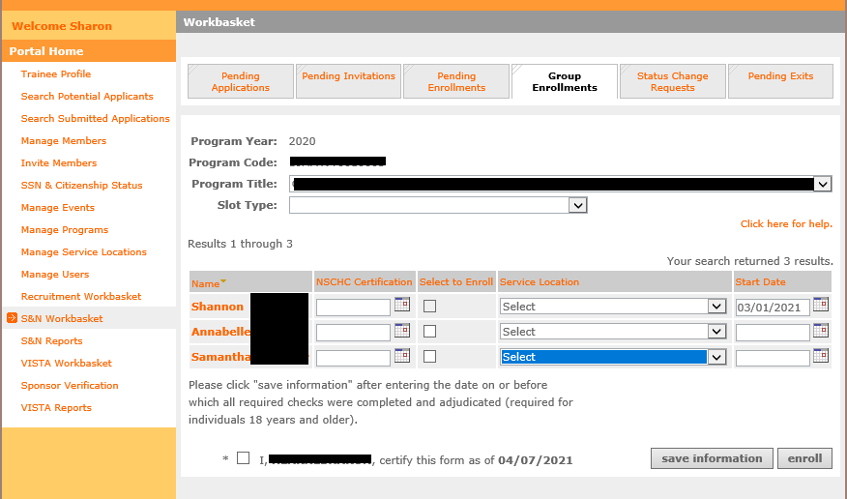
Group Enrollment Screen
Same information needed as in the individual enrollment form with one key difference:
- On the group enrollment form, you may enter information for up to 20 individuals at a time and enroll them simultaneously.
Notes:
Here is what the group enrollment screen looks like. The placement of the fields on the screen is different, but program staff will still enter the same types of information, make the same certifications, and take the same actions. The key difference: while on the individual enrollment form you are entering information for only one applicant at a time, on the Group Enrollment screen you can enter information for up to 20 applicants at a time and enroll those individuals simultaneously.

Slide 39
Group vs. Individual Enrollment
 | Group Enrollment | Individual Enrollment
Number of applicants enrolled at a time | Up to 20 | Only 1
Program Year and Program Title | Pre-populated from member invitation | Selected manually on enrollment screen
Individuals who applied through My AmeriCorps | Cannot be used | Must be used
Individuals invited under different program year/ program title | Cannot be used | Must be used
SSN/Citizenship | Applicants will not appear on Group Enrollment tab until they have been verified | Verification status and dates visible on individual enrollment screen
NSCHC certification | Certified by entering date on or before which all required NSCHCs were completed and adjudicated (ages 18+)
Notes:
This table shows a summary of the differences between the group enrollment and individual enrollment processes. As I said on the previous slide, group enrollment allows programs to enroll up to 20 individuals at a time, while individual enrollment is limited to one applicant at a time. Also, as I mentioned earlier, in group enrollment the applicant’s program year and program title are set during the invitation process. As a result, individuals who applied and were accepted via My AmeriCorps cannot be enrolled via the group enrollment feature, because the My AmeriCorps application process does not link individuals to this specific information. Similarly, individuals that were invited under a different program year or different program title cannot be enrolled via group enrollment. Instead, the program year and program title for these applicants will need to be selected or changed manually using the individual enrollment form.
In both group enrollment and individual enrollment, the applicant’s SSN and citizenship status needs to be verified on or before the applicant’s start date. Applicants will not show up on the group enrollment screen until this verification is complete. For individual enrollment, the verification status and dates are shown directly on the enrollment form. If you are using group enrollment and need to find out the date of SSN or citizenship verification for a particular individual, you can view it on the individual’s enrollment form.
The rules for National Service Criminal History Checks are the same for both group enrollment and individual enrollment. For applicants ages 18 years or older, program staff must enter the date on or before which the three-part NSCHC was completed and adjudicated. Entering this date and is a legal certification that these actions have been completed and this certification is recorded in the My AmeriCorps Portal. The date of certification is not visible on the group enrollment screen but can be viewed on the applicant’s individual enrollment form.

Slide 40
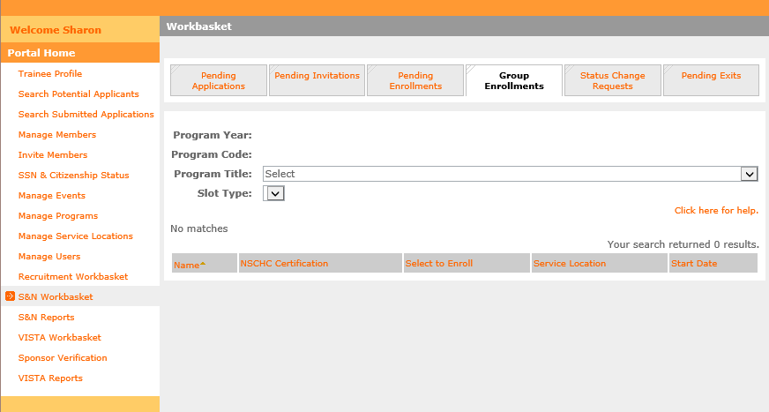
Group Enrollment Steps
Step 1:
In the S&N Workbasket in the My AmeriCorps Portal, click on the Group Enrollments tab
Notes:
The next set of slides will walk you step by step through the group enrollment process. First, you need to locate the Group Enrollments tab in the S&N Workbasket of the My AmeriCorps Portal. It is located to the right of the Pending Enrollments tab. When you first click on the tab there will be no applicants listed; the applicants will appear in the next step.

Slide 41
Group Enrollment Steps
Step 2: Select the correct Program Title (operating site name or subgrantee program name)
The Program Year whose enrollment period is currently open will populate automatically
Applicants who are associated with this Program Year and Program Title, have completed their portion of the Enrollment Form, and whose SSN/citizenship has been verified will appear on the tab. (These individuals are also visible on the Pending Enrollments tab)
Notes:
The next step is to select the Program Title - meaning the operating site name or subgrantee program name - for the individuals you wish to enroll. There will be a brief pause after the Program Title is selected, then the Program Year will automatically populate on the tab. The Program Year that will appear is the one whose enrollment period is currently open for that particular subgrantee or site.
The applicants associated with that particular Program Title and Program Year will automatically appear in the list at the bottom of the tab. The list displays up to 20 individuals at a time. If there are more than 20 individuals associated with this Program Year and Program Title, you will be able to use the navigation tools on the right side of the screen to move to subsequent pages.
Remember that applicants will only appear on the Group Enrollment tab if (1) they have the correct Program Year and Program Title pre-populated from the invitation form; (2) they have completed their portion of the Enrollment Form; and (3) their SSN and citizenship are already verified. If there are individuals you wish to enroll who do not appear on this tab, you can find them on the Pending Enrollments tab and use the individual enrollment process instead. Applicants who appear on the Group Enrollment tab also appear on the Pending Enrollments tab.

Slide 42
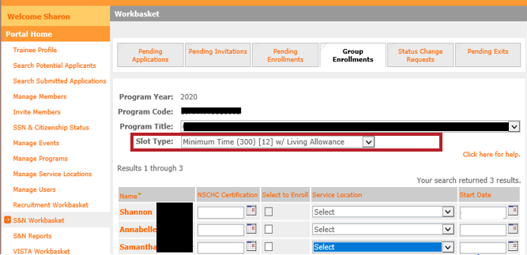
Group Enrollment Steps
Step 3: Select the Slot Type for the applicants you wish to enroll
In subsequent steps, you will only enter information for applicants who will be enrolled in this type of slot
If you have applicants that will need to be enrolled in other slot types, leave those blank for now. (You will repeat these steps to enroll those applicants.)
Notes:
Next, you need to select a slot type. In the group enrollment process, all individuals enrolled in a single action must have the same slot type. If you need to enroll other applicants with a different slot type, you will need to repeat the group enrollment steps with the second set of applicants.
In the example on this slide, I intend to Shannon, Annabelle and Samantha as Minimum Time members.

Slide 43
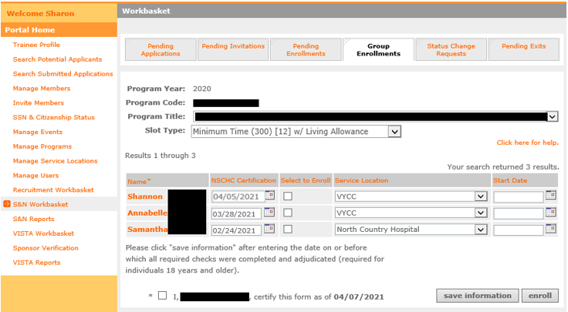
Group Enrollment Steps
Step 4: For the applicants you wish to enroll, enter the date when all required National Service Criminal History Checks were completed and adjudicated for each applicant. For applicants under age 18 as of the entered start date, leave the NSCHC Certification field blank.
IMPORTANT:
All required criminal history checks must be completed and adjudicated prior to inputting a certification date
The applicant start date must be after the date entered in the NSCHC Certification field
Notes:
The next step is to enter the date by which the criminal history checks were completed for Shannon, Annabelle and Samantha. Remember that by entering a date, you are providing a legal certification that you have completed and adjudicated the required NSOPW, State, and FBI checks on or before that date. Also remember that, just like on the individual enrollment form, you must enter a start date for the applicant that is AFTER the date in the NSCHC Certification section.
In the example on this slide, I am entering dates in the NSCHC Certification section for Shannon, Annabelle, and Samantha. The NSCHC certifications were completed on different dates for each applicant, so I will need to ensure I have proper documentation to reference when entering this date.

Slide 44
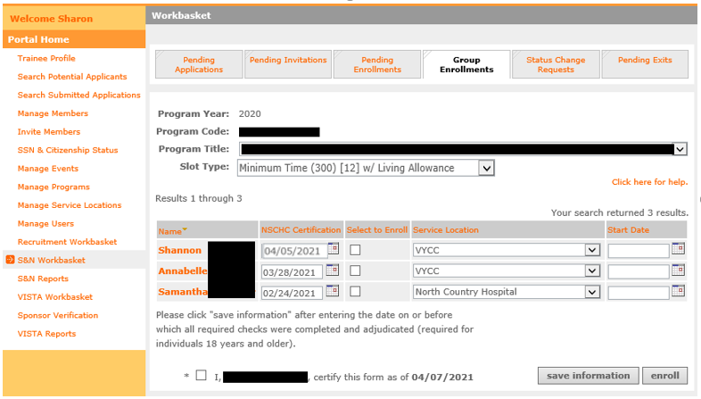
Group Enrollment Steps
Step 5: For the applicants you wish to enroll, select the appropriate Service Location(s)
Service Locations must be set up in the My AmeriCorps Portal prior to taking this step
Notes:
Next, I need to select service locations. For the correct service locations to show up in the drop-down list for these applicants, the service locations need to have been set up previously in the My AmeriCorps Portal. Please see the complete Member Enrollment training for more information about this prior step.​
​
Note that the service locations can be different for each individual in the group enrollment process. In this example, Shannon is being assigned to VYCC while Samantha is being assigned to North Country Hospital.

Slide 45
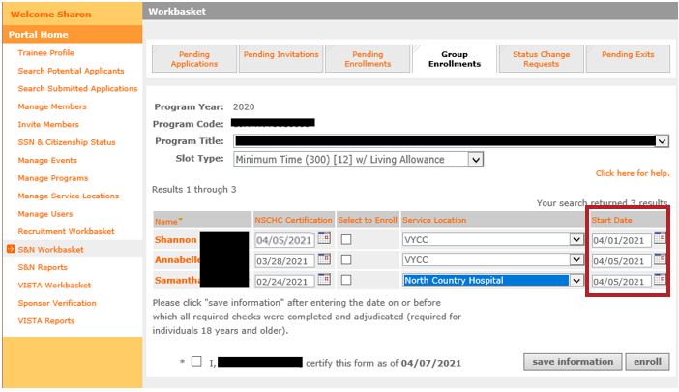
Group Enrollment Steps
Step 6: For the individuals you wish to enroll, enter the correct Start Date
Must be within member enrollment period
Must be on or after the SSN/citizenship verification dates
Must be after the date entered in the NSCHC Certification field
Per AmeriCorps policy, enrollment should be certified within 8 days of the member’s start date
Notes:
Now it’s time to enter start dates.
Remember, in order to enroll an applicant, the correct start date must:
Must be within member enrollment period
Must be on or after the SSN/citizenship verification dates
Must be after the date entered in the NSCHC Certification field
Annabelle and Samantha will start on 4/5/21. For Shannon I have selected 4/1/21 as a start date. However, I just completed the criminal history check certifications on 4/5/21 which is after the selected start date, so I will violate the third bullet. In other words, a 4/1 start date is not actually going to be possible for Shannon. But let’s leave it there for now and see what happens.
Per AmeriCorps policy, member enrollments should be certified within 8 days of the member start date.

Slide 46
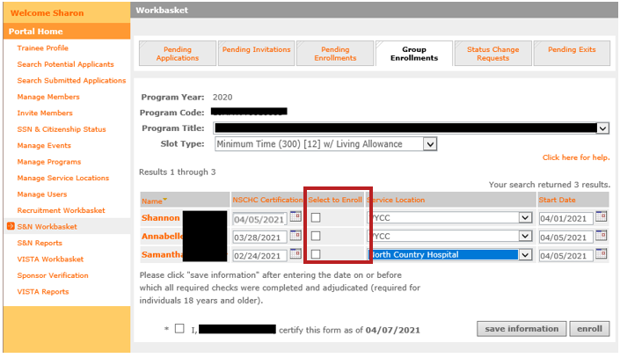
Group Enrollment Steps
Step 7: For the individuals you wish to enroll, click the “Select to Enroll” box
Only the individuals with this box checked will be enrolled when you click the “enroll” button at the bottom of the tab
Notes:
The next step will be to check the “Select to Enroll” boxes since these are the applicants I want to enroll in minimum slots under this Program Title and Program Year. Only the applicants whose “Select to Enroll” boxes are checked will be affected when the “Enroll” button is clicked at the bottom of the tab.

Slide 47
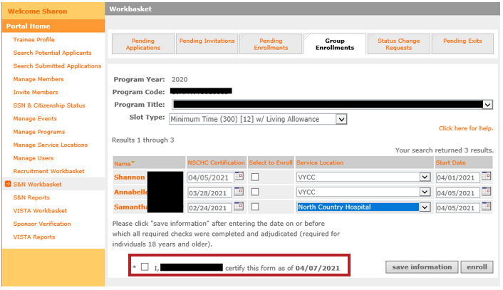
Group Enrollment Steps
Step 8: At the bottom of the tab, certify the form
Notes:
The form needs to be certified at the bottom of the tab. This legal certification confirms that all the information provided on the form is correct and complete, including the criminal history check certification dates.

Slide 48
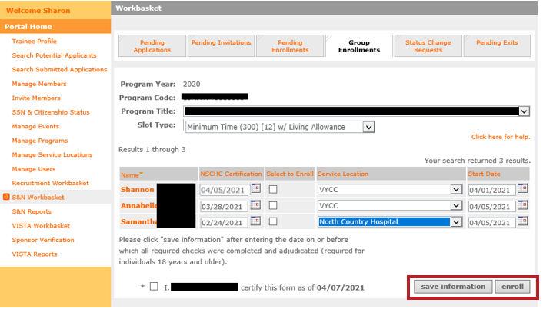
Group Enrollment Steps
Step 9: At the bottom of the tab, take the “enroll” action. (If you are not ready to enroll the individuals yet, click the “save information” button instead)
Up to 20 individuals can be enrolled at a time
Notes:
The next step is click the “enroll” button at the bottom of the tab to attempt to enroll the applicants. The key word here is attempt – clicking this button is not a guarantee that all the enrollments will be successful. The next tab will show you what happens if one or more of the enrollments does not go through.
As a reminder: up to 20 individuals can be enrolled at one time using the group enrollment process. If you have filled out information on this tab for one or more applicant but aren’t yet ready to take the “Enroll” action, click “Save information” instead.

Slide 49
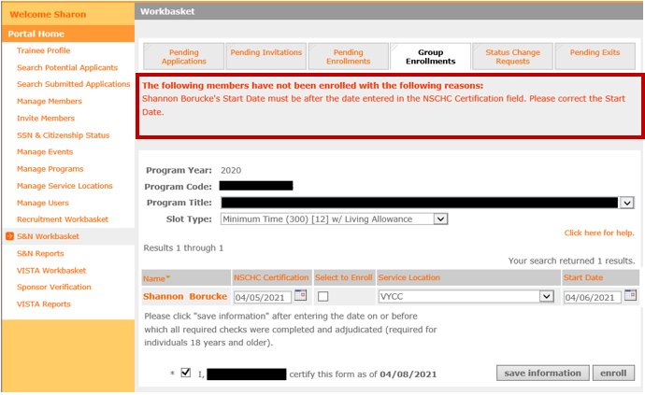
Group Enrollment Steps
Step 10: Check for error messages at the top of the tab. These messages will indicate if one or more of the individuals' enrollments was not successful.
In this example, the start date entered for Shannon was prior to the date of the NSCHC Certification, so they could not be enrolled. Program staff will need to correct Shannon’s start date and try again.
Notes:
If one or more of your enrollment attempts was not successful, you will see a red error message at the top of the tab. The message will tell you which applicants were not enrolled, and why. Applicants that were successfully enrolled will disappear from the Group Enrollment tab, while applicants who were not successfully enrolled will continue to be visible.
In this example Annabelle and Samantha’s enrollment was successful, so they are no longer displayed on this tab. However, as predicted, Shannon’s enrollment was not successful because the start date entered for them was before the NSCHC certification. So, Shannon still appears on the Group Enrollment tab. Program staff will need to correct Shannon’s start date, check the “Select to Enroll” box again, and try again to enroll them.

Slide 50
Troubleshooting Enrollment Error Messages
Sufficient slots available
SSN and citizenship verified on or before member start date
NSCHC Certification date before member start date
Service Location selected
Member start date no later than today’s date
Applicant is eligible to serve
Has not previously served more than 4 terms
Has not declined a partial education award
Has not received an unsatisfactory performance rating from a previous term of service
Is not currently actively enrolled in the same program or in another term that when combined exceeds full-time service
The details of the error message will provide specific guidance
Notes:
There are several reasons why member enrollments might not be successful; some of the possibilities are listed on this tab. ​
It could be that the program doesn’t have enough slots available to enroll all the selected applicants in that particular slot type. ​
It could be that the start date was entered wrong, or that the program staff forgot to select the applicant’s service location. ​
It could be that the applicant has not yet been exited from a current full-time service term.​
Or it could be that the applicant themself was not eligible to serve: they may have previously served four terms with AmeriCorps State and National or received an unsatisfactory performance rating from a prior service term.​
Whatever the reason, the error message will provide you with details about what went wrong and, if possible, what you can do to correct it. The member enrollment WILL NOT be complete until the error is corrected, and program staff successfully take the Enroll action again.

Slide 51
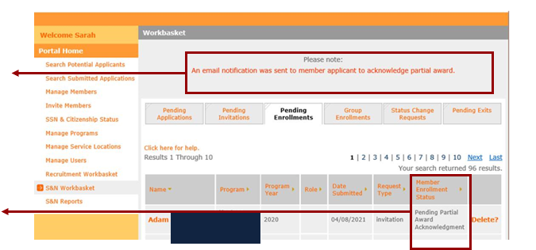
Partial Award Acknowledgment
If an individual will exceed the equivalent amount of two full-time education awards while serving with your program, the applicant will need to acknowledge partial or no education award before they can be enrolled.
When the program attempts to click “enroll” you will see this note for applicants who need to perform a partial award acknowledgment
Additionally, the applicant enrollment status will indicate pending partial award acknowledgement
The member enrollment is not complete
Notes:
There is an additional step that a few of you may need to complete. If you click enroll for an applicant who has previously received the equivalent of two full time education awards, or as a result of the slot type that you entered, will now exceed 2 full time slot awards a notice will show up when you click enroll that is highlighted here.
The note indicates that an email notification was sent to the applicant to request acknowledgement of the partial award.
You will also see in your pending enrollments workbasket that the enrollment status is now in “pending partial award acknowledgement.”
Because this applicant has an additional step, the individual is not yet enrolled even though you hit the enroll button. The applicant must follow the next steps before you are able to enroll the individual.

Slide 52
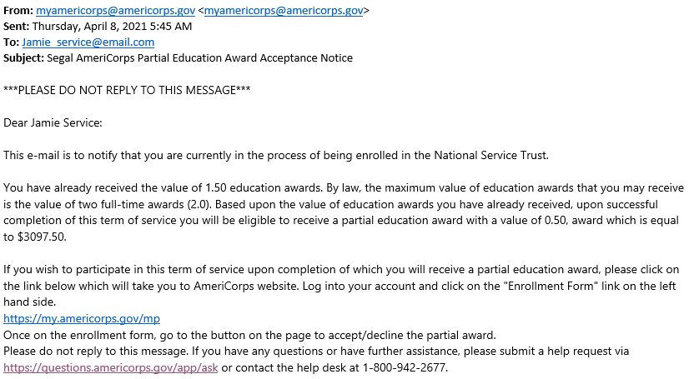
Partial Award Acknowledgement
Partial Education Award notification email:
Recommended reminders for the applicant:
Let the applicant know to look out for this email
Ask the applicant to complete and acknowledge as soon as possible
Communicate that delay in completing this farm will delay their enrollment
Notes:
Here is an example of what the applicant will see if they need to acknowledge a partial award.
The email will indicate the value of education awards the applicant has previously received and provide the partial amount they are still eligible for. This will equate to a specific dollar amount.
The applicant will need to click on the link provided in the email which will bring them back to their enrollment form in My AmeriCorps.

Slide 53
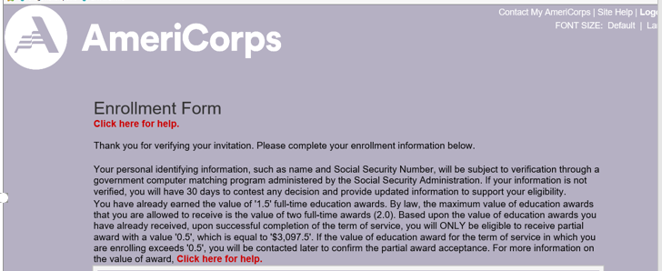
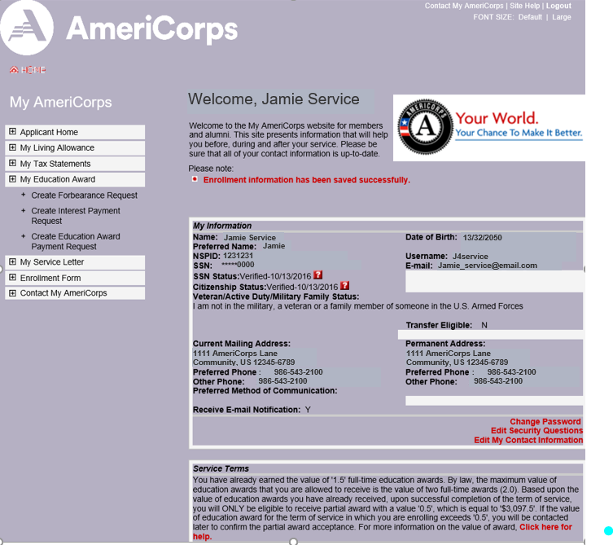
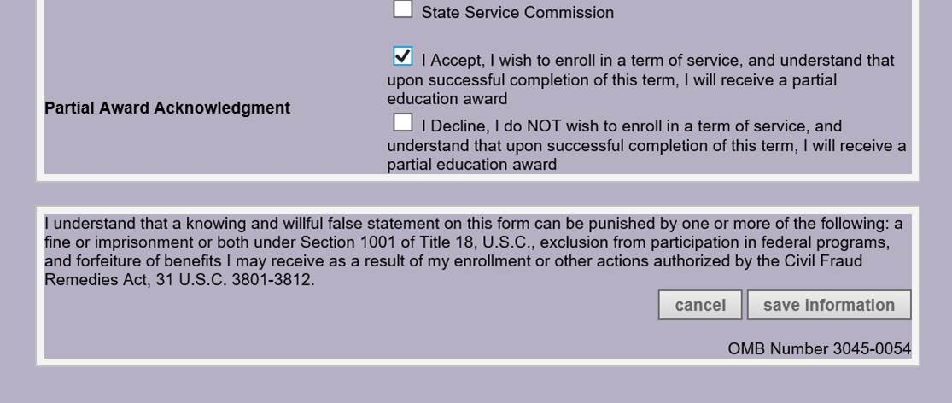
Partial Award Acknowledgment
Applicant view in My AmeriCorps Portal
Step 1: Log into My AmeriCorps and click Enrollment Form
Step 2: Scroll down to the bottom of the enrollment form so the member can select “I accept.”
Step 3: Click “Save Information.”
Notes:
Once the applicant clicks the link in the email they received, they will be taken to the My AmeriCorps portal where they will need to log in. They then need to click on Enrolment Form on the left-hand side of the screen.

Slide 54
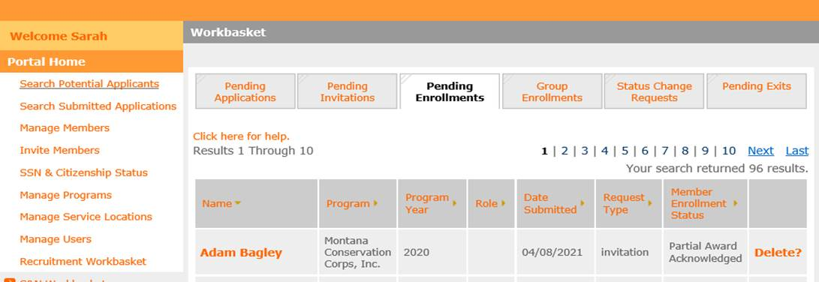
Partial Award Acknowledgement
Once this information is saved, the individual’s enrollment status in eGrants will be updated to “Partial Award Acknowledged.”
The program can then return to the member enrollment form and take the “enroll” action. ONLY THEN IS THE MEMBER ENROLLMENT COMPLETE.
Notes:
At the bottom of the enrollment form, the applicant will be asked to either accept or decline the partial award. If declined, this is an indication that the individual is choosing not to be enrolled into your term of service.
If they accept, eGrants will automatically update the applicant’s enrollment status to “partial award acknowledged” as shown here in the second image.
Once this is complete, you will be able to go back into the member enrollment form in eGrants, enter the member slot type and start date again because these two items are not able to be saved, and then click enroll.

Slide 55
Check your work!
Run reports in eGrants
View each member’s service information in Portal
Double check the following:
Within member enrollment period
Sufficient slots available
SSN and citizenship verified on or before member start date
NSCHC Certification date before member start date
Service Location selected
Start date no later than today’s date
Applicant eligible to serve?
Has not previously served more than 4 terms
Has not declined a partial education award
Has not received an unsatisfactory performance rating from a previous term of service
Is not currently actively enrolled in the same program or in another term that when combined exceeds full-time service
Notes:
There are multiple ways to ensure that you are completing the member enrollment properly. In the next slide, we will cover how you can run reports in eGrants to check your work. You are also able to click on each member’s service information within the portal to make sure the changes/updates you made were saved properly.
Make sure to check all details needed for enrollment to ensure that everything is correct to avoid error messages.

Slide 56
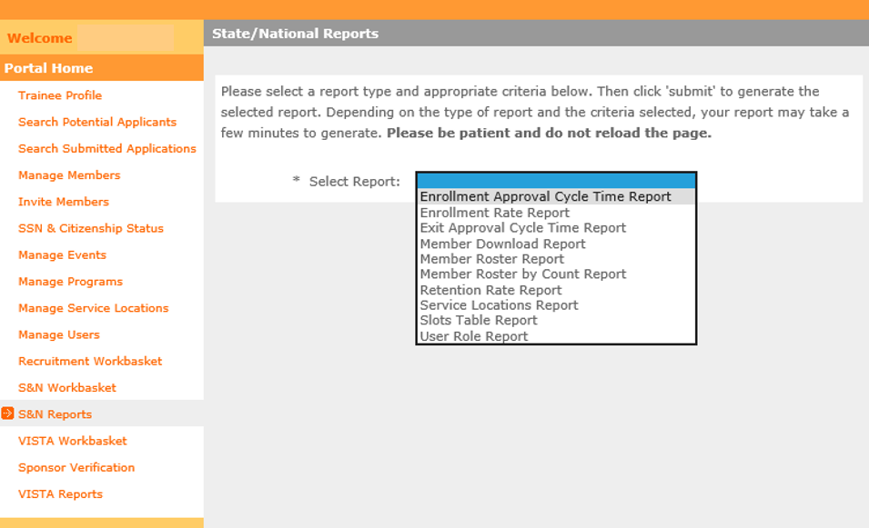
Run Reports to Check Enrollments
S&N Reports
Enrollment Approval Cycle Time
Presence of all expected enrolled members
Number of days from member start date to enrollment activation (should be 8 or less)
Member Download Report
Displays multiple pieces of enrollment information for each member
Check member’s service location, slot type, status (e.g., in-service, suspended, exited), start date, address, etc.
Notes:
You can always check your work by running a report in the portal. Under ‘portal home’ select ‘S&N Reports’ to run a report. Two reports from this tab that are helpful for you during enrollment are the Enrollment Approval Cycle Time report and the Member Download Report.

Slide 57
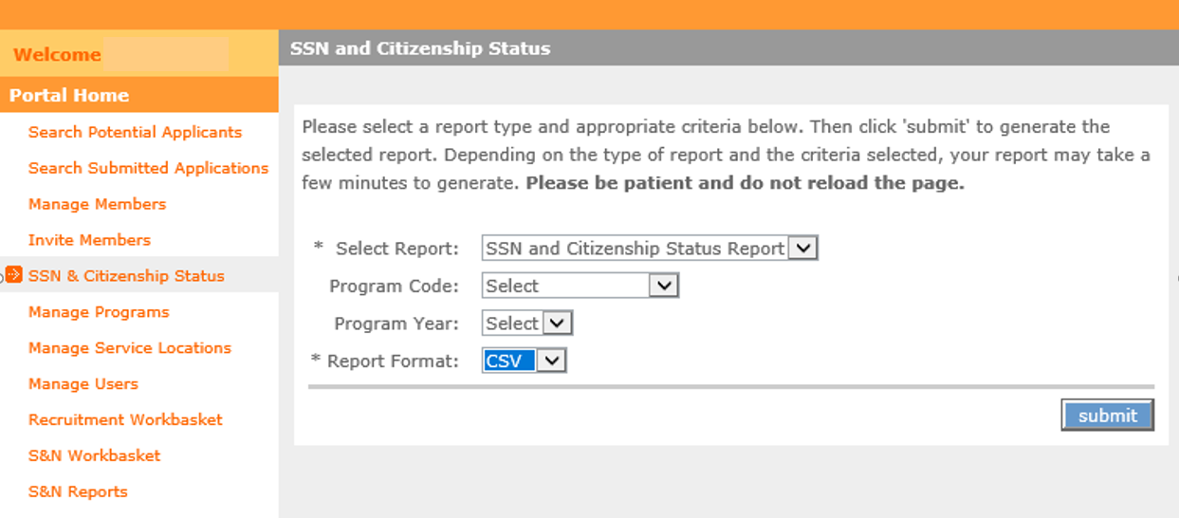
Run Reports to Check Enrollments
SSN and Citizenship Status Report
SSN and Citizenship Status Report
Trust Enrolled Status
Citizenship Status
SSN Status
Notes:
You can also run a report on SSN and Citizenship which will show the Trust enrolled status, citizenship status, and SSN status of members.

Slide 58
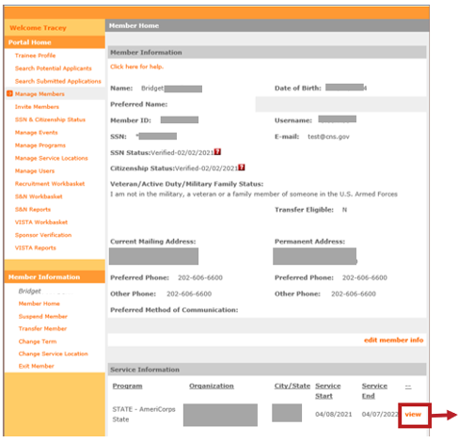
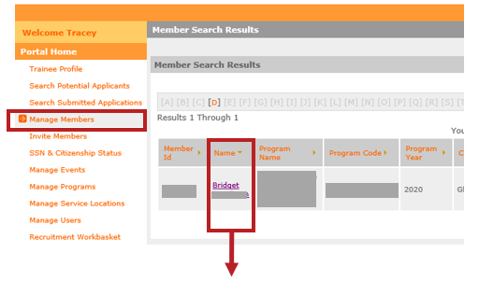
How to Update a Start Date in eGrants
*in-service members only
Step 2: Click the “view” link next to the service term
Step 1: Using the “Manage Members” link from the Portal Home, locate the individual and click on the member name to open the Member Information screen
Notes:
If a situation occurs that requires you to update a member’s start date, you can make that change for in-service members as long as the change is within the allowable enrollment parameters discussed in this training. Please note that if this change is made more than 8 days after the member start date, it may affect a program’s compliance with 8-day enrollment requirements.
To update a start date in eGrants, select “Manage Members”
From there a list of members will appear on your page. Search for the individual who requires the start date change and click on their name. This will take you to their member information screen. At the bottom, under Service Information, you will see the original start date that was entered. Click “View” to open their service term information.

Slide 59
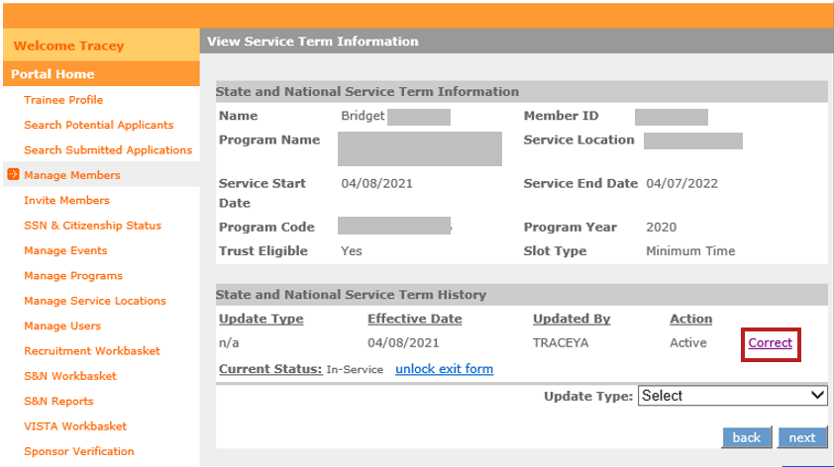
How to Update a Start Date in eGrants
*in-service members only
Step 3: Click the “Correct” link
Notes:
Now that you are in the view service term information page, you can see that you have the opportunity to correct the member’s service term by clicking “Correct” at the right hand side of your screen.

Slide 60
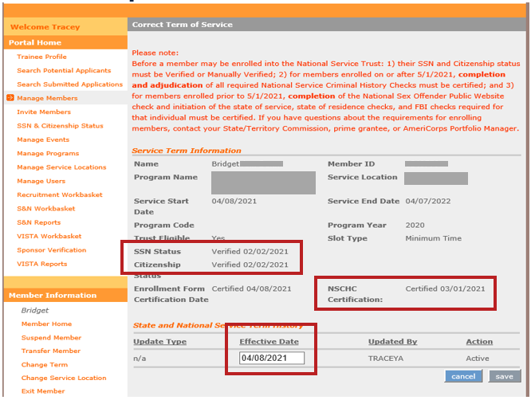
How to Update a Start Date in eGrants
*in-service members only
Step 4: After opening the “Correct Term of Service” screen you can see the member’s current start date is listed in the “Effective Date” field.
The dates of SSN and citizenship verifications and NSCHC certification are also displayed.
Notes:
Step 4: After opening the “Correct Term of Service” screen you can see the member’s current start date is listed in the “Effective Date” field.
The dates of SSN and citizenship verifications and NSCHC certification are also displayed for you to reference and ensure that the newly entered start date meets the requirements of enrollment.

Slide 61
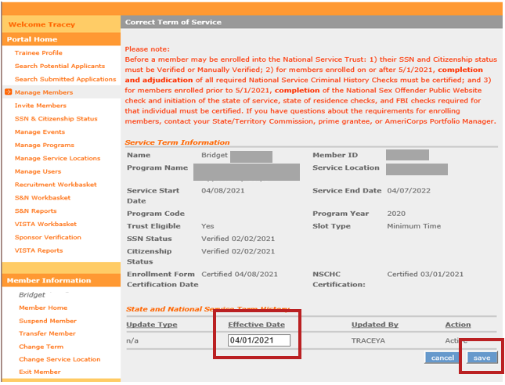
How to Update a Start Date in eGrants
*in-service members only
Step 5: Enter the corrected start date in the “Effective Date” field, ensuring that it is:
Within the member enrollment period
On or after the dates of SSN and citizenship verification
After the NSCHC certification date
Step 6: If the corrected start date is within these parameters, the “Save” button will become active. Click “Save”
NOTE: entering a start date that is more than 8 days in the past will affect the program’s compliance with 8-day enrollment requirements
Notes:
Step 5: Enter the corrected start date in the “Effective Date” field, ensuring that it is:
Within the member enrollment period
On or after the dates of SSN and citizenship verification
After the NSCHC certification date
Step 6: If the corrected start date is within these parameters, the “Save” button will become active. Click “Save”
NOTE: entering a start date that is more than 8 days in the past will affect the program’s compliance with 8-day enrollment requirements.

Slide 62
What to do if the enroll button isn’t active
Check the applicant’s SSN and Citizenship verification status.
Both statuses must be “verified” or “manually verified”
Verification dates must be on or before the entered start date
Check the NSCHC certification
The date entered in the NSCHC Certification field must be before the entered start date
Check the entered start date
The date must be within the member enrollment period
The date cannot be later than today’s date
The date cannot be earlier than the SSN/Citizenship verification dates
The date cannot be the same or earlier than the date in the NSCHC Certification field
Check that all fields are completed
If all the previously mentioned steps are complete and you still cannot enroll the applicant, contact the AmeriCorps Hotline and your Portfolio Manager
Notes:
If your enroll button does not become active, here is a list of items for you to check:
SSN and citizenship status
NSCHC certification- remember, date must be before the entered start date
Check the start date
And finally, if you determine that all the above is correct, and you are not sure why eGrants would be preventing you from enrolling your applicant, contact the AmeriCorps Hotline.

Slide 63
Thank you for your service

