Slide 1
Budgeting for Evaluation
Notes:
Facilitator notes: This presentation provides an overview of how to effectively budget for an evaluation.

Slide 2
Learning objectives
By the end of this presentation, you will be able to:
Understand why budgeting for evaluation is a strategic investment
Recognize how evaluation costs vary by type of evaluation
Explain the key components of an evaluation budget
Identify approaches for creating an evaluation budget
Notes:
For this presentation, we have identified a number of learning objectives.
By the end of this presentation, you will be able to:
Understand why investing in evaluation is a strategic investment
Recognize how evaluation costs vary by type of evaluation
Explain the key components of an evaluation budget
And identify approaches for creating an evaluation budget

Slide 3
Emerging trends
Rule of thumb (5%, 10%) of overall budget for evaluation is proving too simplistic
Administrative data is emerging as a viable source for low-cost RCTs (and some QEDs)
Tiered evidence initiatives (SIF, i3, WIF, etc.) are expanding the number of high-quality evaluations, leading to more available budget data
Continuum from performance measurement to evaluation; links and overlapping data collection
Notes:
This presentation is informed by emerging trends in evaluation, many of which have important implications for evaluation costs and budgeting.
-First, the traditional “rule of thumb” guidance to devote a set percentage of a program’s budget to evaluation is proving to be too simplistic. Evaluation costs vary widely, as we will explain later.
-Second, evaluations that compare outcomes for a randomly assigned control group against outcomes for program beneficiaries, known as randomized control trials or RCTs, and those that use compare outcomes for a statistically matched comparison group against outcomes for beneficiaries, known as quasi-experimental designs or QEDs, tend to have higher costs than other types of evaluations that do not use a control or comparison group.
-To this point, however, better data collection and data infrastructure is leading to more useful administrative data sets that can be used to conduct low-cost RCTs and sometimes also quasi-experimental design evaluations. Data collection is often a large cost driver for evaluations, so utilizing existing data sets has the potential to drive down costs.
-Third, the tiered evidence grant programs, which emphasize rigorous evaluation practices, such as the Social Innovation Fund here at CNCS, are rapidly expanding the number of high-quality evaluations, and these efforts are providing important data about typical evaluation budgets.
-And finally, more organizations are embracing the idea that there is a continuum from performance measurement and management to program evaluation, and that often data collected for one purpose can be used at least in part for another.

Slide 4
Challenges and payoff
Paying for evaluation can be a challenge
  Programs can’t afford it
  Don’t know how to find low-cost evaluation partners
  Funders won’t always pay for it
CNCS acknowledges these challenges
  But we believe that evaluation should be viewed as an investment and not simply a compliance requirement.
Consider evaluation to be a strategic investment
  If you can demonstrate that your program works, you will be able to attract more funders, grow, and become more sustainable.
Notes:
There can be many challenges to budgeting for an evaluation. Paying for an evaluation can be tricky because many programs feel that they can’t afford it, or don’t know how to find resources through low cost evaluation partners. This is complicated by the fact that funders won’t always pay the entire cost of program evaluations, especially those giving restricted dollars. However, there are lower cost ways to conduct an evaluation, and we will be presenting some of those ideas here.
CNCS acknowledges these budgeting challenges, but we believe that evaluation can provide critical insight into your program. We feel strongly that program evaluation goes beyond meeting requirements and provides important information for program management, decision-making, and improvement. We view evaluation as an smart strategic investment in improving your program, and ultimately, as a stepping stone to serving more beneficiaries more effectively.
We encourage you to view evaluation as a strategic investment in future growth: if you can demonstrate to funders and donors that your program works, you become more competitive for their limited financial resources.

Slide 5
Investing in evaluation does pay dividends
Spending money on evaluation is not a tradeoff
Learning for program improvement, so you can:
  Serve more people better
  Serve more people better, at lower cost
Increasing your evidence base attracts funders…
  …which allows you to serve more people
Demonstrating impact is a differentiator in an environment of scare resources
  Policymakers and funders are reluctant to spend scarce resources on programs without evidence
Notes:
-Spending money on evaluation is not a tradeoff. We would encourage you not to think of the money you spend on evaluation as money that you could have otherwise spent helping people. You should think about it as money spent so that you can maximize how you help people.
-Sustained program evaluation will produce critical information needed for program learning and management decision-making. Spending money to gain this information is a necessary financial investment in working smarter.
-Investing in evaluation demonstrates to current – and potential - funders that your program is committed to efficiency and effectiveness. To secure scarce resources, and thus serve more beneficiaries, it is important to consistently demonstrate to stakeholders that your organization is continually building evidence and using it to refine your program.
-Furthermore, including evaluation as part of your organization’s formal budget demonstrates that evidence and informed decision-making is an organizational priority and part of your operating culture; this can speak volumes to potential donors and large funders.
-Remember, the ability to demonstrate impact is a differentiator in an environment of scarce resources; from a funder’s perspective, why would you want to spend scarce resources on things that aren’t working?
-How can you focus your program activities so that you are getting the most result with the resources you have?

Slide 6
Build a long-term research agenda
What does a long-term research agenda look like?
  What do we want to have learned 5 years from now? 10 years from now?
  Work backwards: define your destination, then name the supporting steps that will get you there
  Each evaluation should build on what you learned previously
  If you invest evaluation money strategically, scarce resources can have a big impact
Notes:
As you begin to plan your evaluation, step back and put your evaluation in the context of a long term research agenda. Remember, you don’t have to evaluate your whole program at once, and you can “chunk out” a bigger evaluation into smaller components to maximize the resources you have on hand. Ask program staff and various stakeholders “what does a long-term research agenda look like for this organization?”. Figuring out what you want to know 5 or 10 years in the future will help you spend evaluation money more strategically by laying out studies that build upon one another, and will allow you to create complementary resources that can be deployed multiple times.
You can do this by working backwards from an end goal. If you ultimately want to achieve a strong level of evidence for your program by implementing a randomized control trial (RCT) or a quasi-experimental design (QED), what supporting steps do you need to take to get there? Maybe you need to begin with descriptive studies and start collecting routine data. Then you might develop and administer an annual survey, field a process evaluation, and invest in building additional data collection instruments.

Slide 7
Example of a long-term research agenda
AmeriCorps program provides housing assistance for low-income families.
Goal: Demonstrate that the program has a positive impact on beneficiaries via a randomized control trial (RCT).
  Step 1: Collect program data, routinely, on family background characteristics and number of families served.
  Step 2: Collect pre/post outcome data each year via annual survey.
  Step 3: Implementation study: Is the program being implemented with fidelity to the model?
  Step 4: In addition to data collected from Steps 1&2, collect long-term outcomes data via follow-up survey (1 year post- program).
  Step 5: Demand for the program exceeds supply, so implement RCT by randomly assigning families to receive housing assistance. Collect background data and survey data from all eligible families.
Notes:
-For example, consider the long-term research agenda for a hypothetical AmeriCorps program that provides housing assistance for low-income communities. The program would eventually like to demonstrate that it has a positive impact on beneficiaries by implementing a randomized control trial evaluation.
-This is a very worthy goal, but the program would be wise to build up to this point by investing in a number of earlier steps first. For example, the program might start by collecting data on the families it serves on a regular basis. Then it might design an annual survey and collect pre and post outcome data each year. Next could be an implementation study to assess if the program is actually being implemented with fidelity to its logic model. Then, assuming the program is being implemented well, it could start to collect longer-term outcome data from families by designing and administering a follow-up survey. Finally, knowing that demand for the program far exceeds the available resources, the program could implement a randomized control trial (RCT) by randomly assigning families to receive housing assistance. All the necessary data collection instruments have already been designed and tested in the earlier years, and this data is already being collected routinely from families served, so all the program really needs to do is collect the same information from the families who are not receiving housing assistance.
By incrementally fielding studies as part of a long-term research agenda, not only has the program gradually built up its evidence base but it has put systems in place that made the final more rigorous evaluation much less costly than it otherwise would have been.

Slide 8
Guidelines for budgeting
In general, evaluation budgets should be:
  Commensurate with stakeholder expectations and involvement
  Appropriate for the research design used and key questions to be answered
  Adequate for ensuring quality and rigor
  In line with the level of program and organizational resources available
Notes:
Let’s turn now to budgeting for evaluation. In general, evaluation budgets should:
Reflect the expectations of stakeholders, particularly in terms of scope, duration, and level of rigor of the evaluation. Any requirements or mandated components as a condition of funding are also important here. For example, CNCS grantees receiving over $500k are required to conduct an external impact evaluation covering at least one program year. The use of an external evaluator and the methods needed to implement a comparison or control group design, for example, both bring their own particular cost requirements. So you can see that design requirements, scope of the evaluation, and who will be conducting the evaluation will affect the final budget. The evaluation budget should also reflect any stakeholder investment, be it financial or in another form such as time or technical assistance.
Evaluation budgets should also be appropriate for the research design used and the key research questions you want to answer. Certain evaluation methods or techniques, like primary data collection, simply cost more to execute than others. Relatedly, some key research questions will require different levels of investment, depending on their scope and the depth with which you want to answer them.
Budgets should also be of sufficient size to ensure that your evaluation will be high quality and rigorous. Underfunding may result in design choices that jeopardize the integrity of your evaluation. It can also lead to last minute workarounds, shortcuts, and quick fixes taken in the midst of your evaluation that can seriously impact the results produced.
Finally, an evaluation budget should reflect the financial, human capital, and other resources your program or organization has. For example, consider what kind of data collection systems you currently have in place and what you can plan to build for the future.

Slide 9
Factors that influence budget estimates
  Program Factors
    Geography, number of sites, and characteristics of target population
    Availability of resources
  Evaluation Design
    RCT vs. QED vs. Non-Experimental
    Level of evidence
    Need for evaluation capacity-building
  Reporting, Dissemination and Use
    Using lessons learned for internal decision making
    External dissemination and communication
Notes:
-Broadly, there are three “buckets” of factors that influence evaluation budget estimates.
-First, Program Factors (for example, the number and geographic characteristics of program sites, the type of population served, and challenges in collecting information on that population, and overall program and organizational budget and resource availability, such as data collection systems)
-Second, the Evaluation Design
The type of study design used for conducting the evaluation and the key questions the study intends to answer. More sophisticated evaluation designs, such as randomized control trials and quasi-experimental designs that use control or comparison groups, are typically more expensive, and finding answers to some questions are more difficult and costly than others.
The types of data collection strategies and data sources that are used and the level of effort associated with implementing the data collection approaches. Typically surveys, for example, are costly to develop, pilot test, and implement, particularly when the follow up period is long.
The amount of time required to conduct data analysis and interpretation and the level of technical expertise needed to do that. Analysis of data using sophisticated statistical methods will require technical expertise which will increase the cost of evaluation.
Whether or not evaluation capacity building is a component of the evaluation project as that would require its own dedicated resources and will increase evaluation costs. This means building the capacity of an organization to conduct or manage an evaluation and then use the results productively.
Whether or not the evaluation is conducted by external evaluator(s) or internal staff or both. Engaging external consultants typically increases costs of conducting evaluations.
The level of engagement and expectations/requirements of stakeholders throughout the process and especially upfront in the planning phase. Higher level of engagement and requirements will mean more time has to be dedicated to evaluation and that will make it more costly. On the other hand, there are significant benefits when stakeholders are involved. Engagement of stakeholders can facilitate development of a shared understanding about the program and evaluation, increase buy in, and result in use of evaluation findings in decision making.
-And third, Reporting, Dissemination and Use
Amount of time and resources needed to document evaluation findings and prepare reports, briefs, presentations, and other evaluation deliverables.
Time and resources needed to discuss and reflect on evaluation findings by internal audiences and stakeholders, and make sure findings are used for informing decision making within the organization as needed (internal utilization).
Time, efforts, and resources required to implement (external) communications and dissemination plans around the evaluation study and its results and sharing of lessons learned in the process.

Slide 10
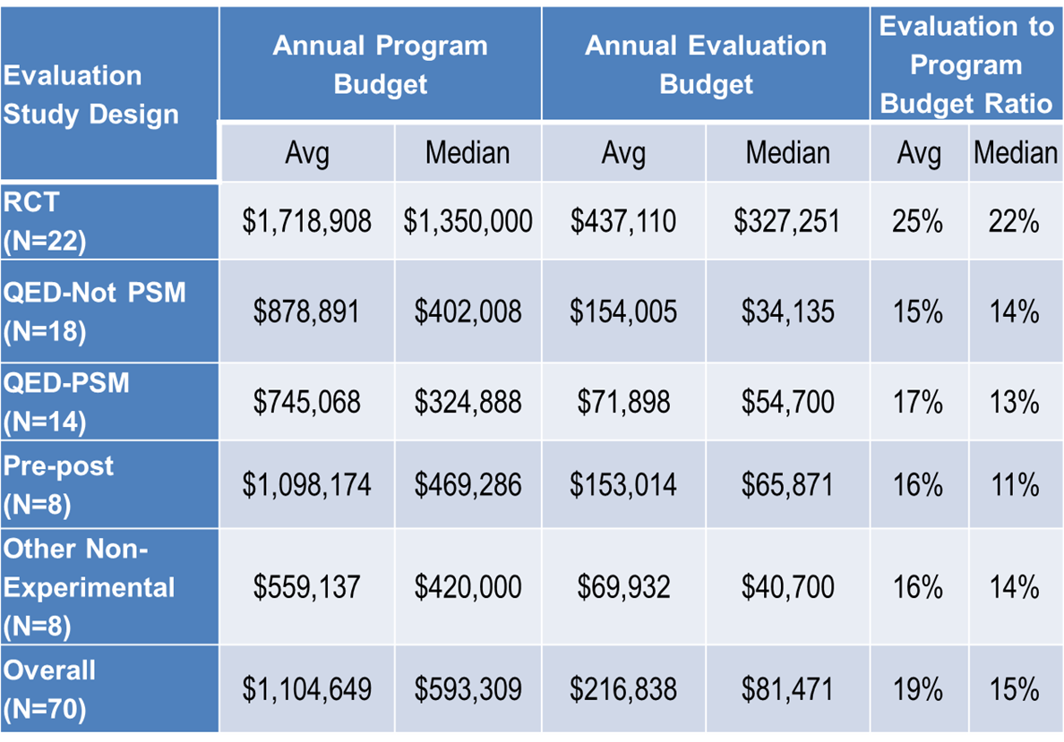
Example evaluation costs by design type
Notes:
-We are often asked to provide information about the average costs of different evaluation designs; however, there is not much publicly available information available about evaluation costs. Here we provide information gathered from another federal competitive grant program. While we acknowledge that this data may or may not be representative of all evaluation budget data, we think it is helpful to share as a starting point for a discussion about evaluation costs for AmeriCorps programs.
-The important takeaway from this slide is that budgets do vary, and the ratio of evaluation budget to overall program budget is higher than the old rules-of-thumb, even for simple pre-post evaluations.
Non-Experimental (NE)
Avg. Program Budget: $828,655
Median Program Budget: $420,000
Avg. Evaluation Budget Per Year: $111,473
Median Evaluation Budget Per year: $40,700
Avg. Evaluation to Program Budget Ratio: 16%
Median Evaluation to Program Budget Ratio: 13%
N=16
Quasi-Experimental Design (QED) [N=32]
Avg. Program Budget: $820,343
Median Program Budget: $362,008
Avg. Evaluation Budget Per Year: $118,083
Median Evaluation Budget Per Year: $38,434
Avg. Evaluation to Program Budget Ratio: 16%
Median Evaluation to Program Budget Ratio: 13%

Slide 11
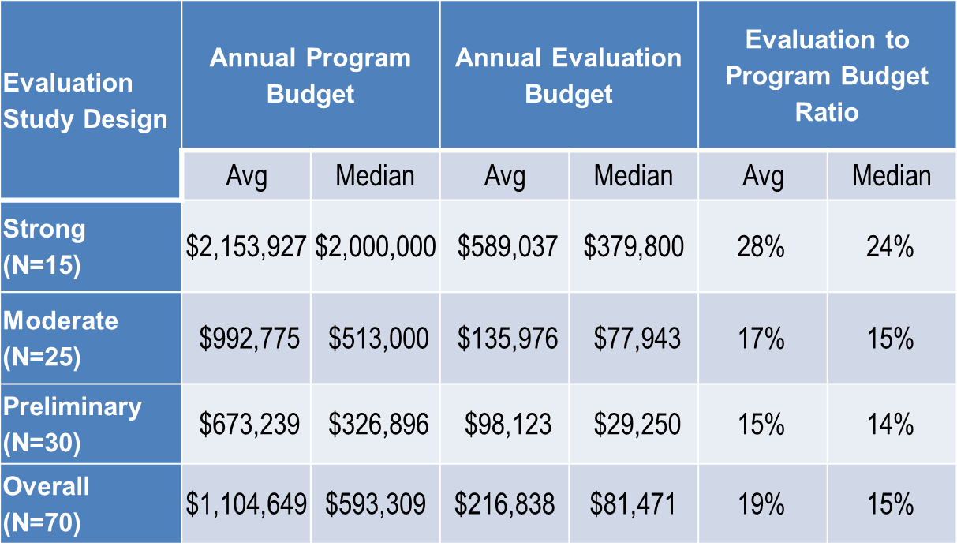
Evaluation costs by level of evidence
Notes:
Looking at these same programs, this time organized by level of evidence, we can see that as you increase the strength of the evaluation design, both average and median evaluation budget increases. You can see that evaluations that would produce a preliminary level of evidence (meaning non-experimental evaluations that did not use a control group or a comparison group) had the lowest ratio of evaluation to program budget (avg. of 15%), and evaluations producing a strong level of evidence (randomized control trials with a randomly assigned control group) had the highest ratio of evaluation to program budget (avg. of 28%).
These budgets reflect the research questions being asked, the duration of data collection, evaluation design and methods being used, and the scale and scope of the evaluation effort.

Slide 12
Key themes in evaluation budgeting
Rule of thumb ratios lead to under-budgeting
Amount budgeted should be considered in its own right
Costs increase with level of evidence
Costs vary based on the study design
Notes:
-The key themes from this analysis of data, and from other recent evaluations, are the following:
First, the existing rule of thumb ratios of 5%-10% of a program’s budget lead to serious under budgeting of evaluations. The bare minimum % is somewhere around 13% to 15% for non-experimental evaluations (evaluation designs without a comparison group) and quasi-experimental designs. However, a more realistic ratio would be closer to 20%. For randomized control trials with randomly assigned treatment and control groups, the % would likely have to be above 25%.
However, the % of program budget is not the best way to allocate evaluation funds. Evaluation costs should be considered in dollars as well as percentages. For example, you can't conduct an evaluation that targets a moderate level of evidence (quasi-experimental design) for less than $75,000 per year, unless you are getting some time or resources donated.
Third, given the current state of evaluation methods, it is not possible to conduct a rigorous evaluation on a shoestring budget and in order to conduct a robust evaluation that targets a high level of evidence you have to be willing to budget for it accordingly. While costs do generally increase as you move toward higher levels of evidence, we want to emphasize the point that costs vary based on the study design.
Remember that you are investing in valuable evidence that will help you serve your beneficiaries more efficiently and effectively. And as you develop a long term research and evaluation agenda for your program, these costs will likely decrease, as you will have data collection systems, instruments, and historical data available to decrease costs.

Slide 13
Key themes (continued)
All design types can potentially be expensive
  Multisite implementation studies
  Feasibility studies for generating stronger levels of evidence
Most evaluation types can be done inexpensively
  Including some randomized control trials (RCTs)
Determine what you want to learn from your evaluation and build a budget that can answer those research questions
Notes:
It’s also important to keep in mind that any type of evaluation design can potentially be expensive. For example, an implementation study, which is a non-experimental evaluation design, can become very expensive if you expand the scope to include multiple sites, particularly those that are geographically dispersed. The same holds for feasibility studies, which are often done before a program embarks upon a rigorous impact evaluation.
Even so, there are also ways to conduct most types of evaluation inexpensively, including randomized control trials (RCTs). Building sustainable data collection systems and instruments that you will use over and over again means that you invest once, upfront, and then can deploy these continuously into the future with just a small maintenance cost. Continuous collection of relevant information, like the data you collect for performance measures, can also significantly reduce evaluation costs. Similarly, using existing administrative data sets can dramatically lower costs.
The bottom line is that you should determine what you want to learn from your evaluation and build a budget that can answer those questions.

Slide 14
So where can I get the money?
Tap into local resources
  Local partners
  Universities, community colleges, Cooperative Extension, consultants
When feasible, consider partnering with similar programs for joint evaluation activities
Some foundations will fund evaluation
  Brady Education Foundation; Annie E. Casey Foundation; WT Grant Foundation
Evaluation IS an allowable cost at CNCS!
Notes:
There are a few options for finding financial resources for your evaluation:
You can tap into local resources, such as program partners or local collaborators that might have a stake in the information you’ll collect and the results your evaluation would generate. You can approach these groups by articulating why the evaluation results will be useful for them: perhaps their own program or cause would be advanced by the questions your evaluation is asking, or maybe the data you generate would help them in their own evaluation efforts. Universities, local consultants, or cooperative extensions may be able to pitch in as well, and many of these groups are interested in the intellectual challenge of designing high-quality evaluations.
Joining forces with other programs that have similar interventions or outcomes may be mutually advantageous in providing sufficient financial resources and large sample sizes necessary for more rigorous evaluations. For example, in 2013 the Public Lands Service Coalition commissioned a quasi-experimental design evaluation of 14 Conservation Corps programs with similar outcomes. The group was able to leverage the large sample size provided by multiple programs to conduct their evaluation.
Some foundations will award grants or provide money to evaluate programs, including the Brady Education Foundation for education programs, the Annie E. Casey Foundation, and the WT Grant Foundation.
Remember, evaluation is an allowable cost at CNCS! We will discuss this in more depth later in the presentation.

Slide 15
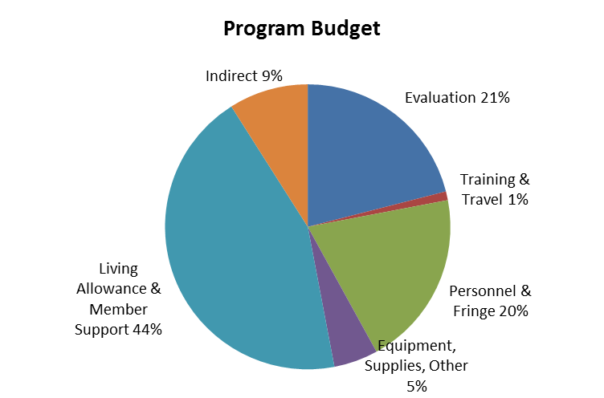
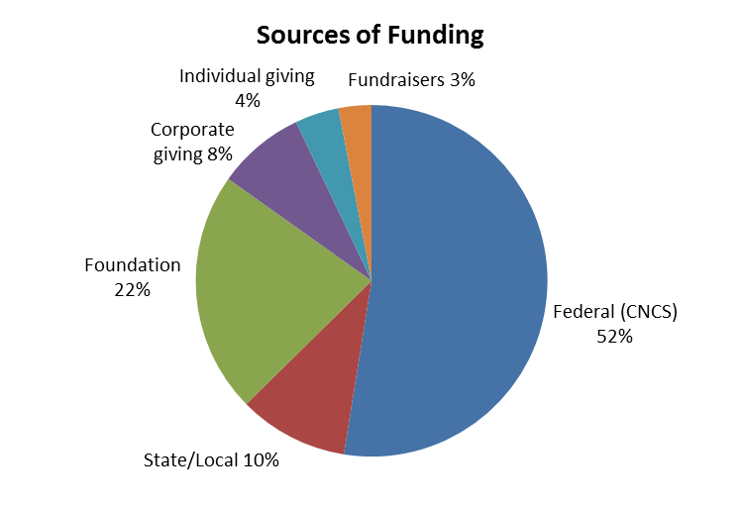
Big picture budget discussion
Evaluation is one piece of your overall budget
  What do you need to spend money on?
  Do you have a diverse, sustainable fundraising strategy?
Notes:
-Before getting into the specifics of how to create an evaluation budget, we want to step back for a high-level view of a program’s overall budget since evaluation is one piece of this budget.
-As you start to budget for an evaluation, you need to think first about your overall program budget. The pie chart on the left shows all of the different costs that are part of operating an AmeriCorps program. Evaluation is one piece of the pie in this program budget.
-The pie chart on the right shows sources of funding for program costs. In this example, we see a program with a diverse funding strategy that includes state & local, federal and private grants, corporate gifts, gifts from individuals, and revenue from fundraisers. While we realize that not all programs have such a diverse array of funding sources, cultivating this type of diversity is critical to building a sustainable, long-term funding strategy and will become even more critical as programs seek out additional funds to offset increased spending on evaluation.
In thinking about how to allocate funding from these diverse sources to the cost items in the AmeriCorps budget, it is useful to think about the difference between restricted and unrestricted funds. In the pie chart on the right, it is likely that state and federal grants will be restricted funds, meaning there are strict guidelines about how funds can be used. CNCS grants, for instance, require detailed program budgets that can only be amended under certain circumstances. Foundation and corporate grants and individual gifts may have fewer or no restrictions on which program costs may or may not be covered, which means these funding sources may offer greater flexibility. Revenue from fundraising events is likely to be entirely unrestricted, meaning it can be used for any program costs.
Some restricted grants do not allow funds to be used for evaluation. In the case of AmeriCorps grants, evaluation is an allowable cost, but due to restrictions on cost per MSY, it is not realistic to expect that a high proportion of evaluation costs will be included in the CNCS share unless other program costs can be shifted out of the CNCS share of the budget and covered by other funding sources. Programs that rely heavily on restricted funds may have to develop new strategies for raising funds to support evaluation, such as cultivating new sources of unrestricted funds, or finding funders who will pay for pieces of the pie that are currently part of the CNCS share of costs so that more evaluation costs can be included in the CNCS budget.
We used a small grantee budget (under $500,000) to construct this example. Without evaluation costs, grantee match rate was 34%. When evaluation costs were added to the budget, assuming CNCS share stayed the same, grantee match rate rose to 48%. In order to cover evaluation costs, the grantee did the following: (1) Required sites to contribute cash match, which was not in the original budget, (2) Increased foundation, corporate giving, individual giving, and fundraising revenue. The program has unrestricted funds from fundraisers and individuals that account for 7% of its budget. All of this revenue could be used to pay for evaluation. Assuming that some portion of the program’s corporate or foundation grants are unrestricted or allow evaluation costs, the program could use these sources to cover the rest of its evaluation costs.

Slide 16
Paying for evaluation
Use of funds can be restricted or unrestricted, regardless of source
  Depends on funder stipulations
You may find that you need mostly unrestricted money for evaluation
  Examine the universe of possible ways to raise money for your program
  From which sources can you most likely get unrestricted money?
  Which other sources will provide restricted money for other portions of your budget?
Notes:
-As we have just discussed, funders may stipulate that certain funds by used for only certain purposes. The use of funds could be restricted or unrestricted regardless of the source, it just depends on the stipulations of the funder (although state and federal funds are often restricted.)
-If you can’t get all the federal money you need to pay for your whole evaluation, then you are going to have to generate additional revenue. As noted, there are three options for doing this:
Raise additional unrestricted revenue to cover evaluation costs.
Raise additional restricted revenue where evaluation is an allowable cost. (For instance, a corporate or foundation grant specifically to cover evaluation costs.)
Shift other allowable costs out of your CNCS budget to other restricted grants that can support these costs. For instance, you might be able to shift a portion of your personnel costs to another state or federal grant, freeing up additional money in your CNCS share for evaluation.
-It is essential to think broadly and strategically about the universe of possible ways to raise money for your program, what are the sources from which you can most likely get unrestricted money if that is what you need? And conversely, where can you use restricted funds to pay for other portions of your budget?
-Think creatively about combining funds over different funding streams or over funding years or cycles. You might also consider pooling evaluation funds or set-asides from multiple funding streams to create a pot of evaluation money. This would be particularly advantageous if you have multiple evaluation requirements from different funders.

Slide 17
Paying for evaluation across years
Evaluation activities often cost different amounts throughout 3-year grant cycle
  Ex: Yr 1 = Planning; Yr 2 = Data Collection; Yr 3 = Reporting and Analysis
  Yr 1 → Smaller evaluation budget; Yr 2 & 3 → Larger evaluation budget
Notes:
-As we said earlier, evaluation is an allowable cost at CNCS
-Furthermore, AmeriCorps grantees submit a new budget every year and CNCS does allow grantee to request different levels each year.
-It is true, though, that we do not expect a program’s cost per MSY to increase from year to year. In practice, that means that if you were to ask for more evaluation money one year you would have to ask for less money for something else.
- It’s also true that CNCS does not allow grantees to carry over money from year to year. [NOTE: as of 12/9/14, CNCS will allow grantees to carry over evaluation money; logistics TBD.] This is where thinking about the whole pie—and what portions can get paid from CNCS vs. match funds--is helpful. Maybe in year 1 of your grant you need a lot of money for member training and just a little for evaluation. If you know in year 2 that you will need a lot more money for evaluation, then you should be thinking about additional revenue streams—either money to pay for the evaluation, or money to pay for something else in your budget -- so you can pay for evaluation with CNCS funds.
-So, for instance, in the hypothetical example of this slide:
Year 1: Member Training $25,000 (CNCS share) Evaluation $10,000 (CNCS share)
Year 2: Member training $25,000 (CNCS) Evaluation $10,000 (CNCS) AND Evaluation $25,000 (match)
This year I raised a bunch of matching funds for evaluation. (Or this could also be unrestricted fundraising revenue.)
Year 3: Member training $20,000 (match) Evaluation $35,000 (CNCS)
This year I found a source of match funds that was willing to support member training, so I didn’t have to ask CNCS for training funds. Instead, I asked for the full amount for evaluation.
The key here is that grantees can have some flexibility in their budgeting – since you create and submit annual budgets, you can increase or decrease evaluation to some extent as you need. It can’t be huge, of course, since it is true you are constrained by the overall match, program structure, and what not. But we want to encourage you to plan longer-term and focus other fundraising efforts on the evaluation needs. This is really not much different than other organizational costs (like office space or personnel costs) that fluctuate each year and that you have to figure out how to manage within the AmeriCorps budget constraints. If you plan ahead, you can better build a plan and cultivate resources pro-actively to meet your evaluation needs.

Slide 18
Overview of evaluation budget planning
Consider questions of:
Who will conduct the evaluation?
  If external evaluator, consider what services are and are not included in their cost
  If own staff, consider cost of time spent on evaluation relative to programmatic tasks
What will it include and how will it be conducted?
Will it involve new data collection?
  If so, at what time points and where?
Who will manage it?
How will the results be communicated?
Notes:
Facilitator notes: Now we’ll turn to some details about evaluation budget planning.
In determining what resources are needed to conduct the evaluation, you should consider,
“Who will conduct the evaluation?”, whether it will be an external evaluator or a member of the program staff. If it will be a member of the program staff, you should anticipate the extra hours it will take to complete evaluation activities. Remember that large grantees are required to use an external evaluator, while small grantees are not.
Some other considerations in estimating resource needs are:
“What will the evaluation include?”
“How will it be conducted?”
“Will the evaluation involve new data collection?” If so, at what time points will data be collected and where will the data collection take place?”
Even when an external evaluator is hired, organizations must also invest staff time in managing an evaluation. Just as you would monitor your program to ensure that it is on track and running smoothly, you want to have staff responsible for monitoring that your evaluation is moving forward as planned. This may require regular meetings (e.g., weekly, monthly, quarterly) with the evaluator to check in on the current status of the evaluation, progress made, whether there have been any setbacks or challenges that need attention, any resource needs, etc. Having program staff invested in the evaluation process ensures that an informed and well-planned evaluation will be produced.

Slide 19
Components of an evaluation budget
Evaluation staff and subcontractor salary/benefits, consultant time
Travel (airfare, ground transportation, lodging, incidental travel costs)
Other Direct Costs (e.g. communications printing and postage, supplies/equipment)
Overhead Costs and Fees
Program Costs to Support Evaluation
Notes:
There are 5 main components of an evaluation budget:
Evaluation staff and sub-contractor or consultant time (or labor)
Travel, which is often to sites for data collection or to meet with program staff
Other direct costs (sometimes referred to by the acronym ODCs), that are comprised of items like printing and postage, communications, or other supplies and equipment
Overhead costs and fees (operating expenses such as the cost of office space, utilities, etc.)
Program costs necessary to support the evaluation
We suggest that you talk to an evaluator as early as possible so that you can get multiple quotes and get a better sense from an expert about what your evaluation should cost.
We will describe each of these in detail in the following slides.

Slide 20
External evaluator time
Evaluation staff salary/benefits and consultant time
  Evaluation planning
  Instrument selection, development, validation
  IRB approval
  Data collection, processing, analysis, reporting
  Project administration
Common cost drivers are data collection and analysis
  Fielding surveys and conducting interviews
  Analyzing large datasets and/or transcripts
Don’t underestimate time for planning and reporting
Notes:
If you choose to use an external evaluator, a major component of your evaluation budget will be labor, or the cost of paying evaluation staff salary and benefits while they conduct your evaluation. When estimating the cost of external evaluator time, it is helpful to estimate the time (# of hours) they’ll need to spend performing work in planning the evaluation; selecting, developing, and/or validating your data collection instrument; obtaining approval from an institutional Review Board (IRB) for research involving human subjects; collecting data, and then processing, analyzing, and reporting that data; and managing the overall project.
Some major cost drivers are typically data collection and analysis. Particularly if you are fielding surveys or conducting interviews, you will likely need to budget for a large number of hours to be spent collecting data. If you’ll need large datasets analyzed or transcriptions made, these can also drive up costs because they are time-intensive.
Finally, don’t underestimate the time that will be spent planning the evaluation and reporting final results. Budgeting for these adequately will ensure that you ultimately receive a product that reflects your needs and desired uses.

Slide 21
Calculating labor costs
Task by time by staff member
Notes:
Here is a sample chart planning out the amount of time needed to complete various evaluation tasks, listed down the rows. You can see that it’s also divided up by staff member type, listed across the columns. Note also that we’ve simplified the chart by listing the time to complete each task by days, but be aware that some contractors or consultants will offer an hourly rate instead. If you would rather use hours, which might be more precise for your needs, simply multiply the hourly rate you’re quoted by 8 to get the cost per day, then multiply that by the number of days needed to complete a task to get the total cost per task.
You can estimate the number of days that a given staff member will spend working on each task, then multiply that by the cost to get the cost per staff member per task. If you add those up, you’ll get a total cost per task.

Slide 22
Calculating labor costs (continued)
Staff member by time by task
Notes:
This is another way to organize the same information presented in the last slide to calculate labor costs. Here, we have organized the chart by staff member down the rows and evaluation tasks across the columns. Again, you can multiply the daily rate for that staff member by the number of days required for a task to get the total cost per task for each staff member. If you add across the columns, in other words across all the evaluation tasks, you will arrive at the total cost per staff member for the entire project.
On both these slides, you can see that the time required for each task varies by staff member. Some tasks can be performed by less-experienced, and therefore less expensive staff members, while other tasks require more advanced expertise and must be done by staff with higher labor rates.

Slide 23
How to estimate labor rates
An example of labor rates for private firms (loaded govt. rate) and university consulting
Labor Rate per Hr. | Labor Rate: Consulting Firm | Labor Rate: University-based Consulting
Project Manager | $204.14 | $111.52
Executive/Key Principal | $240.95 | $162.18
Senior Research/Principal or Technical Staff | $187.47 | $99.50
Mid Level Research/Analyst/Technical | $102.57 | $100.56
Mid-level Program Management | $125.73 | N/A
Subject Matter Experts | $209.43 | $167.25-$243.48
Learning consultant | $118.98 | $76.19
Management Consultant | $156.02 | $156.02
Support Staff | $64.41 | $40.23
Notes:
This table shows sample labor rates charged by private consulting firms and university based consulting services. Please note that the rates for the private consulting firm reflect estimates for governmental clients only. The rates for other entities may be slightly higher or lower; the government often negotiates these prices on behalf of all federal entities.
It is worth mentioning that oftentimes, a university will offer a la carte consulting services in a given subject matter area, such as education, or in technical areas like statistics. Those rates are usually not available publicly. But, for example, some publicly available rates for statistical consulting services at the Illinois Statistics Office, based at the University of Illinois- Urbana Champaign, are $50/hr. for a Ph.D. student consultant and $150/hr. for a manager or director consultant.

Slide 24
Travel
Travel to and from:
  Client site
  Program site for stakeholder meetings and planning
  Program site(s) for site visits, data collection, etc.
Travel line item should include:
  Airfare or train tickets, car mileage
  Ground transportation
  Lodging and meals
  Incidental travel costs
Notes:
Next we turn to travel costs. Often, an evaluation will require travel for evaluation staff to program sites to collect data or to your organization’s headquarters for meetings. In your budget, you should include a line item for travel that includes the following cost components:
Transportation: this includes airfare, train tickets, and/or private car mileage
Ground transportation: including bus fare, taxi charges, rental car fees and mileage or private car mileage if traveling locally
Lodging and meals: this includes any lodging and meal costs that evaluation staff will incur during travel. This is often covered in a “per diem” cost or allowance that staff can spend at their discretion.
Incidentals: this could include small, unforseen expenses, that are incurred during travel.

Slide 25
Other direct costs
Communications
  Conference call lines, WebEx, etc.
Printing and postage
  Mailing surveys
  Printing consent forms
Supplies and equipment
  Online survey platform; survey incentives
  Voice recorders and transcription services
  Renting meeting spaces
  Purchasing datasets, databases, survey tools, etc.
Notes:
Other direct costs, known as “ODCs” are a cost category that cover expenses for supplies and equipment, communication, and materials directly related to your evaluation project that are not labor or travel.
ODCs typically include communications equipment, such as phone lines for conference calls; printing and postage, particularly if you’ll be mailing surveys or printing consent forms; and supplies and equipment.
Note that in this category are potentially high cost items like purchasing survey instruments or data collection platforms, and purchasing datasets.

Slide 26
Overhead costs and fees
Overhead costs for large evaluation firms are often built into “loaded” labor rates
University staff may account for overhead differently
Fees will depend on contract type
  Cost plus fixed fee
  Firm fixed price
  Time and materials
Notes:
-Overhead costs (operating costs such as office space and utilities) for large evaluation firms are often built into their “loaded” labor rates, but be aware that university staff or private consultants may account for overhead differently.
-Fees charged for evaluation will depend on the type of contract: for federal agencies like CNCS, we typically issue contracts that are either cost plus fixed fee, firm fixed price, or time and materials. We won’t get into the details here except to make the point that contract types for evaluation services do vary.

Slide 27
Program costs to support evaluation
Staff time to meet regularly with evaluator; quality control and monitoring
Staff time for facilitating connections between evaluator and program/site staff
Resources for additional policy briefs, website summaries, travel to conferences, etc.
Data systems
Notes:
Importantly, you should account for the fact that there may be significant investments of program staff time (spent on activities like quality control and monitoring) that raise the overall cost of the evaluation. This may not appear on a spreadsheet of direct costs, but this will come up, especially if you seek lower cost options.
Consider the following costs that you will incur in the course of an evaluation:
Staff time to meet with the evaluator:
Staff time facilitating connections between the evaluator and program/site staff
Time spent producing resources for derivative products
Staff time and resources for quality control of evaluator products and monitoring of activities: when you hire an evaluator, you have paid for a service, and should expect to do appropriate quality control checks and monitoring of activities to ensure you are getting what you want and what you’ve paid for. There are real costs; monitoring work up front will prevent costly mistakes and ultimately helps avoid receiving a sub-par product.
And finally, building data systems. This is a wise investment that will pay for itself many times over, but it will incur up-front costs that you need to account for.

Slide 28
Example evaluation budget
Notes:
Here we present an example evaluation budget for illustrative purposes only.
The hypothetical program is a ten site AmeriCorps program within one city that places members in credit unions and local financial institutions to provide financial counseling to low-income individuals and young people. Members also assist with financial seminars and informational fairs, and they recruit experienced financial professionals to serve as volunteers in a credit counseling program
The evaluation’s two main research question ask: First, are low income individuals that participate in member-led financial counseling through this program able to better manage their personal finances? And second, is 1:1 financial counseling a successful way to serve low income clients? [In other words, does this particular component of this program work well as compared to other methods?]
This is a sample budget for a three year, quasi-experimental design evaluation with a statistically matched comparison group
The organization developed their own data collection instrument and evaluation plan, but both need validation from an evaluation consultant.
The evaluation will be externally conducted, using a comparison group.
We encourage you to think about evaluation budgeting on a multi-year timeframe. For example, the first year may be focused on evaluation planning and securing an external evaluator. The second year may be focused on data collection, and the third year may be focused on analysis and reporting. As we noted earlier, it is not uncommon for evaluation costs to vary across years as the evaluation’s activities and tasks vary.

Slide 29
Creating an internal evaluation budget
Same general cost categories
Consider additional staff time/resources for
  New or augmented data collection
  Travel outside of normal program operations
  Additional analysis
  Reporting and communication
  Consultants
Notes:
-Remember, not all programs are going to use an external evaluator. If you are an AmeriCorps program that receives less than $500K a year, you may choose to instead conduct an internal evaluation.
-In this case, the components of an internal evaluation budget are not very different from an external evaluation budget. In addition to time spent managing the evaluation and providing quality control mentioned earlier, you will need to consider the additional staff time and resources needed to conduct new data collection or enhance current data collection efforts; travel that goes beyond the scope of normal program operations; additional analysis that will need to be conducted; time needed to develop reports, derivative products, and any pieces of communication you desire; and time to manage consulting staff. These costs will need to be covered in some fashion; you should not expect program staff to cover these costs in their free time or in addition to their normal workloads. It may require thinking creatively about the number of staff used on a project. Consider also that you may be able to utilize site staff, AmeriCorps members, interns, or volunteers to help conduct certain portions of the evaluation.

Slide 30
Other budgeting tips
Create a high and a low estimate
Refer to evaluations of similar size and scope
Consult with procurement or budgeting experts
Talk to staff working in the locations where data collection will occur
Assess the budget with the stakeholders who have been engaged in evaluation planning
Plan for contingencies and adjust as needed
Notes:
-We will close with a few additional tips that may help you to design adequate evaluation budgets.
-First, it can be helpful to create two versions of your budget, a high and a low estimate, knowing that true costs will likely fall somewhere in the middle.
-Second, it can be helpful to talk to colleagues and partners about what they spent for evaluations of similar size and scope.
-In this vein, consult with budgeting experts or staff members familiar with contracting or procurement processes. They often possess a wealth of knowledge about typical costs and ways to maximize resources.
-You should always talk to staff working in the locations where data collection will occur so that you can better determine what systems are in place, which new ones will need to be created, and how data can be collected most efficiently and effectively.
-You should discuss your budget with other stakeholders who have been involved in the evaluation planning process to make sure that your assumptions are reasonable and that everyone is on the same page about what the evaluation is designed to deliver.
-And finally, as in all things, it is wise to plan for contingencies and be prepared to adjust your evaluation budget along the way as needed.

Slide 31
Challenges with evaluation “on the cheap”
Lack of continuity
  Ex: Student groups
Lack of appropriate expertise
  Internal staff who do not have evaluation training
Under-powered study
  Sample is so small that you will never detect any difference in outcomes due to your program
Poor communication
  Technical jargon that you can’t interpret or use
Too many unanswered questions
  Poor design did not shed light on research questions
Notes:
Overall, quality control and monitoring become much more important when using cost cutting options. This can raise the burden on program staff, which may not be fully reflected in the budget (but still has costs that affect the organization’s bottom line).
Specific challenges you might face with lower cost evaluation options include:
Lack of continuity: using an option like a student group may mean you need to transition the project between a number of different evaluators. Each transition point is a chance to lose continuity and context of the work that has been conducted.
Lack of appropriate expertise to conduct the evaluation you’ve designed: internal staff or less experienced evaluators may not have the training, experience, or expertise you need to properly execute your study, which can affect the quality of your results.
Under-powered study: frequently, evaluations sacrifice statistical power, which comes from having an appropriately large sample size, in order to lower costs. Smaller sample sizes mean less data to collect and less follow up work to be done. But an under-powered study that uses too small a sample size frequently does not produce the useful information you need to answer your research question. It can even fail to detect an effect that is actually happening! In other words, even if your program is achieving the outcomes you want to achieve, if your sample size is too small you may not be able to see this in the data.
Poor communication: you may end up with a research product that is obscure, difficult to interpret, and impossible to use or disseminate. Translating evaluation work into something understandable for stakeholders is critical, but may not be made available in a cheap evaluation.
Too many unanswered questions: inexpensive workarounds can ultimately lead to unanswered or partially answered research questions. Depending on the kind of the research question you’ve asked, an evaluation on the cheap may simply not produce the depth or breadth of information you desire.

Slide 32
Tips for cutting costs and retaining quality
Utilize existing program data and administrative data
Build data collection into routine program operations
Develop internal staff capacity for evaluation work
Engage pro bono experts
Build a long-term research agenda so that each evaluation builds upon previous work
Consider replicating an evidence-based program
Notes:
-As we mentioned earlier in the presentation, one important theme is that evaluation costs are largely driven by data sources and the technical expertise required for analysis. If you can answer most of your research questions with program data (perhaps extended to a comparison group) or with existing administrative data, and with relatively simple analyses, then you can lower your costs significantly.
-Develop internal staff capacity to do evaluation work. This will both increase staff buy-in for evaluation and will make staff better prepared to work with an external evaluator, better versed in proposal development, quality control, managing the process, and what to expect.
-Furthermore, don’t hesitate to try to engage pro bono experts in your evaluation efforts. Many local colleges, universities, and cooperative extension offices have experts trained in evaluation who may jump at the opportunity to use their skills to help. Social science departments or public policy schools are great places to start; if they can’t help, they can likely direct you to someone on campus who can.
-Finally, one additional low-cost strategy for evaluation is to focus your efforts on replicating an evidence-based model with fidelity. Hopefully you’ve seen the guidance we recently released on approvals for alternative evaluation approaches. We will approve an alternative evaluation approach for organizations that are replicating an evidence-based model with fidelity, as long as you do an implementation evaluation. This can be a strategy for small and large programs – not only do you not need to invest in a new impact evaluation, but you may discover a great way to serve your local community even more effectively.

Slide 33
Using existing data
Utilize program data
  Data you already collect for performance measures
  Data you already collect for other funders
Utilize administrative data
  Student test scores, attendance records
  Census data, unemployment insurance claims
Build data collection into routine program operations
  Collect data from beneficiaries, AmeriCorps members, and staff on a regular schedule
  Use that data to inform decision-making and for continuous improvement
Notes:
-Again, we want to emphasize the importance of using program data that you are already collecting for your evaluation. This could be data you are collecting for performance measures or for other funders.
-Similarly, be creative in exploring how you might use administrative data such as student test scores, attendance records, census data, or unemployment insurance claims. This is a rapidly growing field, and we encourage you to stay tuned for more guidance on best practices.
-And finally, try to build data collection into routine program operations from the start rather than viewing it as a one-time exercise for a specific evaluation only. Collecting data regularly will pay dividends for years to come, for both performance measurement and evaluation and for continuous program improvement. Being a true learning organization means regularly collecting data and using it to inform decisionmaking.

Slide 34
Example: Allocating funds for evaluation
Program has raised funds from CNCS ($500K), state grant ($100K, up to 5% for evaluation), unrestricted foundation grant ($150K), restricted corporate giving ($100K), and organizational match ($150K, currently used for personnel salary).
Evaluation will cost $200,000 – where should the money come from?
  $5K can come from the state grant
  $150K can come from the foundation grant
  That leaves $45K to come from CNCS
Where could you shift other costs out of the CNCS share?
Could you shift salary costs?
Notes:
-Program has raised funds from CNCS, a state grant, an unrestricted foundation grant, a restricted corporate giving grant, and organizational match.
Part I
-Evaluation will cost $200,000 – where should the money come from?
-First, where can’t we used money for evaluation? We cannot use money for evaluation from the restricted corporate giving, and currently the organizational match is being used for personnel costs.
-Therefore we should use up to 5% of the state grant, which is $5,000, plus all $150,000 of the unrestricted foundation grant, leaving $45,000 of the evaluation cost to come from CNCS.
-Also seek out in-kind resources from community partners, community colleges, etc.
Part II
-$45,000 is about 10% of the total CNCS share, which is very reasonable. But what if this was more than you had currently budgeted for evaluation and you needed to shift some other costs out of the CNCS share and into the other revenue sources. What costs could you shift elsewhere? How would you decide what costs to shift?
-Answer: Depends a bit on whether the unrestricted grants have restrictions on cost items other than evaluation. In general, think about what budget items are most appealing to other funders. In general, you would have to move as much as possible to the state grant and the restricted corporate giving, provided there are no other restrictions.
Part III
-What would you do if you found that you couldn’t shift all the necessary costs to the state grant and the corporate giving due to other restrictions on these grants?
-Answer: You could see if the organization would allow you to shift salary costs to the state and/or restricted corporate instead and free up that money. Otherwise, you might have to seek out additional unrestricted funding.

Slide 35
Resources on budgeting for evaluation
Social Innovation Fund Budgeting Guide: http://www.nationalservice.gov/build-your-capacity/grants/funding-opportunities/2014/social-innovation-fund-grants-fy-2014/financial-management-system-requirements
U Michigan Evaluation Budgeting Checklist: http://www.wmich.edu/evalctr/archive_checklists/evaluationbudgets.pdf
Pell Institute Evaluation Toolkit: http://toolkit.pellinstitute.org/evaluation-guide/plan-budget/develop-a-budget/
BetterEvaluation: http://betterevaluation.org/evaluation-options/calculate_evaluation_costs
Notes:
We’ll end with a few more resources that may help you as you design and build an evaluation budget.

Slide 36
AmeriCorps Evaluation Resources
https://www.nationalserviceresources.gov/evaluation-americorps

Slide 37

Questions?

