Slide 1
AmeriCorps Office of Monitoring: Monitoring Process Overview
Notes:
Marsheta-
Hello and welcome to the Office of Monitoring webinar that will provide an overview of the monitoring process. This session is designed for representatives from organizations who have been selected for a monitoring activity. The webinar is being recorded, so please know that you will be able to return to it as a reference in the future. (ask for recording to begin)

Slide 2
Introductions
Presenters
Cathy Thompson
Senior Monitoring Officer
Marsheta Boyton
Senior Monitoring Officer
Notes:
Marsheta-
First let's begin with introductions from our team. I will start by introducing myself and will then ask my colleague to do the same.

Slide 3
Agenda
On today’s call we will discuss:
Objectives of Monitoring
AmeriCorps remote and on-site monitoring lifecycles
Next steps and timing of monitoring kick-off
Using Secure Folders
Grantee monitoring resources
Q&A
Notes:
Marsheta-
Here is our agenda for the day. We will first go through the agency’s objectives for monitoring activities. We’ll then move into the process itself by providing an overview of the monitoring lifecycle start to finish. After that, we will discuss the next steps in the process in greater detail. We will provide an overview of using the secure folders, which is our document management system that we will use throughout the process. Towards the end, we will show you where you can access support and resources throughout the monitoring cycle. If you have questions feel free to email monitoring@americorps.gov.

Slide 4
Objectives of Monitoring
A routine part of managing federal grants
Assess compliance with all requirements (statutory, regulatory, and agency policy)
Collect data from across the agency on strengths and areas for growth
Continuously improve agency’s monitoring procedures based on monitoring activities and results
Ensure agency compliance with federal regulations
Notes:
Marsheta-
First let’s discuss the agency’s objectives for our office’s monitoring activities. So here is the “why” behind monitoring. As a quick reminder, the Office of Monitoring is only a few years old. It was borne out of the 2019 Transformation and Sustainability Plan, which separated out monitoring activities from the rest of our grants management activities. Agency-wide monitoring is a regulatory requirement, and every grantee should expect to be monitored at some point. The goals of monitoring are to: (read out bullets)

Slide 5
Objectives of Monitoring
What Monitoring Is
✓ Routine
✓ Targeted
✓ Required by regulations
✓ Used to inform training and technical assistance offered by the agency
✓ Applied to the prime grantee
What Monitoring Is Not
X A direct result of “wrongdoing” (you are not selected because your organization is “in trouble”)
X An audit
X Related to OIG or PIIA activities
X Applied directly to subrecipients
Continued
✓
Notes:
Marsheta-
Continuing along with our objectives, I want to spend some time discussing what monitoring is and isn’t. (Read through chart.)

Slide 6
Monitoring Life Cycle- Remote
You are here!
Initial notification (sent in January) followed by kick-off email from monitoring officer (MO) requesting initial documentation
Submit initial documents via Secure Folders (Timeline informed by OM)
MO reviews initial docs, identify individuals selected for interviews, and request supplemental documents
Notes:
Marsheta-
We have gotten through the “why” and now will move into the “what.” Here is the birds eye view of what our remote monitoring process looks like. We have the activities broken up into three main phases – pre-monitoring, monitoring, and post-monitoring & closeout. Pre-monitoring includes notifying you of the upcoming monitoring assignment, requesting the required documents and supplemental documents, and scheduling interviews if applicable. Monitoring includes the review of your submitted documents and conducting any interviews if necessary. After the monitoring phase, you will receive a monitoring report, which will note any findings. If there are findings, the post-monitoring and closeout phase will include the creation and submission of your corrective action plan or CAP, our office’s review of that CAP, and ultimately your implementation of the CAP. Once all findings are addressed and brought into compliance, we will move to close out the monitoring activity.

Slide 7
Monitoring Life Cycle- On-Site
You are here!
Initial notification (followed by) request to select timeframe, 35-40 business days prior to on-site visit.
MO and Grantee will schedule a call to discuss on-site visit and initial document collection
MO reviews initial docs, works with grantee to finalize on-site agenda
Notes:
Marsheta-
On-site monitoring has a very similar lifecycle to remote monitoring. Highlight some differences:
35-40 business days out from planned on-site visit: Grantees have received initial notification, next will be a request to visit on-site that will include suggested dates, and planning for an entrance conference call with the MO to discuss the process and document request in more detail.
The entrance conference takes place around 30-35 business days out from the on-site visit
An additional call will take place 10-20 days prior to the visit to finalize the agenda, interviews, etc.
And of course, a major difference is the compliance assessment itself, which will take place on-site, which is highlighted here in the green box. Note: the on-site portion is an opportunity for the MO to collect documentation, review it with grantee staff, interview appropriate staff, members, etc., and begin the compliance assessment. Additional compliance determinations will likely be made after the fact with information and documents gathered during the visit.
From this point forward, the post-monitoring and closeout portion of the lifecycle mirrors the remote process that we just discussed.

Slide 8
Monitoring Activities
Your assignment(s) can be found in your initial letter.
Uniform Monitoring Package
Program Specific
National Service Criminal History Check (NSCHC)
Prohibited Activities
ASN
VISTA
AmeriCorps Seniors
Days of Service
IAA - Expanded Financial Operational Fitness Assessment
Commission Operations
New to AmeriCorps (NTA)
Financial and Operational Fitness Assessment (FOFA)
Notes:
Marsheta –
This is a graphic presentation of our different monitoring activities. Taken as a whole, they are referred to as the Uniform Monitoring Package. Many grantees are monitored for one activity while some, particularly when our monitoring is on-site, are monitored for all activities. I will go over each monitoring activity briefly from left to right starting with FOFA. The activity or activities for which you are being monitored was noted in the letter you received from the OM.
FOFA
This Financial and Operational Fitness Assessment entails the submission to us of key financial documents such as the general ledger, match ledger, documentation for selected PMS drawdowns, and an interview with Prime Staff who oversee financial aspects of the program.
Program Specific
This is a review of compliance with regulations, terms & conditions associated with the respective grant program operations (ASN, VISTA, FGP, SCP, RSVP, Days of Service, Commission Operations). We will request initial and supplemental documentation as well as conduct interviews with 3 members, 1 site supervisor, and a prime staff member.
NSCHC
This is the National Service Criminal History Check record and policy review. We will assess that your criminal history checks have been completed. We will also request information on volunteers and staff in covered positions, or those paid for by AmeriCorps funds either directly or through match. There are no interviews, however it is a multi-layered review that entails first collecting a list of names and clearance documents if the grantee does not use our preferred vendors, Truescreen and Fieldprint.
Prohibited Activities
This activity reviews a recipient's training, policies, and procedures related to prohibited activities; We conduct a member document review and interviews to determine if prohibited activities are being performed. We will interview 4 volunteers, 2 site supervisors and a prime staff member.
New to AmeriCorps
This activity is assigned to first time AmeriCorps grantees. It will consist of a review of grantee policies, practices, and systems with the intention of confirming that a recipient's foundational practices comply with federal and program requirements. This activity will touch on selected items from the FOFA, Prohibited Activities, NSCHC, and Programmatic monitoring activities.
IAA - Expanded Financial Operations Fitness Assessment (FOFA)-
The expanded FOFA is a higher level monitoring review based on input from AmeriCorps OCRO Risk Assessment, Internal Program Offices, and Office of Inspector General Referrals. This activity is conducted by the Department of Veterans Affairs' Office of Business Oversight on behalf of the Office of Monitoring. The expanded FOFA activity examines the grantee’s internal controls to identify and prevent fraud, waste and abuse, and provides the Office of Monitoring with an assessment of the grantee's ability to meet the needs of AmeriCorps funded programs.
The purpose of this activity is to (1) assess project compliance with statutory, regulatory, and policy requirements; (2) identify necessary corrective actions; (3) identify opportunities to provide technical assistance; and (4) ensure that adequate controls are in place to improve accountability of
federal funds.

Slide 9
General Timeline and Next Steps for Remote Monitoring
Depending on your spot in the queue, activities assigned, speediness in your response, and other variables
Estimated time frame | Activities likely taking place
Month 1 | Notifications Secure Folders access granted Initial documentation requests
Month 2 | OM reviews initial documentation, requests supplemental documents Grantees upload supplemental documentation Interviews conducted
Month 3 | Documentation reviewed by OM Interviews conducted Initial scope results for NSCHC and opportunity to provide additional documents (if applicable)
Month 4 - 6 | OM provides monitoring report with results and indicates whether or not a CAP is required Exit Conference PM/SPM Consultation CAP submission Review of CAPs, determinations made Approved CAP implementation
Notes:
Marsheta - ​
So we’ve done the what and why, and now here is the when. I want to emphasize that this is a very, very rough timeline, and you may find that your organization is starting later, or that certain phases take a little extra time depending on your assigned activities. It could also go much faster, depending on the completeness and speed with which your organization is able to respond. In general, many of you can expect to receive your initial notification and document request in the coming days or weeks. The timeline to submit requested documents will be provided in the notification. When the documents are uploaded, we will review the information and request supplemental documentation. Please note that supplemental documentation will be requested only if this applies to your assigned activity. ​
​
I want to quickly explain the general distinction between initial and supplemental documentation. Initial documentation is likely to include a list from which we will pull samples, while the supplemental documentation is likely to be the backup documentation associated with those samples. For example, in the NSCHC activity, the initial documentation request is a list of individuals covered by the grant. The supplemental documentation request is for the actual NSCHC documents. ​
​
Once we have all the initial and supplemental documents, as well as interviews on the calendar, we’ll review everything and conduct the interviews. This typically takes about a month, but can vary. We expect that grantees will receive the monitoring report, months 4 thru 6 of the monitoring process. There may be occasions where grantees receive the monitoring report within 3 months of the process, however, this is very rare. If a Corrective Action Plan is required, grantees will begin developing their CAP in months 4-6 of the monitoring process. If a CAP is not required, grantees will receive their monitoring report results with no findings.
​
Please note that if the monitoring review report has findings that take time to implement and resolve, the grantee will remain in a status that is approved-in progress, and not yet closed, until the corrective measures are implemented and complete. ​

Slide 10
General Timeline and Next Steps for On-Site Monitoring
Depending on your spot in the queue, activities assigned, speediness in your response, and other variables
Estimated timeframe | Activities likely taking place
35-40 Business Days Prior to Visit | Notifications Secure File access granted Initial documentation requests
30-35 Business Days Prior to Visit | Entrance conference Grantee submits initial documentation (15 business days to submit)
20-30 Business Days Prior to Visit | OM reviews initial documentation, requests supplemental documents Grantees upload supplemental documentation (if requested)
10 Business Days Prior to Visit | Draft Agenda to Awardee
On-site Visit | On-Site Monitoring over 2-3 days including interviews with members/volunteers, site supervisors, financial staff and the project director, cost testing, review of NSCHC records and more.
0-3 Months Post-Visit | OM provides monitoring report with results and indicates whether or not a CAP is required CAP submission Review of CAPs, determinations made Approved CAP implementation
Notes:
Marsheta
On-site reviews are slightly different as the bulk of our monitoring activity takes place at the Prime Grantee's office. As such, the general timeline here is centered around the on-site visit itself.
The first few steps remain the same – then we get ready for the visit by meeting to go over the draft agenda -
You will receive a draft agenda for your review and interviewee selections.
• For NSCHC assignments, you will receive a separate letter with instructions and the timelines may vary. Due to the sensitive nature of these items, we use Secure Folders to receive NSCHC documentation.
On-Site Monitoring Activity
An on-site visit usually spans over 2-3 business days, though timelines may be adjusted as needed. The following will be completed and applies to specific monitoring activity assignments:
Interviews will be conducted on-site with members/volunteers, site supervisors, financial staff, and the project director.
Volunteer/member files, possibly including NSCHC records, and financial documentation will be reviewed.
Cost testing will be performed.
Post-Visit
After the on-site visit, the MO will return to their home office to complete any remaining reviews and compliance determinations and finalize the monitoring report. Once finalized, the report will be shared with the grantee and the ORO Portfolio and Senior Portfolio Manager.
If a Corrective Action Plan is required, grantees will get started on the development of the CAP in months 4-6 of the monitoring process. If a CAP is not required, grantees will receive their monitoring report results with no findings.
Please note that if the monitoring review report has findings that take time to implement and resolve, the grantee will remain in a status that is approved-in progress, and not yet closed, until the corrective measures are implemented and complete.
I'll turn it over to Cathy, thank you!

Slide 11
Notification of Monitoring Assignment Kick-Off
Email from Monitoring Officer
(@americorps.gov)
To awardee Authorized Representative
Includes attachment of formal AmeriCorps letter (PDF)
Includes attachment of External User Guide (PDF) for using Secure Folders used by AmeriCorps Office of Monitoring
Information (weblink) for viewing this recording
Summarizes monitoring activity assignment and period of assessment (date range applied to grant monitoring)
Copy (CC) to awardee Project Director
Copy (CC) to AmeriCorps Portfolio Manager
Includes attachment of the slides for this presentation (PDF)
If ASN grant, ASNInfo@americorps.gov is also copied
Introduction to your Monitoring Officer
Notes:
Cathy-
The next step in the process involves a kick-off notification. You will receive the kick-off notification at some point over the next month or so. This notification will come from the Office of Monitoring and will be directed to the Authorized Representative listed on your grant. The project director listed will also be copied along with your assigned Monitoring Officer, Portfolio and Senior Portfolio Managers. Finally, the ASN office will also be included for awareness if appropriate.
The email will include a formal AmeriCorps letter that –
* Summarizes the monitoring activity assigned to your agency and the date range for the monitoring assessment
* Introduction to your Monitoring Officer
In addition to the formal notification of monitoring, instructions for accessing your Secure Folder will also be included. Please note that the kick-off notification for recipients selected for on-site monitoring will be slightly different. The differences include a request to confirm your physical address and the option to select on-site visit dates.

Slide 12
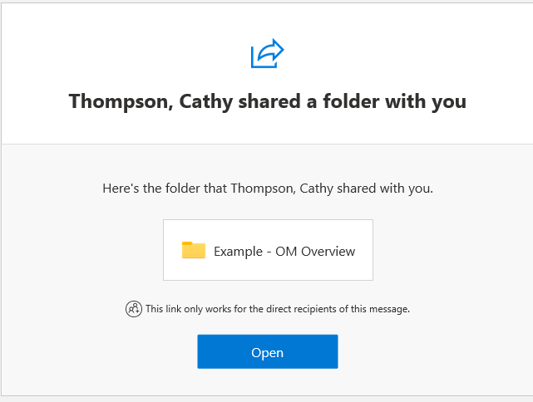
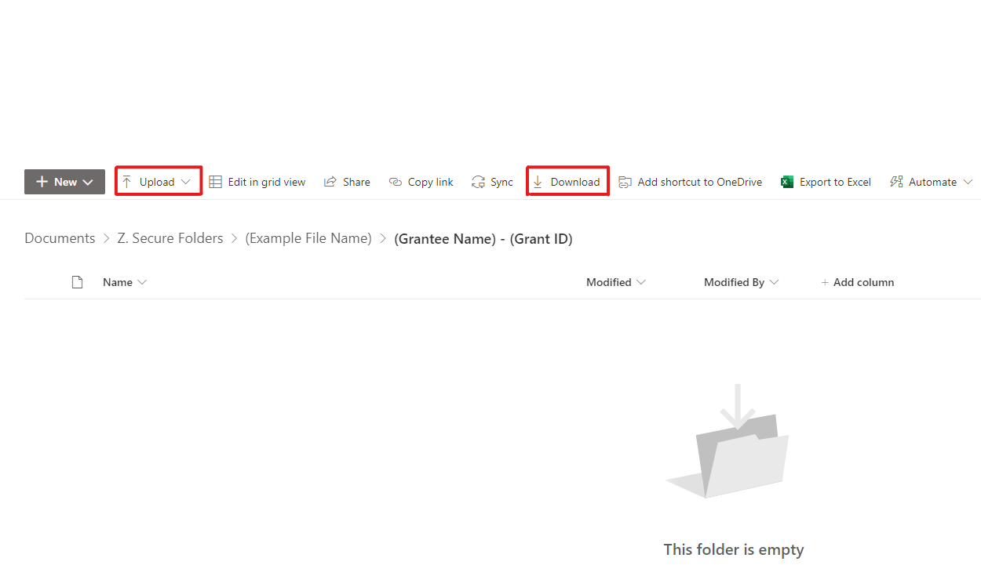
Using Secure Folders
The Office of Monitoring uses a secure online platform, to facilitate monitoring activities.
Notes:
Cathy
Secure Folders are used to communicate to grantees detailed information about their assigned monitoring activity such as documents to submit, monitoring results, and CAP information. This system has been thoroughly vetted by our internal Information Technology colleagues and has been deemed safe to transmit Personally Identifiable Information. Please use the secure folder, rather than an email, to submit documents to your monitoring officer. This will help safeguard any sensitive material (e.g. scans of driver’s licenses for assigned NSCHC activities).

Slide 13
Accessing Secure Folders
Authorized Representatives (AR) will receive an email from their assigned Monitoring Officer with a link to their Secure Folder.
Check spam inbox if not received within 24 hours after receiving kick-off and documentation request from AmeriCorps Monitoring Officer.
Use the AmeriCorps Secure Folders External User Guide to learn how to access and use your secure folder.
Contact your assigned Monitoring Officer or monitoring@americorps.gov for assistance.
Notes:
Cathy
(Discuss Bullets) If grantees want to grant access to additional persons or different email accounts to the their Secure Folder, they must reach out to their MO to make the request.

Slide 14
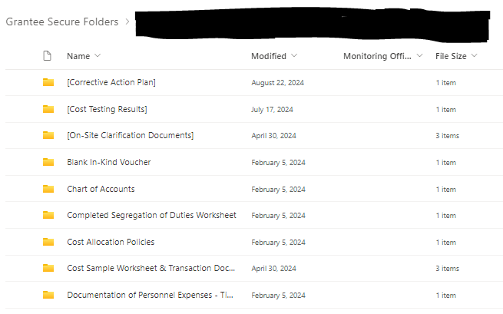
Using Secure Folders
Monitoring Officers use Secure folders to:
Collect required documents
Provide monitoring results and review notes
Provide corrective action plan status updates and feedback, where applicable
Notes:
Cathy
The monitoring officers will us the secure folders to : read slides

Slide 15
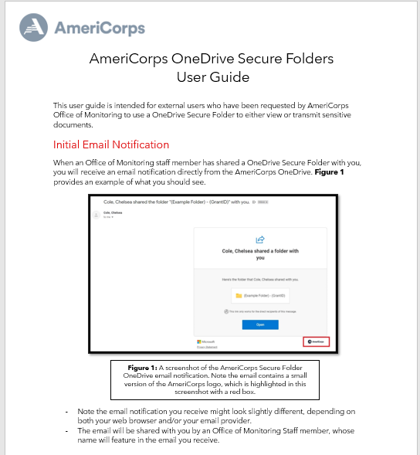
Using Secure Folders
Grantees use Secure folders to:
Upload initial documentation
Upload supplemental documentation and/or clarifying information
Review and download monitoring results
Submit a Corrective Action Plan (CAP)and supporting documents, where applicable
Review and download CAP report, where applicable
Use the Secure Folders External User Guide
for step-by-step instructions
Notes:
Cathy​
The role of the grantee will be to: read slide. A Secure folder user guide with step by step instructions will be attached to the monitoring assignment kick-off notification. ​
​
It is very important for grantees to review this document and all communication from the monitoring officer to ensure an understanding of the next steps, and the supporting documentation required. Some monitoring activities require the completion and return of forms within a defined period of time which the MO will provide in communication to the grantee. ​
​
The secure folder user guide coupled with the information provided by the assigned monitoring officer will support a smooth monitoring process and timely submission of documents. ​
If specific forms are required, blank copies of those forms will be uploaded to the grantee's secure folder for access and resubmission of completed forms. Once all supporting documents are received, the MOs will use a separate Excel based tool to communicate the monitoring results or ask for clarification, if needed. The results will be communicated via an email and a copy of that tool will be uploaded to the grantee's folder. ​
​

Slide 16
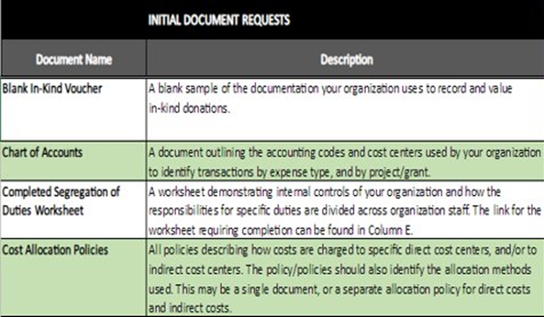
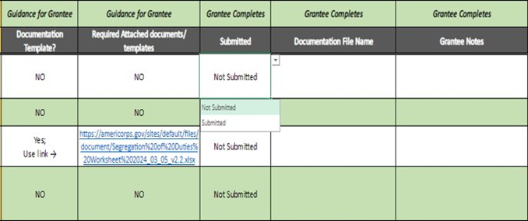
Grantee Document and Supplement Request List
Name of the documents requested and description of the information the document should provide.
Guidance for the grantee – if there is a specific template, if the grantee submitted the document, file name, and grantee notes, if applicable.
Notes:
Cathy
Here is a snippet taken from the Grantee Document and Supplement Request List that Monitoring Officers will use to communicate:
What documents are being requested (Initial Document Request column);
A Description of the document.
Whether a document has a specific template from OM (Document Template? Column) and where to access that template (Required Attached documents/templates); and,
Whether the document has been submitted, and
There is also a Grantee Notes column that can be used to provide notes the grantee feels are pertinent. For example, it is possible that some requests may not be applicable to the grantee's agency. Please provide a description of why the request is not applicable.

Slide 17
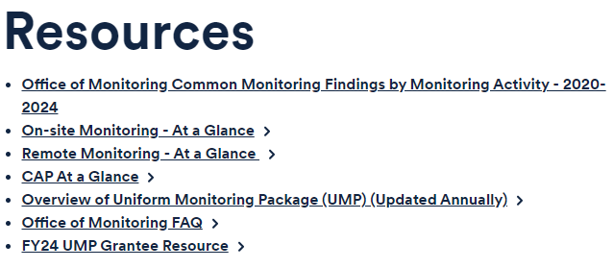
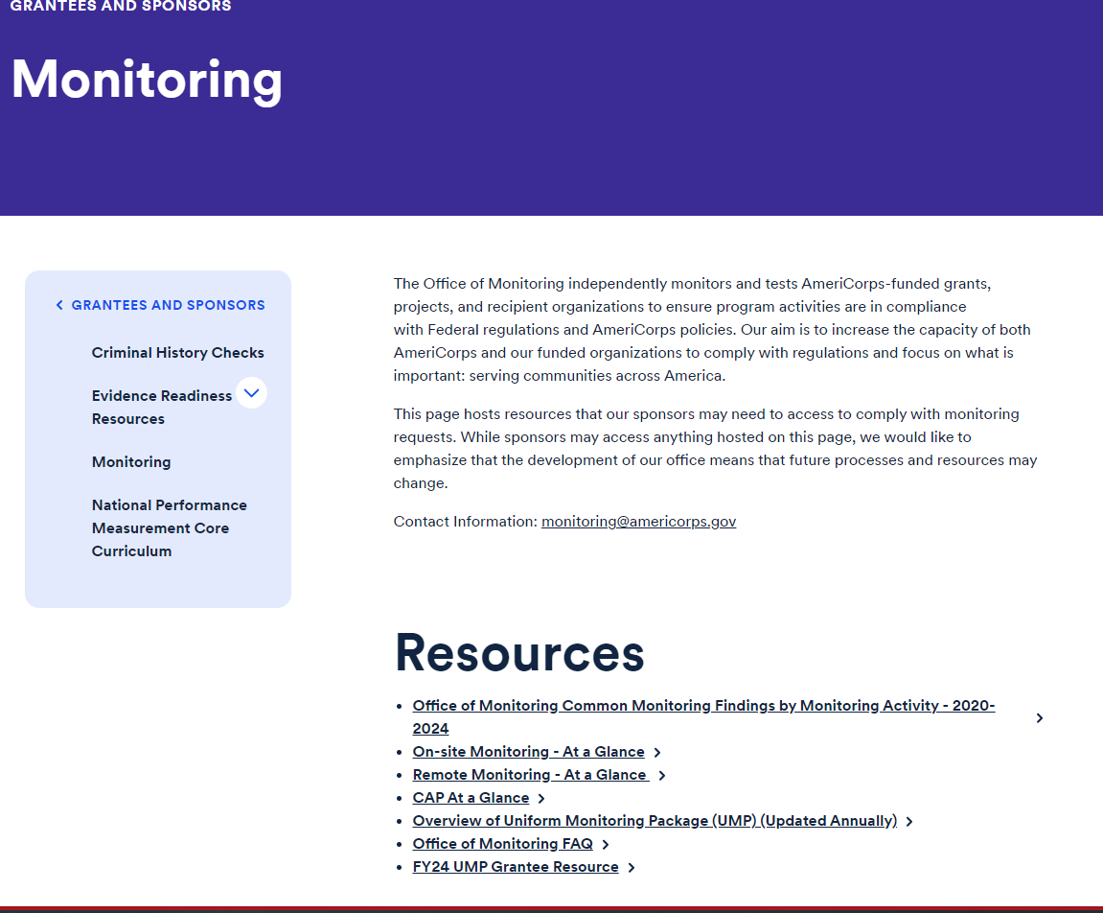
AmeriCorps Website
https://americorps.gov/grantees-sponsors/monitoring
Notes:
Cathy​
The Office of Monitoring Website offers resources that will be beneficial during the monitoring activity to provide guidance on the monitoring process, document requests, and corrective action planning.​ The resources are updated regularly to ensure the most recent information is available.
The snippet shows the first set of resources; however, when scrolling through the website, you will see the additional sections for document requests, recordings, and the corrective action planning resources. ​
The Uniform Monitoring Package (the questions for each monitoring activity) can be used to help become familiar with the monitoring process and requirements.​
The at a glance documents (remote, onsite, and CAP) will provide an overview of each process and steps. ​
There is also a resource guide on how to successfully develop a Corrective Action Plan, and ​
The Office of Monitoring FAQS.​
​
Now let's take a look at how the UMP is structured. (next slide)​

Slide 18
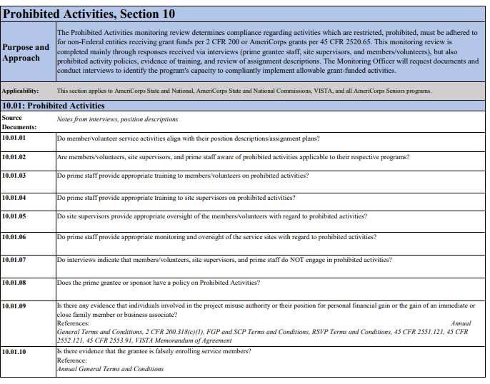
AmeriCorps Website
Overview of Uniform Monitoring Package (UMP)
Uniform Monitoring Package
Program Specific
National Service Criminal History Check (NSCHC)
Prohibited Activities
ASN
VISTA
AmeriCorps Seniors
Days of Service
IAA - Expanded Financial Operational Fitness Assessment
Commission Operations
New to AmeriCorps (NTA)
Financial and Operational Fitness Assessment (FOFA)
Notes:
Cathy
This is a view of the Prohibited Activities section of the Uniform Monitoring Package (UMP). Each section of the UMP provides the purpose and approach to the monitoring activity, the questions, and references used to guide compliance determinations. The overview of the Uniform Monitoring Package can be used to become familiar with compliance requirements for monitoring purposes or just to maintain compliance.

Slide 19
Quick Recap
Monitoring kick-off and documentation request notifications will go out in the month of January.
Once you receive your kick-off notification, questions can be directed to your assigned monitoring officer.
Thoroughly read all communication from the Office of Monitoring.
In the meantime, direct questions to monitoring@americorps.gov
Notes:
Cathy
It is very important for grantees to read all communication from the Office of Monitoring. Some monitoring activities have a require the completion and return of forms by a specified time. Where applicable, these items are directly linked and described within the system. Once the forms are completed, they should be uploaded with the requested documents within the Secure Folders.

Slide 20
Questions? Contact monitoring@americorps.gov
Notes:
Cathy
Thank you for your participation in this presentation, we hope you find this helpful. Please reach out to the AmeriCorps Office of Monitoring if you have questions.

