Slide 1
AmeriCorps Monitoring Report and Corrective Action Planning
Office of Monitoring

Slide 2
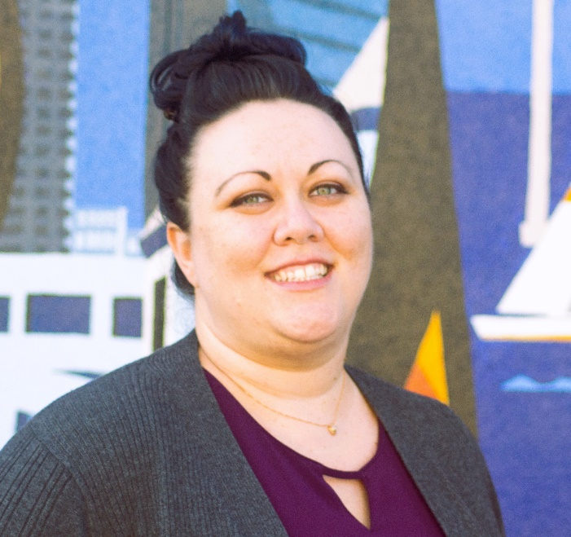
Welcome Message
Monitoring Process - Post Monitoring Stage
Overview of Monitoring Notification Materials and Report Format
The Corrective Action Planning Process
Tips on Corrective Action Planning
Lainie Patterson
Corrective Action Planning Specialist
Notes:
Hello and welcome to AmeriCorps Office of Monitoring’s Overview of Monitoring Reports and Corrective Action Planning. My name is Lainie Patterson, a Corrective Action Planning Specialist with the Office of Monitoring here at AmeriCorps. Throughout this webinar, I will provide an overview of the next steps in the monitoring process, discuss the monitoring report results and notifications, and provide an overview and tips on the Corrective Action Planning process.

Slide 3
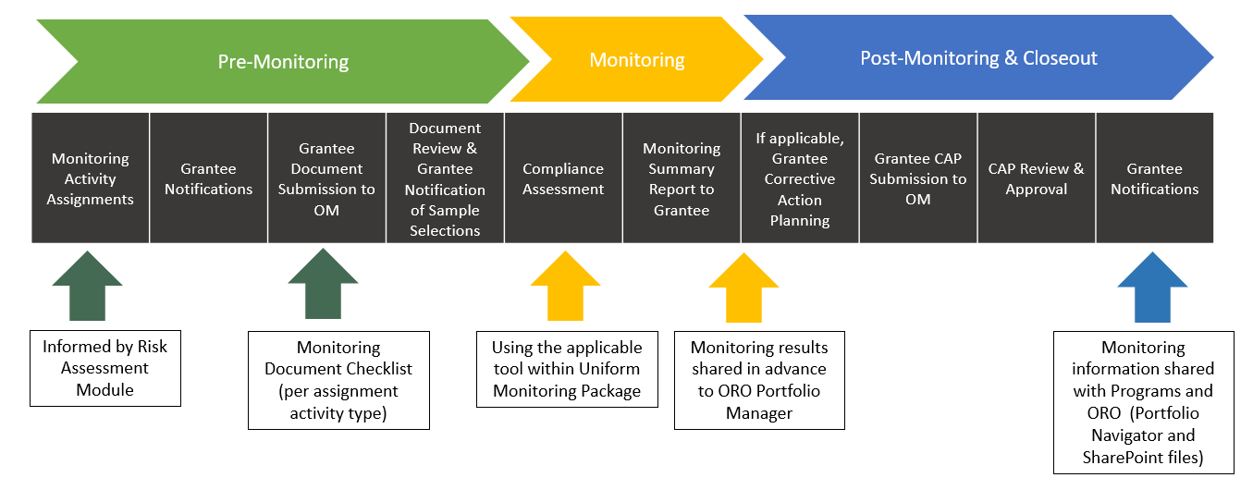
Monitoring Activity Lifecycle
You are here!
*ORO: AmeriCorps Office of Regional Operations
Notes:
Since initiating the monitoring cycle earlier this year, our Monitoring Officers have coordinated remote monitoring assessments with grantee staff, which included a review of internal policies and procedures, a review of sample documentation to validate our assessment, and in some cases, interviews with grantee staff, members, and volunteers.
This slide of the monitoring activity lifecycle shows the steps that have been taken since the kickoff this cycle. The pre-monitoring activities have been completed, we are now completing our monitoring phase of the lifecycle and are entering the post-monitoring and closeout phase of the monitoring lifecycle. So, at this point, we are preparing to distribute the monitoring results to each awardee monitored this round. Please know, these monitoring results are shared in advance to the Office of Regional Operations Portfolio Managers.
Once the results are received, if there were identified issues of noncompliance, it will be time to begin work on a Corrective Action Plan, or CAP- a plan that outlines how your organization will address the issues discovered during the monitoring activity. This is discussed in more detail later in the webinar.
That is a high-level overview of the post monitoring and closeout phase, but lets talk a bit more about the details of the results you will receive.

Slide 4
Monitoring Results and CAP Notifications
Email
From assigned Monitoring Officer
Secure Folder
NSCHC Supplement Results Excel Spreadsheet (if applicable)
Includes PDF attachment of formal AmeriCorps letter
Instructions for accessing the monitoring report and NSCHC Supplement Results (if applicable) via secure folder
Summarizes monitoring activity assignments for the grant and results (findings or no deficiencies), provides detailed instructions on next steps
To Authorized Representative
Copy (CC) to grantee Project Director
Copy (CC) to AmeriCorps Portfolio Manager
Access the monitoring report Excel file, which includes a results summary
Secure Folder
Complete and submit Corrective Action Plans (Excel File) and supporting documentation through the secure folder within 20 business days
Information on how to view a recording of this webinar for reference
Notes:
Grantees will be receiving an email notification from their assigned Monitoring Officer, indicating the monitoring results are ready for review. The email includes a PDF attachment of the formal monitoring results notification from the Office of Monitoring. This letter provides key information about the monitoring activities that were assigned to the AmeriCorps grant, as well as the outcomes of each review- whether there are issues of noncompliance or no deficiencies. The letter will also indicate if monitoring activity results will require the grantee to develop a Corrective Action Plan within 20 business days from receiving the results.
The email and notification letter will also provide instructions for how grantees can access their secure folder to review the Monitoring Report, and detailed National Service Criminal History Check components, if applicable.
To reiterate, the email will give you the documents you need, instructions on next steps, and how to access to your Secure Folder. The monitoring summary report itself, and the National Service Criminal History Check Supplemental Results spreadsheet (if applicable) will be available to view and download from the Secure Folder.
Now that we’ve covered what you will receive in the notification, lets take a closer look at the Monitoring Report itself.

Slide 5
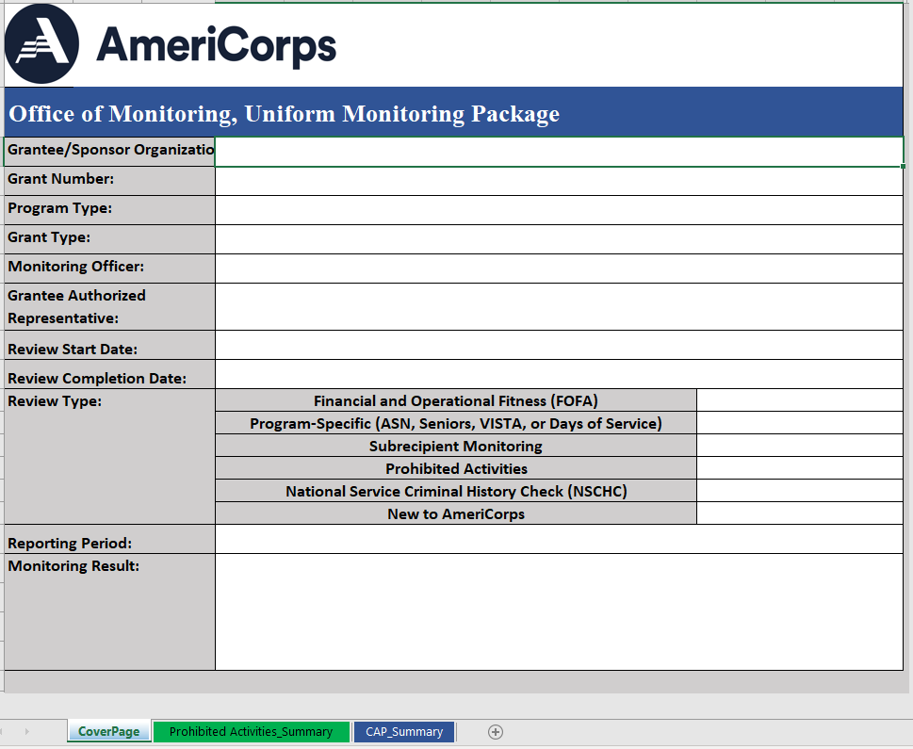
Monitoring Report Format
Cover Page
Notes:
The next few slides will show the layout and format of the monitoring report. The monitoring report is an excel spreadsheet; each part of the report is accessed through tabs located at the bottom of the worksheet. The first tab is the cover page. The top section will give you general information related to your grant, your organization, the Monitoring Officer who conducted the review, and the review start and completion date.
The middle section shows the Monitoring Activity Assignments. Throughout this monitoring process, your grant has been monitored for either one or more of these different review types. A summary tab for each assigned monitoring activity will be visible at the bottom of the report.
The bottom of the cover page provides the monitoring results. If all assigned monitoring assessments resulted in no deficiencies, you will see a ‘PASS’, which means there is no corrective action or follow up activity related to noncompliance. In that case, it will still be helpful to review the monitoring results on the summary tab which we’ll talk about in a moment, but it will not require corrective action planning.
Alternatively, if issues of noncompliance were discovered during the review, you will see a result of ‘Corrective Action Plan’ or CAP, as shown here.

Slide 6
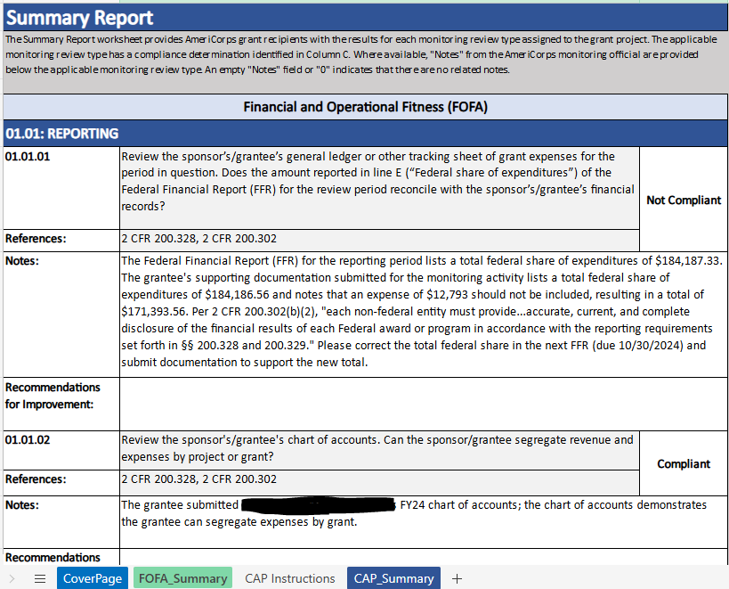
Monitoring Report Format
Monitoring Activity Summary (Monitoring Report)
Notes:
Now let's review the Summary Tab- which again will be specific to the monitoring activity assigned to your organization. The image above is a FOFA Activities summary. Summary tabs lists all assessment questions within that activity, the compliance determination for each question, and any associated notes from the Monitoring Officer or Recommendations for Improvement.
For example, we see this first question in the sample image is noncompliant, and there are notes from the Monitoring Officer with details of why.
Moving down, the following question was determined to be compliant. This sample includes a note stating the compliance determination, but there may not always be notes for compliant questions.
Each question includes space for Recommendations for Improvement. These recommendations are for you to review and incorporate as you see fit, but will not require a Corrective Action Plan, as the overall subject area involved has already been deemed compliant, there is just an opportunity for improvement.
Upon receiving the monitoring report, it is recommended to read the report in-full, including all compliance determinations, monitoring officer notes, and recommendation for improvement. The last tab of the report is the corrective active plan tab.

Slide 7
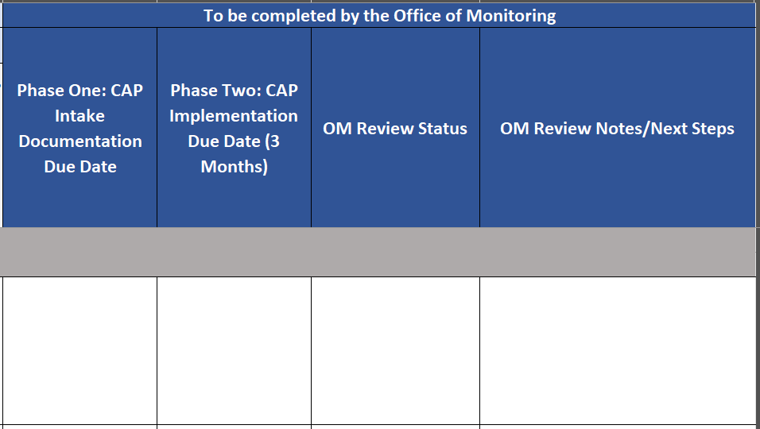
Monitoring Report Format
Corrective Action Plan tab (CAP)
Notes:
Monitoring reports with identified issues of non-compliance will require corrective action plans, also known as CAPs. The corrective action plan is the last tab of the monitoring report. This blank tab is where grantees document their plan for bringing issues into compliance. The left section of the tab lists all monitoring questions that resulted in a Not Compliant status and a description of the identified issue of noncompliance. The middle portion of the tab holds spaces for grantee’s to document the root cause of the issue, action steps for resolving the issue, list out the deliverables that will demonstrate compliance and plan completion, a description of the plan to maintain long-term compliance, and other information. The right side of the tab is filled out by the Office of Monitoring and includes relevant due dates, issue status (after documentation is submitted), and OM Review Notes. All notes provided throughout the CAP process is documented in this space.
We’ll discuss developing a corrective action plan later in this webinar.

Slide 8
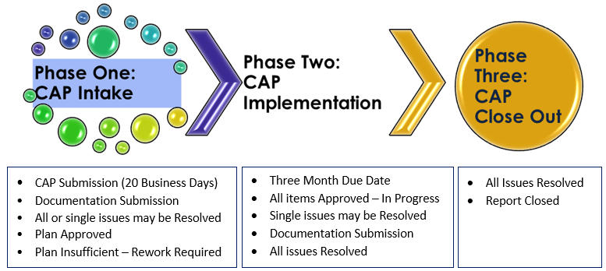
Corrective Action Planning
What Happens Next?
Notes:
After receiving Monitoring Results showing a Corrective Action Plan is needed, you may be asking yourself, What Happens Next? The Corrective Action Planning process provides grant recipients with a standard approach for reviewing and addressing identified issues of noncompliance. It will be conducted in three phases: CAP Intake, CAP Implementation, and CAP Closeout.
Each Phase will be discussed in further detail throughout the next few slides. However, please know during each of these phases there may be several requests for documentation re-work. (Next slide)
(SD Note: Recommended script/Notes Page Change as needed.
Second paragraph from OM Awardee Guidance on Developing CAPs.)
If there was a determination of “Corrective Action Plan”, the Grant Recipient will need to submit a plan to correct the areas identified as noncompliant on the Monitoring Summary Report.
The AmeriCorps Office of Monitoring Corrective Action Planning (CAP) process provides grant recipients with a standard approach to reviewing and addressing identified findings of noncompliance. The process can assist awardees in validating compliance, identifying breakdowns in processes and systems that may have contributed to noncompliance, as well as identifying preventative measures to reduce and eliminate findings in future monitoring activities. The CAP is structured to support the awardee in facilitating an internal process to identify root causes of the event that resulted in a finding, while fostering a timely, concise, and technically adequate corrective action proposal for submission to the Office of Monitoring (OM) for review and approval.

Slide 9
CAP Phase 1: CAP Intake
ISSUE | Root Cause | Action Steps | Deliverables | Long-Term Compliance
 | Describe in detail the underlying reason for the issue. | What specific steps will you take to address the identified root cause of the issue? Describe the policy/ procedure/ practice that will be created or modified. | List the items that will be provided to the Office of Monitoring to resolve the finding. | Describe the plan to maintain compliance post-monitoring.
[automated response based on monitoring question] | [Response should identify the root cause of the identified issue of non-compliance] | [Response should outline how grantee will address non-compliance and the root cause] | [Response lists the documentation needed to show implementation of the action steps] | [Response should explain plan for self-monitoring to reduce the likelihood of reoccurrence]
Notes:
A corrective action plan is a method of documenting an issue or finding of non-compliance, identifying its root cause, clearly laying out corrective measures, and the plan of action to resolve the finding. In addition, to check on the effectiveness of the proposed corrective action, it should contain an evaluation or follow-up that allows your organization to verify that corrective actions put in place are working to ensure long-term compliance.
-Prior to creating the Corrective Action Plan, review the Awardee Guide for developing CAPS as it provides guidance in developing responses to each CAP element for findings of noncompliance identified within the monitoring summary results.
-Create the Corrective Action Plan within the Excel based tool used during the Monitoring.
-Each finding of non-compliance listed in the Monitoring requires a response to the four elements: Root Cause, Action Steps, Deliverables and Long Term-Compliance. Each element has guiding questions to assist in planning how to resolve each finding.
-After providing a response to each element for the finding, determine a target date for completing the corrective actions, and the person responsible for plan implementation.
-Now, let’s take a look at each individual element in the Corrective Action Plan. (Next slide)

Slide 10
CAP Element: Root Cause
Symptom: The Result or outcome of a problem, an observation.
The organization has volunteers participating in prohibited activities.
Problem/Issue:
The volunteer is unaware of the prohibited activities.
Root Cause: What is causing the issue.
The agency does not have an updated policy on all prohibited activities.
Volunteers have not been trained on prohibited activities.
Describe, in detail, the underlying reason for the issue.
What is causing the issue?
What action or actions resulted in the non-compliance?
What gaps were identified in the work process that led to the issue?
Notes:
The first CAP Element is the root cause. The issues in the Monitoring Report are essentially the symptoms, the result, or the outcome of a problem.
The root cause is what is causing the issue.
For this section, describe in detail, the underlying reason for the issue. When completing this section, ask:
What is causing the issue?
What action or actions resulted in the non-compliance?
Asking these questions can help identify the gaps in the work process that led to the issue.
Let's look at the example next to the tree in the picture:
The organization has volunteers participating in prohibited activities. This is the symptom, it's what was shown during the monitoring.
The gap identified in the work process is the volunteer is unaware of the prohibited activities.
The Root cause, the underlying reason for the issue, is the agency does not have an updated policy on all prohibited activities. Volunteers have not been trained on prohibited activities.
**There may be one root cause or multiple causes. Make sure to accurately identify what is causing the issue. (Next slide)

Slide 11
CAP Element: Action Steps
Describe the specific steps will you take to address the identified issue
Who is doing what?​
How and when will the plan be implemented?
Can you implement your solution and complete it timely?​
Notes:
Element Two of the CAP is Action Steps.
Describe the proposed action steps to the processes/systems/policies that will eliminate the root cause and reduce the likelihood of a reoccurrence of noncompliance, as well as how these changes will be implemented.
Clearly state what is to be done, by whom, and when. Some action plans may be short-term interventions that can be accomplished quickly, while others may require a longer implementation period. Consider how to effectively implement the plan so people are complying with the proposed changes and whether the changes have will make a difference. Create SMART goals with feasible deadlines. They should be specific, measurable, achievable, realistic, and time-bound. Make sure these goals or solutions are centered around the root cause, detailing every step necessary to eliminate the underlying cause of the issue.
The key is to choose corrective actions that address each root cause. These actions will generally require creating a new process or making a change to a current process. Corrective actions that change the system and do not allow the errors to reoccur are the strongest. If a particular corrective action or change can't be completed due to current constraints (e.g., lack of resources), you should look for other ways of changing the process to prevent a similar event from occurring in the future. (next slide)

Slide 12
CAP Element: Deliverables
List the items you will provide to the Office of Monitoring to resolve the finding.
What supporting documentation will be needed to effectively implement the Action Steps?
Deliverables provided to AmeriCorps should document proof of completion of the listed Action Steps.
Notes:
After determining what action steps are needed, the next step is to list the items you will provide to the Office of Monitoring.
What supporting documentation will be needed to effectively implement the Action Steps?
Deliverables provided to AmeriCorps should document proof of completion of the listed Action Steps.
The deliverables you plan to submit to AmeriCorps should demonstrate implementation of the listed Action Steps. For example, if your action steps include training staff or volunteers on a new procedure, then you should list a Training Attendence List as one of your deliverables.
(Next Slide)

Slide 13
CAP Element: Long Term Compliance
Describe the plan to maintain compliance post-monitoring.
What is the self-monitoring process/procedures that will be implemented to reduce the likelihood of the reoccurrence?
How often will the plan be evaluated?
What are the desired outcomes?
Notes:
The fourth CAP Element is Long Term Compliance. Please describe the plan to maintain compliance post-monitoring.
• What is the procedure/process to self-monitor the plan implemented?
• How often will the plan be evaluated?
• What are the desired outcomes?
Our goal is to help you make the changes needed - to ensure your organization’s long-term compliance after the monitoring exercise is complete.
We ask you to focus on self-monitoring - and routinely – review – processes, and make updates as needed to maintain compliance.
(next slide)

Slide 14
CAP Element: Additional Fields
Person(s) Responsible for Implementation
Notes:
The one remaining field to complete within the CAP Document is the Person Responsible for Implementation.
-In the Person(s) Responsible for Implementation field, List individual(s) within the grantee/sponsor organization who will complete and maintain the required plan of action.
List individual(s) who will provide the deliverables to the Office of Monitoring.
(Next slide)

Slide 15
CAP Example
ISSUE | Root Cause | Action Steps | Deliverables | Long-Term Compliance
Volunteers are participating in Prohibited Activities. | The agency does not have an updated policy on all prohibited activities. Volunteers have not been trained on prohibited activities. | 1. Program Director will update the Prohibited Activities Policy by July 31, 2024. 2. Policy will be reviewed and approved by the board of Directors at the August Board Meeting. 3. All volunteers and staff will be trained on prohibited activities during September site meetings. 4. Volunteer orientation will include training on prohibited activities. 5. Site Supervisors will e-mail quarterly reminders to volunteers. | The Program Director will provide the Office of Monitoring: 1. A copy of the updated and board approved policy 2. Proof of volunteer/staff training on prohibited activities 3. A copy of the Volunteer Orientation Agenda and Material | 1. The policy will be reviewed and updated annually then submitted to board for approval at the June board meeting. 2. New volunteers are trained at orientation and current volunteers/staff are trained on the updated policy/prohibited activities procedures every September. 3. Site-Supervisors quarterly check in results will be reviewed quarterly to monitor long-term compliance. 4. The desired outcome is 100% of current staff/volunteers are trained on, and are not participating in prohibited activities.
Notes:
Let's look at an Example of a Corrective Action Plan for Prohibited Activities.
The snapshot shown on the screen is a portion of the CAP. The CAP Elements discussed earlier are shown across the top of the screen.
With this example, the issue is: Volunteers are participating in Prohibited Activities.
Root Cause:
The agency does not have an updated policy on all prohibited activities.
Volunteers have not been trained on prohibited activities.
**Keep in mind, the root cause for a finding may be different depending on the organization. Is it policy related? Is it training related? Is it lack of Supervision? Determine the reason for the issue at hand.
Action Plan:
1. Program Director will update the Prohibited Activities Policy by July 31, 2024.
2. Policy will be reviewed and approved by the board of Directors at the August Board Meeting.
3. All volunteers and staff will be trained on prohibited activities during September site meetings.
4. Volunteer orientation will include training on prohibited activities.
5. Site Supervisors will e-mail quarterly reminders to volunteers.
Deliverables:
The Program Director will provide the Office of Monitoring:
1. A copy of the updated and board approved policy
2. Proof of volunteer/staff training on prohibited activities
3. A copy of the Volunteer Orientation Agenda and Material
Long-Term Compliance:
1. The policy will be reviewed and updated annually then submitted to board for approval at the June board meeting.
2. New volunteers are trained at orientation and current volunteers/staff are trained on the updated policy/prohibited activities procedures every September.
3. Site-Supervisors quarterly check in results will be reviewed quarterly to monitor long-term compliance.
4. The desired outcome is 100% of current staff/volunteers are trained on, and are not participating in prohibited activities.
This example shows how to develop responses for one issue; the process continues until responses have been provided for all issues of noncompliance listed on the CAP.

Slide 16
CAP Intake: Process
I added 10 business days in the notes – grantee to submit rework
Step 1 | Develop a corrective action plan by filling in responses for each issue on the CAP
Step 2 | Submit CAP to the Office of Monitoring
Step 3 | Monitoring Officer reviews CAP and determines whether the plan is approved or requires rework
Step 4 | (if rework is requested) Monitoring Officer sends notification CAP rework is required within 10 business days
Step 5 | (if rework is requested) Revisions are made to the CAP based on feedback provided in OM Review Notes
Step 6 | (if rework is requested) CAP is submitted for review; process continues until CAP is approved
Step 7 | (once CAP is approved) Monitoring Officer sends notification CAP is approved
CAP Intake must be completed within 20 business days.
The day notification of CAP approval is sent begins the three-month CAP Implementation period (CAP Phase 2)
Notes:
As mentioned in the previous slide, all issues listed on the CAP must have responses for the CAP to be completed. Now I’ll work through the process of submitting the CAP for review to the Office of Monitoring.
First step is to develop the corrective action plan. This is done by ensuring all issues contain responses for each CAP element.
Next, the CAP is submitted to the Office of Monitoring for review.
Once the CAP is received, the monitoring officer will review the CAP responses. Each issue will receive a status and relevant notes. If any information is missing, or if more detail is needed in responses, a rework will be requested.
If a rework is requested, the issues with Insufficient statuses, must be revised based on the feedback provided in the OM Review Notes section of the CAP. The rework must be resubmitted within 10 business days.
Once insufficient issues have been revised, the CAP must be resubmitted to the Office of Monitoring. This cycle continues until all issues are approved.
Once responses to all issues are approved, the CAP is considered approved – in progress. The Monitoring Officer will send a notification of CAP approval.
Remember, this entire process should be completed within 20 business days; to avoid repeated requests for reworks, it is important to read the OM Review Notes in detail and respond accordingly.
The day the notification of CAP approval is sent starts the three – month long CAP implementation period, which is phase two of the CAP process.

Slide 17
30 – Business Day Requirement
“This issue has a 30-business day requirement.
Supporting documentation to resolve this issue
must be submitted within 30-business days of
the monitoring report. If sufficient
documentation is not submitted within 30-
business days, AmeriCorps may take additional
enforcement actions including a manual hold.”
Notes:
Some issues of non-compliance will contain a 30 – business day requirement, which will be noted in the corrective action plan tab of the monitoring report. This is reserved for issues resulting in tangible debts and/or grant related reports that require correction. These issues should be prioritized in the CAP Intake phase because unlike other issues, which have a three-month implementation period for resolution, these issues only have 30 business days. CAPs with 30 – Business Day Requirement issues will highlight the due date for those issues and will be discussed by the Monitoring Office during the exit conference.

Slide 18
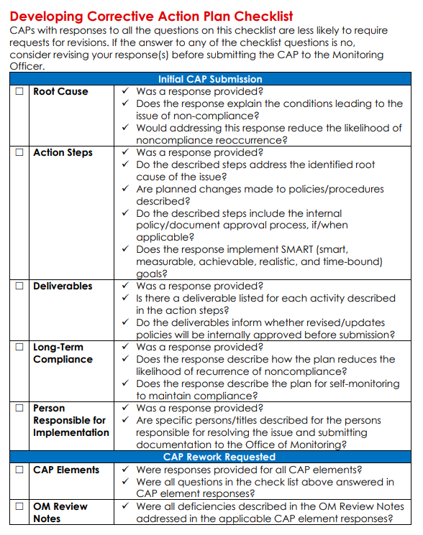
CAP Phase 1: Key Points
CAP Intake
All CAP elements include responses for each issue
Must be completed within 20 business days
May submit documentation to resolve issues in Phase 1
Phase 2 (CAP Implementation) starts the day CAP approval is sent
Developing CAP Checklist available in Awardee Guide for Developing CAPs Guide
Notes:
Let’s review the key points for Phase One of the Corrective Action Planning process.
Each issue of noncompliance identified in the monitoring report must be addressed by creating a CAP. The plan will be developed and compiled on the CAP tab of your Monitoring Report. The Corrective Action Plan must be submitted to your assigned Monitoring Officer within 20 business days of the receipt of your monitoring report. Any requests to extend this deadline must be communicated to the Monitoring Officer as soon as possible.
CAP submissions must contain the elements previously reviewed – root cause, corrective measures, required plan of action, and evaluation/follow-up.
If an issue can be resolved during the initial 20-business day CAP creation period, please remember to submit all relevant supporting documentation for review by your Monitoring Officer. This should be reserved only for issues that can be resolved in a single step as the primary focus of CAP Intake is to develop an approved plan. The CAP implementation period is for developing CAP documentation to resolve issues.
Once the CAP is approved, Phase 2 begins, which is what I’ll discuss next.

Slide 19
CAP Phase 2: CAP Implementation
3 MONTH TIMELINE
Step 1
Meet with assigned OM Staff
Step 2
Submit documentation to resolve CAP issues
Develop milestone dates for resolving issues within 3 months
Adjust milestone dates and deliverables, as needed
All issues must be resolved in the three-month implementation period
Notes:
If your Corrective Action Plan is approved in progress, you will move into Phase Two of the Corrective Action Planning process, CAP Implementation.
Phase two is considered the implementation and maintenance phase. For the next two phases of the plan, you will work with your assigned OM staff who will provide support to ensure you complete your CAP within 3 months of the CAP approval or sooner.
There are three steps in phase two, let’s review each in turn.

Slide 20
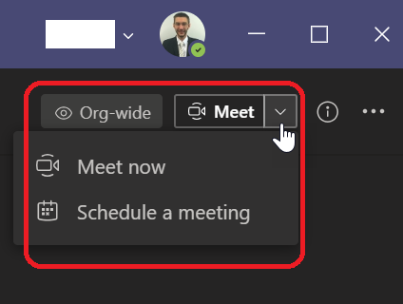
CAP Phase 2: Meet with your assigned OM staff
After CAP approval, a call will be requested from your assigned OM staff. This may be the Monitoring Officer who conducted the monitoring activity or a Corrective Action Planning Specialist.
Review Corrective Action Plan process and next steps.
Discuss timeline for components of the Corrective Action Plan.
Establish goals to resolve any findings and complete the post- monitoring process.
This Photo by Unknown Author is licensed under CC BY-NC-ND
Notes:
When your Corrective Action Plan is approved in progress, you will move into Phase Two of the Corrective Action Planning process.
When the Corrective Action Plan is approved, your organization will receive a notice of approval from your Monitoring Officer. Note that the date of the approval notice determines the deadline to fully resolve your CAP (as noted previously, three months from the date of the approval notice).
Shortly after receiving the notification of CAP approval, you will receive a message from OM staff (this could be the monitoring officer who conducted the monitoring activity or a Corrective Action Planning Specialist) requesting you to schedule a call within 14 days. During this meeting you will have an opportunity to review the CAP, confirm timelines/deadlines, discuss the deliverables you will submit to the Office of Monitoring, and ask any questions you may have about the CAP process.

Slide 21
CAP Phase 2: Submit CAP documentation and provide progress update
Provide timely progress updates and submit documentation showing CAP items resolved.
Monthly or bi-monthly meetings may be necessary depending on the CAP’s complexity.
Assigned OM staff will review and provide feedback.
Notes:
Your organization's designee for handling the CAP process should plan to update their assigned OM staff on the progress of each issue of the CAP throughout this three month period. Timelines for each CAP will differ. Monthly or bi-monthly meetings may be necessary depending on the CAP’s complexity. Conversely, an issue may be able to be resolved in a matter of weeks.
Regular communication is key to closing the CAP as quickly as possible. At any point, if you are ready to submit a document for review, contact your assigned OM staff and they will provide you with a link to your Secure Folder.
Once they receive your submission, the assigned OM staff will review the document and provide feedback. Please note, some issues may not be resolved quickly. Multiple submissions may be required, and documentation provided may need to be revised one or more times in order to fully resolve the issue. This is not a punitive process; this work ensures that your organization will implement the plan necessary to achieve and maintain compliance.
If the finding is not resolved, the assigned OM staff will send you a CAP update with detailed feedback, including a summary of the steps necessary to resolve the issue in full. The update email will also contain a link to schedule a meeting with a CAP specialist, if needed. Grantees are strongly encouraged to take advantage of this meeting opportunity, in order to get clarification about next steps and coordinate any new timelines for response.

Slide 22
CAP Phase 3: CAP Closeout
Our Goal is to provide the needed support to help grantees resolve issues noted on the CAP report.
Once all issues are resolved, the grantee will receive a notice from the Monitoring Office of the CAP Closure.
This Photo by Unknown Author is licensed under CC BY-NC
Notes:
The end goal of the CAP process is phase three, the resolution of all issues noted on your monitoring report and closure of your CAP.
Once all issues are resolved, your assigned OM staff will send you an official notification by email stating the CAP has been closed. The notification will be accompanied by a final CAP report, which details the actions taken to resolve each issue and the determination of compliance by the Monitoring Officer. All documentation should be retained in accordance with all other records pertaining to the grant that was monitored.

Slide 23
Corrective Action Plan Phase 2 and 3: Key Points
Phase 2: CAP Implementation
Assigned OM staff provide support until CAP is closed
Timely progress updates provided
Phase 3: CAP Closeout
Notification of CAP closure sent
All issues resolved before due date (three months)
Submissions include documentation/evidence to resolve the issues
To be complete within three-months of CAP Approval
Notes:
Let’s review the key points for Phases two and three of the Corrective Action Planning process.
While the CAP is Approved In Progress, your Monitoring Officer will provide support until all findings are resolved and the CAP is closed.
Grantees will provide progress update basis to discuss progress and workshop challenges. While routine progress updates are required, OM staff are available at any time to address questions or concerns.
CAP documentation is submitted through a secure folder, in accordance with standard practices within the Office of Monitoring. The assigned OM staff will review all submissions and respond with an updated CAP report that either outlines next steps or confirms resolution for each issue.
Once all approved in progress issues are resolved, a notification of CAP closure will be sent to the grantee, along with a final CAP report. All records associated with the CAP should be retained in accordance with all other records pertaining to the grant that was monitored.

Slide 24
Questions?
Please contact your assigned Monitoring Officer or the Monitoring Office at
monitoring@americorps.gov.
Notes:
This concludes the Monitoring Report and Corrective Action Planning informational webinar, thank you for listening along. If you have any additional questions, please contact your assigned Monitoring Officer or the Monitoring Office at monitoring@americorps.gov.
Thank you.

