Slide 1
AmeriCorps National Civilian Community Corps (NCCC)
Apply at AmeriCorps.gov/NCCC

Slide 2
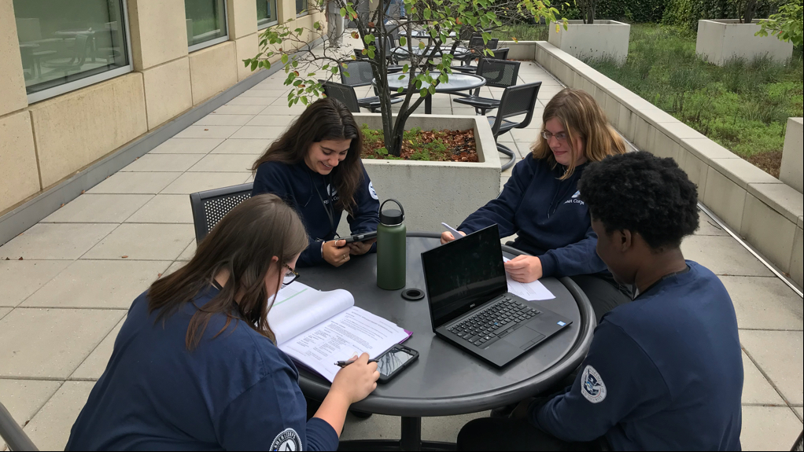
THE BASICS
18-24 YEARS OLD
10-12 MONTHS
TEAM BASED
4 CAMPUSES
Age limit for Corps Members. No upper age limit for Team Leaders.
Full-time service. Traditional Corps serves 10 months. FEMA Corps serves 12.
Members are assigned to a team of 8-12 members with one Team Leader. They work, live, and travel together.
Members are assigned to one of 4 regional campuses where they receive training and which they call home base between each of their 3-6 service projects.

Slide 3
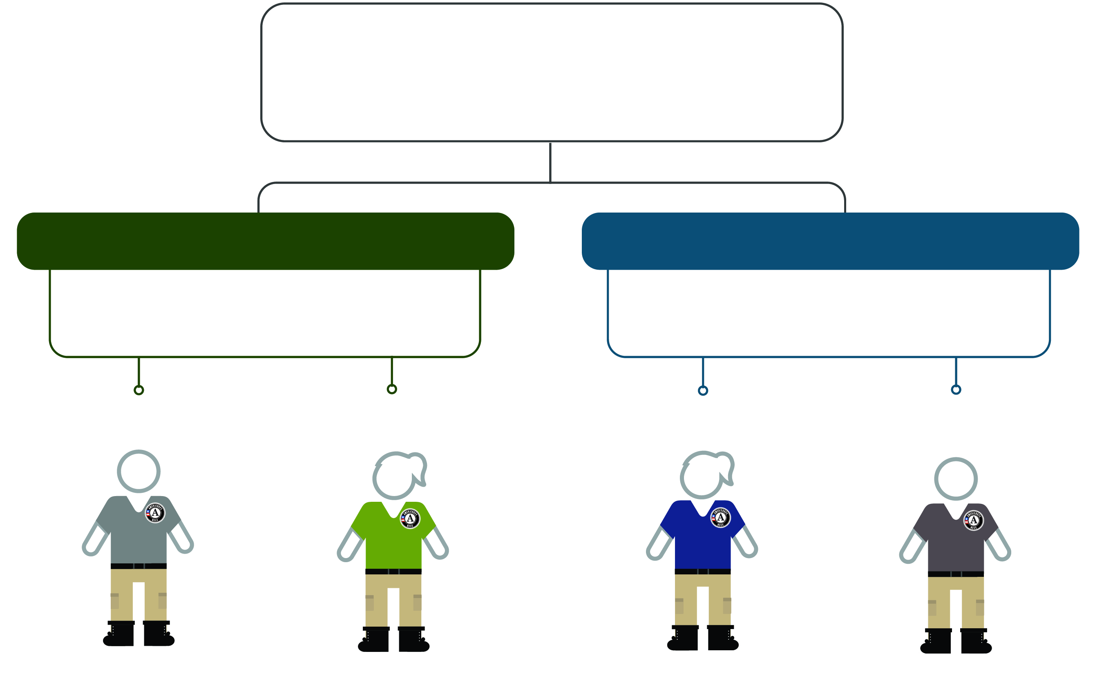
Structure
AmeriCorps NCCC
National Civilian Community Corps
Traditional Corps
FEMA Corps
Our original, rugged, and demanding 10-month service experience in which members complete hands-on projects within a region.
A 12-month professional experience in which members work on disaster preparedness and response projects in an administrative capacity.
Corps Member
Team Leader
Corps Member
Team Leader
Ages 18-24
Ages 18+ (no upper limit)
Ages 18-24
Ages 18+ (no upper limit)

Slide 4
Benefits
Build your resume.
Travel the country.
Most expenses covered.
Experiences that will help you grow professionally. Develop leadership skills that will come in handy throughout your career.
Discover new communities as you serve.
Receive housing, food, transportation, and medical benefits.
Earn an Education Award.
Living allowance.
Make a difference.
Once you graduate, you’ll receive an Education Award of over $6,000 to be used for student loans or future educational expenses.
Receive a bi-weekly living allowance during service.
Leave your mark on communities through your service.

Slide 5
Application Process
Search Opportunities
Visit My.AmeriCorps.gov to search NCCC opportunities.
1
Apply
Complete a profile, complete an application, and submit your application.
2
Once a Corps Member applicant completes an eligibility questionnaire, NCCC will assess your application; Team Leaders applicants are reviewed and selected by each campus.
3
Application Assessment
Receive confirmation that you are selected to serve, complete medical and legal clearances, and begin service term.
4
Invitation to Serve

Slide 6
CONNECT WITH US
AmeriCorps.gov/NCCC
/AmeriCorpsNCCC
Reach out to us or stay connected through social media.
1-800-942-2677
@AmeriCorpsNCCC
ANCCC@CNS.GOV
@AmeriCorpsNCCC

